Slide 1
Compression

Slide 2
LZW
Used in GIFs
Records repeating patterns of bits in a dictionary
Dictionary is accessed using a short code to represent the pattern instead of the whole pattern.

Slide 3
DCT
Discrete Cosine Transformation
Used in JPEG
Allows variable levels of compression and quality
The colour value of each pixel is compared to those around it.
These values are plotted on a COSINE graph
If the values are close enough (depending on the level of compression) they are flattened into one colour value – reducing storage space needed.

Slide 4
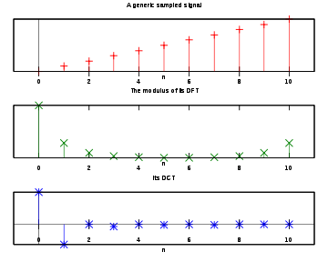
JPEG
This is very complicated and you will not be asked to try it yourselves
Original Values
Plotted on Cosine graph
Similar values levelled out – only the first 2 deviate from the graph

Slide 5
JPEG
Low Compression
High Compression

Slide 6
Perceptual
Used by MP3 files
Probably not important – MP3 uses MPEG-1 Audio type 3 compression – it is not the precursor to MP4
Information that is unlikely to make a difference to sound quality is removed
File size reduced around 90%

Slide 7
MP3
Human hearing operates from 2-20Khz approximately
Anything outwith this range is not stored
Quiet sounds will be drowned out by loud sounds
Quiet sounds are not stored

Slide 8
FLAC
Free Lossless Audio Codec
A high quality open source audio format - .FLAC
File size reduced around 40-50%
Works similarly to LZW in that it uses a dictionary to record large blocks of binary

Slide 9
Video
Intraframe Compression
Full individual frames are compressed using JPEG DCT compression
These are called Keyframes or i-frames
Interframe Compression
The differences between keyframes are recorded
Still areas of the video without movement do not need to be updated so that information is not stored

Slide 10
MPEG

