Slide 1
Higher
Computing Science
Binary to Denary Conversion

Slide 2
Higher Computing Science - Computer Systems
Learning Intentions
Remember and practice skills from National 5 Computing Science to convert up to 24 bit binary to denary and vice versa.
Success Criteria
I can convert from binary to denary (up to 16 bit)
I can convert from denary to binary (up to 16 bit)

Slide 3
Higher Computing Science - Computer Systems
Binary number: Binary (or base-2) a numeric system that only uses two digits — 0 and 1. Computers operate in binary, meaning they store data and perform calculations using only zeros and ones. A single binary digit can only represent True (1) or False (0) in boolean logic.
Denary number: Denary, also known as "decimal" or "base 10," is the standard number system used around the world. It uses ten digits (0, 1, 2, 3, 4, 5, 6, 7, 8, and 9) to represent all numbers. Denary is often contrasted with binary, the standard number system used by computers and other electronic devices. The first two letters in denary ("de") are an abbreviated version of "dec" which is a Latin prefix meaning "ten." The Latin prefix "bi" means two. Therefore, the denary system contains ten digits, while the binary system only contains two (0 and 1).
Integer: An integer is a whole number (not a fraction) that can be positive, negative, or zero. Therefore, the numbers 10, 0, -25, and 5,148 are all integers. Unlike floating point numbers, integers cannot have decimal places.
Floating point numbers: As the name implies, floating point numbers are numbers that contain floating decimal points. For example, the numbers 5.5, 0.001, and -2,345.6789 are floating point numbers. Numbers that do not have decimal places are called integers. Computers recognize real numbers that contain fractions as floating point numbers.
Real number: A real number is any positive or negative number. This includes all integers and all rational and irrational numbers. Rational numbers may be expressed as a fraction (such as 7/8) and irrational numbers may be expressed by an infinite decimal representation (3.1415926535...). Real numbers that include decimal points are also called floating point numbers, since the decimal "floats" between the digits.

Slide 4
Higher Computing Science - Computer Systems
128 | 64 | 32 | 16 | 8 | 4 | 2 | 1 | Denary
1 | 0 | 1 | 0 | 1 | 1 | 0 | 1
173
1 x 128
0 x 64
1 x 32
0 x 16
1 x 8
1 x 4
0 x 2
1 x 1
128
32
8
4
1
160
13
173

Slide 5
Higher Computing Science - Computer Systems
In the booklet:
Page 5
Question 1 a-h

Slide 6
Higher Computing Science - Computer Systems
128 | 64 | 32 | 16 | 8 | 4 | 2 | 1 | Denary
1
1
0
0
1
1
0
1
205
205 > 128
77 > 64
13 < 32
13 < 16
13 > 8
5 > 4
2 < 1
1 = 1
205
- 128
77
77
- 64
13
13
- 8
5
5
- 4
1
1
- 1
0

Slide 7
Higher Computing Science - Computer Systems
In the booklet:
Page 5
Question 2 a-h
Try the Extension Questions in Google Classroom

Slide 8
Higher Computing Science - Computer Systems
Learning Intentions
Remember and practice skills from National 5 Computing Science to convert up to 24 bit binary to denary and vice versa.
Success Criteria
I can convert from binary to denary (up to 16 bit)
I can convert from denary to binary (up to 16 bit)

Slide 9
Higher
Computing Science
2. Negative Numbers using Two’s Complement

Slide 10
Higher Computing Science - Computer Systems
Learning Intentions
Learn how computers store negative numbers using a systems called Two’s Complement.
Success Criteria
I can convert from a negative denary number to a Two’s Complement binary number (up to 8 bit)
I can convert a Two’s Complement binary number to a denary number (up to 8 bit)

Slide 11
Higher Computing Science - Computer Systems
Negative number: A negative number is a real number that is less than zero. Negative numbers represent opposites. If positive represents a movement to the right, negative represents a movement to the left. If positive represents above sea level, then negative represents below sea level.
Two’s Complement: In Two’s complement, the most significant bit (the leftmost bit) indicates whether the number is positive or negative. If the most significant bit is a 1 then it is a negative number, if it is a 0 then it is positive.

Slide 12
Higher Computing Science - Computer Systems
To convert a negative denary number into its Two’s Complement representation you:
work out the positive binary number
invert all the bits (so a 1 becomes a 0 and a 0 becomes a 1)
then add 1

Slide 13
Higher Computing Science - Computer Systems
To convert a negative denary number into its Two’s Complement representation you:
work out the positive binary number
invert all the bits (so a 1 becomes a 0 and a 0 becomes a 1)
then add 1
Example
To convert -17
Step | 128 | 64 | 32 | 16 | 8 | 4 | 2 | 1
1 - positive binary | 0 | 0 | 0 | 1 | 0 | 0 | 0 | 1
2 - invert all the bits
3 - add 1
1
1
1
0
1
1
1
0
1
1
1
0
1
1
1
1

Slide 14
Higher Computing Science - Computer Systems
In the booklet:
Page 7
Question 1 a-c

Slide 15
Higher Computing Science - Computer Systems
To convert a negative binary number into its Denary representation you:
Look at leftmost bit to see if it is negative or not
1 indicates negative:
Subtract 1
Invert all the bits
Write a -ve sign
0 indicates positive:
Write a +ve sign
Add to get the denary number
Write the denary number with the correct sign

Slide 16
Higher Computing Science - Computer Systems
To convert a negative binary number into its Denary representation you:
Look at leftmost bit to see if it is negative or not
1 indicates negative:
Subtract 1
Invert all the bits
Write a -ve sign
0 indicates positive:
Write a +ve sign
Add to get the denary number
Write the denary number with the correct sign
Example:
Convert 1100 1101 from Two’s Complement to denary
Negative, as LMB is 1
1100 1101 - 1 = 1100 1100
Invert all bits: 0011 0011
Answer will be -ve
32 + 16 + 2 + 1 = 51
Denary number is -51

Slide 17
Higher Computing Science - Computer Systems
In the booklet:
Page 9
Question 1 a-c
Try the Extension Questions in Google Classroom

Slide 18
Higher Computing Science - Computer Systems
Learning Intentions
Learn how computers store negative numbers using a systems called Two’s Complement.
Success Criteria
I can convert from a negative denary number to a Two’s Complement binary number (up to 8 bit)
I can convert a Two’s Complement binary number to a denary number (up to 8 bit)

Slide 19
Higher
Computing Science
3. Range of numbers using Two’s Complement

Slide 20
Higher Computing Science - Computer Systems
Learning Intentions
Learn how using Two’s Complement to store negative numbers affects the range of positive and negative integers that can be stored.
Success Criteria
For a stated number of bits (up to 16 bits), I can calculate the range of positive and negative integers that can be stored.

Slide 21
Higher Computing Science - Computer Systems
Range: The range is the distance from the lowest to the highest in a set of numbers. For Two’s Complement, we need to identify the lowest negative number and the highest positive number that can be stored.
Range of non-Two’s Complement.
With 8 bits, the smallest integer that can be stored is
0000 0000 = 0
and the largest integer that can be stored is
1111 1111 = 255
This gives a range of 0 to 255 for 8 bits

Slide 22
Higher Computing Science - Computer Systems
To find the range of a Two’s Complement number, follow these steps.
Calculate the range of numbers as if it were all positive
Half it - this will be the lowest negative number
Subtract 1 to get the highest positive number
Write the range

Slide 23
Higher Computing Science - Computer Systems
To find the range of a Two’s Complement number, follow these steps.
Calculate the range of numbers as if it were all positive
Half it - this will be the lowest negative number
Subtract 1 to get the highest positive number
Write the range
Example: 4 bits
Amount of integers with 4 bits is: 16
½ this for lowest negative integer: -8
Subtract 1 to get highest positive integer: +7
The range is therefore from -8 to +7

Slide 24
Higher Computing Science - Computer Systems
In the booklet:
Page 1
Question 1 a-b
Try the Extension Questions in Google Classroom

Slide 25
Higher Computing Science - Computer Systems
Learning Intentions
Learn how using Two’s Complement to store negative numbers affects the range of positive and negative integers that can be stored.
Success Criteria
For a stated number of bits (up to 16 bits), I can calculate the range of positive and negative integers that can be stored.

Slide 26
Higher
Computing Science
4. Floating Point Representation

Slide 27
Higher Computing Science - Computer Systems
Learning Intentions
Learn how real (floating point numbers) are stored in a computer system.
Success Criteria
I can convert real numbers to binary floating point
I can identify the mantissa and exponent in a binary floating point number

Slide 28
Higher Computing Science - Computer Systems
Integer: An integer is a whole number (not a fraction) that can be positive, negative, or zero. Therefore, the numbers 10, 0, -25, and 5,148 are all integers. Unlike floating point numbers, integers cannot have decimal places.
Floating point numbers: As the name implies, floating point numbers are numbers that contain floating decimal points. For example, the numbers 5.5, 0.001, and -2,345.6789 are floating point numbers. Numbers that do not have decimal places are called integers. Computers recognize real numbers that contain fractions as floating point numbers.
Real number: A real number is any positive or negative number. This includes all integers and all rational and irrational numbers. Rational numbers may be expressed as a fraction (such as 7/8) and irrational numbers may be expressed by an infinite decimal representation (3.1415926535...). Real numbers that include decimal points are also called floating point numbers, since the decimal "floats" between the digits.
Mantissa: The mantissa is the part of a number located after the point. It is normally used when dealing with scientific notation.
Exponent: The exponent, in scientific notation is the power that is used to determine how far the point has moved.

Slide 29
Higher Computing Science - Computer Systems
The structure of a floating point number is:
mantissa x base^{exponent}
To work out the mantissa and exponent you need to:
move the point all the way so the number is a fractional value
the entire number without the point is the mantissa
the number of places the point was moved (expressed as a two’s complement binary number) is the exponent.
Example
Original Number: 217 . 46
Scientific Notation: 0.21746 x 10³
Mantissa: 21746
Exponent: 3

Slide 30
Higher Computing Science - Computer Systems
In the booklet:
Page 13
Question 1

Slide 31
Higher Computing Science - Computer Systems
Dealing with Large numbers using Floating Point Representation
Consider 1845.75
2048 | 1024 | 512 | 256 | 128 | 64 | 32 | 16 | 8 | 4 | 2 | 1
0 | 1 | 1 | 1 | 0 | 0 | 1 | 1 | 0 | 1 | 0 | 1

Slide 32
Higher Computing Science - Computer Systems
Dealing with Large numbers using Floating Point Representation
Consider 1845.75
2048 | 1024 | 512 | 256 | 128 | 64 | 32 | 16 | 8 | 4 | 2 | 1
0 | 1 | 1 | 1 | 0 | 0 | 1 | 1 | 0 | 1 | 0 | 1
0.5 | 0.25
1 | 1

Slide 33
Higher Computing Science - Computer Systems
Dealing with Large numbers using Floating Point Representation
Consider 1845.75
1024 | 512 | 256 | 128 | 64 | 32 | 16 | 8 | 4 | 2 | 1
1 | 1 | 1 | 0 | 0 | 1 | 1 | 0 | 1 | 0 | 1
0.5 | 0.25
1 | 1
11 places moved to the left, so exponent is 11 (0000 1011 in binary)
Mantissa is 1110 0110 1011 1000 (last three 0s appended to make up to 16 bits)

Slide 34
Higher Computing Science - Computer Systems
Dealing with Large numbers using Floating Point Representation
Consider 1845.75
1110 0110 1011 1000 x 2 ⁰⁰⁰⁰ ¹⁰¹¹
Using 16 bit mantissa and 8 bit exponent

Slide 35
Higher Computing Science - Computer Systems
In the booklet:
Page 15
Question 1

Slide 36
Higher Computing Science - Computer Systems
Dealing with Small numbers using Floating Point Representation
Consider 0.1875
8 | 4 | 2 | 1
0 | 0 | 0 | 0
0.5 | 0.25 | 0.125 | 0.0625
0 | 0 | 1 | 1

Slide 37
Higher Computing Science - Computer Systems
Dealing with Small numbers using Floating Point Representation
Consider 0.1875
8 | 4 | 2 | 1 | 0.5 | 0.25
0 | 0 | 0 | 0 | 0 | 0
0.125 | 0.0625
1 | 1
2 places moved to the right, so exponent is -2 (1111 1110 in Two’s Complement binary)
Mantissa is 1100 0000 0000 0000 (last fourteen 0s appended to make up to 16 bits)

Slide 38
Higher Computing Science - Computer Systems
Dealing with Small numbers using Floating Point Representation
Consider 0.1875
1100 0000 0000 0000 x 2 ¹¹¹¹ ¹¹¹⁰
Using 16 bit mantissa and 8 bit exponent

Slide 39
Higher Computing Science - Computer Systems
In the booklet:
Page 15
Question 2

Slide 40
Higher Computing Science - Computer Systems
Learning Intentions
Learn how real (floating point numbers) are stored in a computer system.
Success Criteria
I can convert real numbers to binary floating point
I can identify the mantissa and exponent in a binary floating point number

Slide 41
Higher
Computing Science
5. Floating Point - Range and Precision

Slide 42
Higher Computing Science - Computer Systems
Learning Intentions
Learn how the number of bits allocated to the mantissa and exponent affects the range and precision .
Success Criteria
I can explain that the number of bits allocated to the mantissa affects the precision of the number
I can explain that the number of bits allocated to the exponent affects the range of the numbers that can be stored

Slide 43
Higher Computing Science - Computer Systems
Range: The range is the distance from the lowest to the highest in a set of numbers. In this context, it is about the amount of numbers that can be stored in different numbers of bits.
Precision: The precision of the binary number is how accurately it can reproduce the original denary number. As storage space may be limited, some data may be lost, making the binary number less precise.
The number of bits allocated to a floating point number is usually fixed.
For example: if you had a fixed 40 bits for storing a floating point number then 32 bits could be allocated to the mantissa leaving 8 bits for the exponent.
The number of bits allocated to the mantissa affects the precision of the number.
The number of bits allocated to the exponent affects the range of numbers that can be stored.

Slide 44
Higher Computing Science - Computer Systems
Precision of Floating Point Representation
Consider 145.25
128 | 64 | 32 | 16 | 8 | 4 | 2 | 1
1 | 0 | 0 | 1 | 0 | 0 | 0 | 1
0.5 | 0.25
0 | 1
Information is truncated, so data is less precise
1001 0001 0100 0000 x 2 ⁰⁰⁰⁰ ¹⁰⁰⁰
Using 16 bit mantissa and 8 bit exponent - total of 24 bits
1001 0001 x 2 ⁰⁰⁰⁰ ¹⁰⁰⁰
Using 8 bit mantissa and 8 bit exponent - total of 16 bits

Slide 45
Higher Computing Science - Computer Systems
Range of Floating Point Representation
111111 x 2 ¹¹ = 111 . 111 = 7 . 875
Using 6 bit mantissa and 2 bit exponent - total of 8 bits
11111 x 2 ¹¹¹ = 1111 100 . 0 = 94 . 0
Using 5 bit mantissa and 3 bit exponent - total of 8 bits
Increasing the Exponent increases the range of numbers that can be stored.

Slide 46
Higher Computing Science - Computer Systems
In the booklet
Page 17
Question 1

Slide 47
Higher Computing Science - Computer Systems
Learning Intentions
Learn how the number of bits allocated to the mantissa and exponent affects the range and precision .
Success Criteria
I can explain that the number of bits allocated to the mantissa affects the precision of the number
I can explain that the number of bits allocated to the exponent affects the range of the numbers that can be stored

Slide 48
Higher
Computing Science
6. Storing Text

Slide 49
Higher Computing Science - Computer Systems
Learning Intentions
Learn how computers use different methods to represent printable and non-printable characters.
Success Criteria
I can explain the advantages and disadvantages of Extended ASCII and Unicode
I can explain technical terminology relating to the storage of text.

Slide 50
Higher Computing Science - Computer Systems
ASCII: American Standard Code for Information Interchange. One method for representing printable and non-printable characters. ASCII uses 7-bits, so can store a maximum of 128 different characters.
Extended ASCII: Extended ASCII uses 8-bits to store the character, which doubles the number of characters to 256 different characters.
Unicode: Unicode is a development of ASCII that allows for 16-bits per character, meaning it can represent 65 536 different characters. This is often referred to as UTF-16. A newer version of Unicode, UTF-32, allows 32 bits per character.
Printable Character: A character that is visible to the user. Any letters, numbers or punctuation marks are printable characters.
Non-printable Character: Any character that does not display in a form normally visible to the user. Examples include <return>, <tab>, <end of line> and <end of file>
Character Set: All the characters that can be stored in a particular representation.

Slide 51
Higher Computing Science - Computer Systems
ASCII
When you are using a program and you press a key on the keyboard the program has to have some way of identifying which key you pressed. Each character on the keyboard has a unique binary code allocated to it. This is called ASCII - American Standard Code for Information Interchange.
ASCII code includes:
Non-printable characters: <return>, <tab>
Numbers: 0-9
Upper and Lower Case Letters: A-Z, a-z
Punctuation and other symbols: $, %, !, ?, @
All of the above are examples of the character set. This is the group of letters and numbers and characters that a computer can represent and manipulate.

Slide 52
Higher Computing Science - Computer Systems
Printable vs Non-Printable (Control) Characters
Control characters include keys such as RETURN, TAB and DELETE. They are the first 32 characters in ASCII. These are used to send a control signal to a printer e.g. <backspace> or <new line>. Sometimes control characters are referred to as ‘non-printable characters’.

Slide 53
Higher Computing Science - Computer Systems
Unicode
More recently, the number of characters has required to be extended, as increasingly we communicate using foreign characters (such as à, ñ, û). To help, ASCII was developed further to create UNICODE, which uses 16 bits to represent the characters.
The disadvantage of this is that Unicode requires twice as much storage as Extended ASCII, but significantly increases the number of potential characters from 256 to 65 536 different characters. This is often referred to as UTF-16.
A newer version of Unicode, UTF-32, allows for storage of 4 294 967 296 different characters, but again, requires double the storage of UTF-16.

Slide 54
Higher Computing Science - Computer Systems
In the booklet
Page 19
Question 1

Slide 55
Higher Computing Science - Computer Systems
Learning Intentions
Learn how computers use different methods to represent printable and non-printable characters.
Success Criteria
I can explain the advantages and disadvantages of Extended ASCII and Unicode
I can explain technical terminology relating to the storage of text.

Slide 56
Higher
Computing Science
7. Storing Graphics

Slide 57
Higher Computing Science - Computer Systems
Learning Intentions
Learn how computers use different methods (bitmap and vector) to store graphics.
Success Criteria
I can explain the advantages and disadvantages of bitmap and vector graphics
I can explain technical terminology relating to the storage of graphics.

Slide 58
Higher Computing Science - Computer Systems
Pixel: Picture Element - the most basic component of any computer graphic.
Bitmap: a map of pixels, where each pixel has a binary number, determining its colour.
Resolution: The resolution of a bitmap image is a measure of the number of pixels in the image.
Colour depth: The colour depth of a bitmap image is the number of bits assigned to each pixel, and hence determines the maximum number of different colours that can be used in the image.
Vector graphics: use 2D point located polygons to represent images in computer graphics. Each of these points has a definite position on the x- and y-axes of the work plane and determines the direction of the path; further, each path may have properties, including such values as stroke color, shape, curve, thickness, and fill.

Slide 59
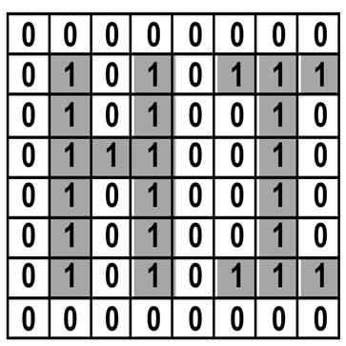
Higher Computing Science - Computer Systems
Bitmap Graphics
Bitmap graphics are made up of tiny dots called pixels.
Paint is an example of a bitmap graphics package.
On a bitmap graphic the colour of each individual pixel is stored.
The more bits allocated per pixel, the more colours can be used in the graphic.
The more bits per pixel, the higher the storage requirement!

Slide 60
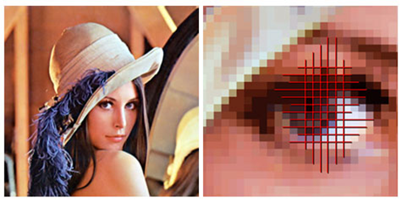
Higher Computing Science - Computer Systems
Bitmap Graphics
When zoomed, bitmap graphics become “jaggy”. However, in higher resolution graphics this may require more zooming to become obvious.
Because the colour of each individual pixel can be controlled,
Bitmaps are ideal for photographs.

Slide 61
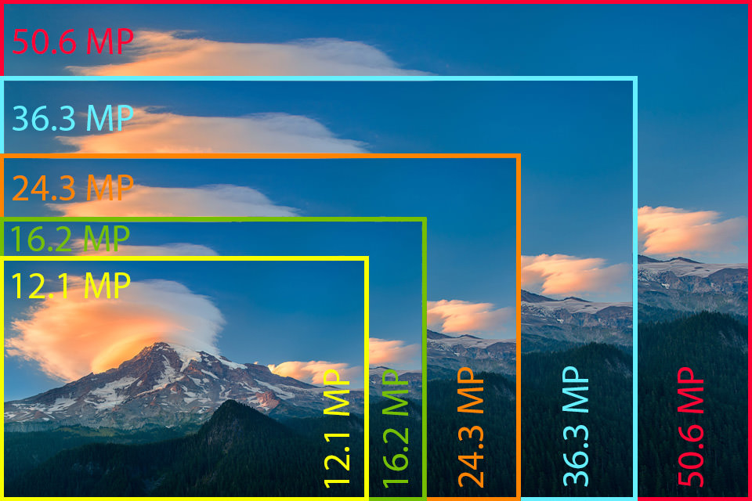
Higher Computing Science - Computer Systems
Bitmap Graphics
The same image can be saved (as separate files) at different resolutions. Higher resolution files will require more storage.
The resolution chosen should reflect the intended purpose of the image. For example, if the image is for display on a website, low resolution can be used. If, however, a large poster or banner is to be made, then high resolution is required.
A high-res image can easily be made low-res. The reverse is not true!

Slide 62
Higher Computing Science - Computer Systems
Bitmap Graphics - Practical Task
Open the file “high-res image” in a suitable bitmap graphics package (e.g PhotoShop, Paint). The resolution of this image is 3000 x 1688 pixels and requires 835kb of storage.
Zoom into the image to see the quality.
Use the software to change the Image Size and
resolution and investigate the effects.
(This will depend on the software being used)

Slide 63
Higher Computing Science - Computer Systems
Vector Graphics
In programs such Fireworks that can work with vector graphics, the computer stores information about an object by its attributes i.e. a description of how it is to be drawn.
For a rectangle these attributes might be: start x and y position, length, breadth and angle of rotation thickness and colour of the lines, colour fill etc.
The rectangle can be selected at any later time and altered by changing its length, dragging it to a new position etc.

Slide 64
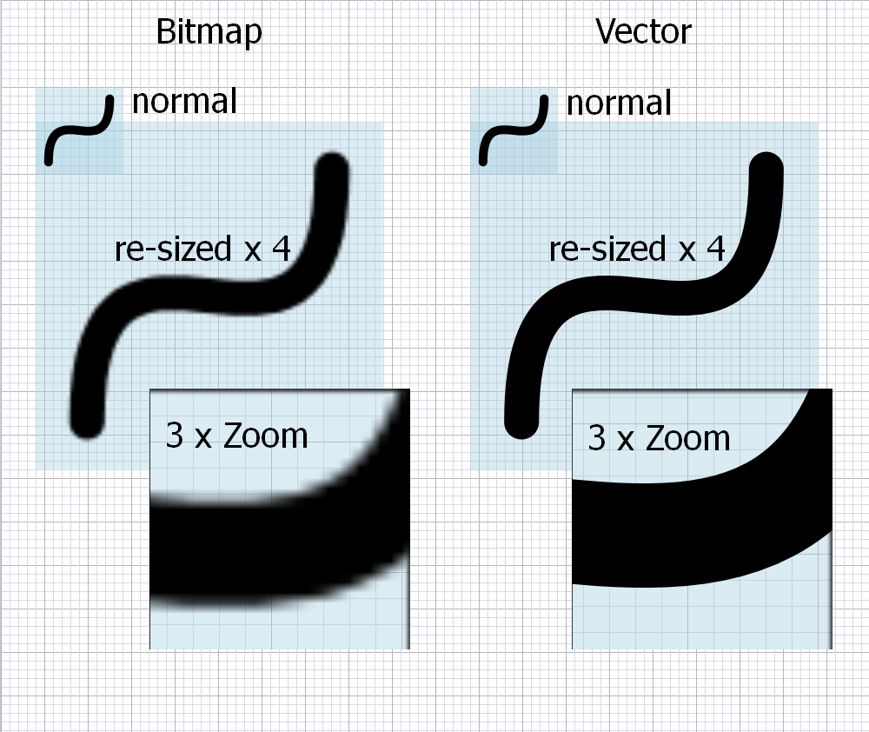
Higher Computing Science - Computer Systems
Vector Graphics
When the drawing is saved, only the list of objects and their
attributes is stored
When the drawing is loaded the drawing package redraws all
the objects.
This means that if you increase the size of the object it will remain
clear and crisp.
Vectors are useful for technical and simple drawing, but not much
use for more intricate graphics, such as photographs.

Slide 65
Higher Computing Science - Computer Systems
Vector and Bitmaps Graphics Task
Use two pieces of software (one vector and one bitmap) to create
this image as closely as possible. Be sure to save your files and
compare the file sizes.

Slide 66
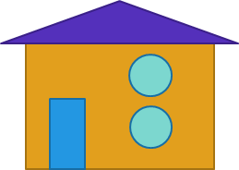
Higher Computing Science - Computer Systems
Vector and Bitmaps Graphics Task
Edit both versions from the previous task to look like this.
What do you notice?
Record your findings on page 21 of the booklet

Slide 67
Higher Computing Science - Computer Systems
Learning Intentions
Learn how computers use different methods (bitmap and vector) to store graphics.
Success Criteria
I can explain the advantages and disadvantages of bitmap and vector graphics
I can explain technical terminology relating to the storage of graphics.

Slide 68
Higher
Computing Science
8. The Fetch-Execute Cycle

Slide 69
Higher Computing Science - Computer Systems
Learning Intentions
Learn how computers use memory read and memory write operations to transfer data and instructions between the processor and memory.
Learn about the concept of the fetch-execute cycle.
Success Criteria
I can explain, with reference to correctly named buses and registers, the memory read and memory write operations.
I can explain, with reference to correctly named buses and registers, the fetch-execute cycle.

Slide 70
Higher Computing Science - Computer Systems
Address Bus: a collection of wires connecting the processor to memory, used to inform memory which uniquely addressed location is being used. The Address Bus is uni-directional (the address only travels one-way - from processor to memory). The address bus is made up of parallel wires each carrying a single bit.
Data Bus: a collection of wires connecting the processor to memory, used to inform memory what data is to be sent/ received from memory. The Data Bus is bi-directional (the data can travel both ways - to and from memory). The data bus is made up of parallel wires each carrying a single bit.
Control Bus: The control bus is made up of individual lines with specific functions giving instructions to the rest of the system from the control unit. There are a number of important lines on the control bus:
Read line: used to initiate a memory read operation which reads the contents of a memory location into the processor
Write line: used to initiate a memory write operation which writes an item of data from the processor into a memory location
Clock line: sends a series of pulses into the processor to synchronize events. The time interval between pulses is called a clock cycle.
Registers: storage locations inside the processor that are used to hold instructions or data.
Address Register: used to hold the address of the next instruction or piece of data to be sent to or received from memory.
Data Bus: used to hold the next piece of instruction or piece of data to be sent to memory or just received from memory.
Instruction Register: a register used to keep track of where a program is in its execution.

Slide 71
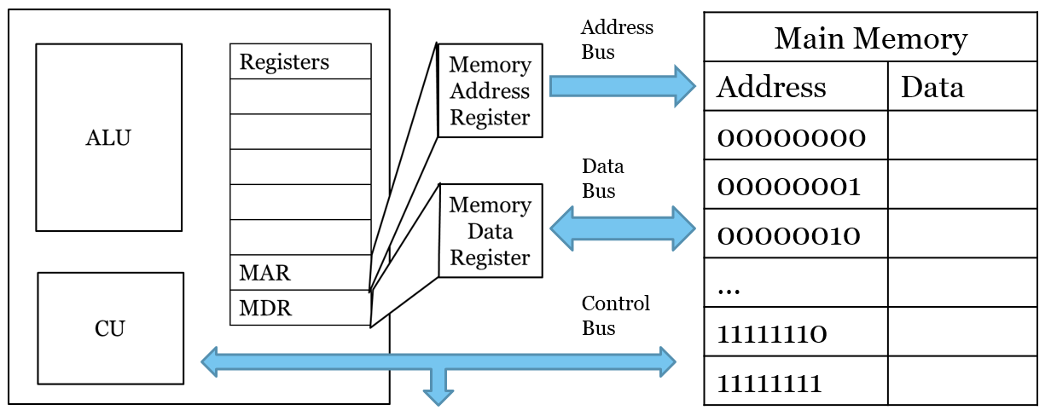
Higher Computing Science - Computer Systems

Slide 72
Higher Computing Science - Computer Systems
Memory Read operation
The processor sets up the address bus with required memory address.
00000010
1101
The processor activates the read line on the control bus.
1001
0010
0010
0010
00000010
The contents of the memory location are transferred along the data bus into the data register.
0010
0110
READ
1011

Slide 73
Higher Computing Science - Computer Systems
Memory Write operation
The processor sets up the address bus with required memory address.
11111110
1101
The processor sets up the data bus with the data to be written to memory.
1001
1101
0010
The processor activates the write line on the control bus.
11111110
1101
0110
The contents of the data register are transferred along the data bus into the memory location.
1101
WRITE
1011

Slide 74
Higher Computing Science - Computer Systems
Fetch Execute Cycle
The processor sets up the address bus with required memory address.
00000010
0010
1101
The processor activates the read line on the control bus.
0010
1001
0010
0010
0010
An instruction is fetched from the memory location using the data bus and stored in the instruction register
00000010
0110
The instruction in the instruction register is interpreted by the processor, decoded and carried out.
READ
1011

Slide 75
Higher Computing Science - Computer Systems
Fetch Execute Cycle
In the booklet
Page 24
Questions 1 and 2

Slide 76
Higher Computing Science - Computer Systems
Learning Intentions
Learn how computers use memory read and memory write operations to transfer data and instructions between the processor and memory.
Learn about the concept of the fetch-execute cycle.
Success Criteria
I can explain, with reference to correctly named buses and registers, the memory read and memory write operations.
I can explain, with reference to correctly named buses and registers, the fetch-execute cycle.

Slide 77
Higher
Computing Science
9. Factors affecting performance

Slide 78
Higher Computing Science - Computer Systems
Learning Intentions
Learn how the performance of a computer system can be affected by increasing and decreasing various factors.
Success Criteria
I can explain how the number of cores a processor has can affect the performance of a computer system.
I can explain how the width of the data bus can affect the performance of a computer system.
I can explain how the use of Cache memory can affect the performance of a computer system.
I can explain how the clock speed can affect the performance of a computer system

Slide 79
Higher Computing Science - Computer Systems
Cores: A multi-core processor is a single computing component with two or more independent processing units called cores, which read and execute program instructions. The instructions are ordinary CPU instructions (such as add or move data) but the single processor can run multiple instructions on separate cores at the same time.
Dual core: a multi-core processor with exactly two independent processors.
Quad core: a multi-core processor with exactly four independent processors.
Cache: a component that stores data so future requests for that data can be served faster; the data stored in a cache might be the result of an earlier computation, or the duplicate of data stored elsewhere.
Clock speed: The clock rate typically refers to the frequency at which a chip like a central processing unit (CPU), one core of a multi-core processor, is running and is used as an indicator of the processor's speed. It is measured in clock cycles per second. The clock rate of the first generation of computers was measured in hertz or kilohertz (kHz), but in the 21st century the speed of modern CPUs is commonly advertised in gigahertz (GHz).

Slide 80
Higher Computing Science - Computer Systems

Slide 81
Higher Computing Science - Computer Systems
Impact of the number of cores on system performance
This is the development of several sets of processor components in one microprocessor.
A dual core processor has two separate CPU’s in one chip and a quad core processor has four separate CPU’s in one chip.
The more cores a processor has, the more sets of instructions the processor can receive and process at the same time — this improves system performance.
A dual core processor is not as fast as a single processor running at twice the speed, as it is not always possible to share some tasks equally between the cores. This reduces efficiency.

Slide 82
Higher Computing Science - Computer Systems
Impact of the width of the data bus on system performance
The data bus is a set of parallel wires that connects the processor with memory and other hardware devices.
By increasing the data bus from 32 wires to 64 wires, the computer can transfer twice as much information at one time.
Therefore, increasing the size of the data bus improves the system performance of the computer.

Slide 83
Higher Computing Science - Computer Systems
Impact of the use of cache memory on system performance
Cache memory is a small amount of fast accessible memory, usually on the same chip as the processor.
The processor checks this for data or instructions before accessing the main memory.
If it finds the data or instruction, then this is termed as a cache ‘hit’, resulting in an improved performance.
If the instruction is not present, then a cache ‘miss’ occurs and a slower main memory is accessed.
Many computers use multiple levels of cache, with small caches backed up by larger, slower caches. Multi-level caches operate by checking the fastest cache (level 1) first. If it has a match, the processor proceeds at high speed. If it does not have a match, it checks the next fastest cache (level 2) and so on.

Slide 84
Higher Computing Science - Computer Systems
Impact of Clock Speed on system performance
This is the electronic unit that synchronises related components by generating pulses at a constant rate.
Clock pulses are used to trigger components to take their next step.
The clock rate is the frequency at which the clock generates pulses.
The higher the clock rate, the faster the computer may complete a series of instructions.
Different manufacturers measure the clock rate in different ways, so it is not always possible to do direct comparison between different processor manufacturers.

Slide 85
Higher Computing Science - Computer Systems
In the booklet
Page 27
Answer the questions.

Slide 86
Higher Computing Science - Computer Systems
Learning Intentions
Learn how the performance of a computer system can be affected by increasing and decreasing various factors.
Success Criteria
I can explain how the number of cores a processor has can affect the performance of a computer system.
I can explain how the width of the data bus can affect the performance of a computer system.
I can explain how the use of Cache memory can affect the performance of a computer system.
I can explain how the clock speed can affect the performance of a computer system

Slide 87
Higher
Computing Science
10. Environmental Impact

Slide 88
Higher Computing Science - Computer Systems
Learning Intentions
Learn how the use of Intelligent systems can have both positive and negative impacts on the environment.
Success Criteria
I can explain how the use of Intelligent Heating Systems can impact on the environment.
I can explain how the use of Intelligent Traffic Control Systems can impact on the environment.
I can explain how the use of Intelligent Car Management Systems can impact on the environment.

Slide 89
Higher Computing Science - Computer Systems
Intelligent System: An intelligent system is a machine with an embedded, Internet-connected computer that has the capacity to gather and analyze data and communicate with other systems. Other criteria for intelligent systems include the capacity to learn from experience, security, connectivity, the ability to adapt according to current data and the capacity for remote monitoring and management.

Slide 90
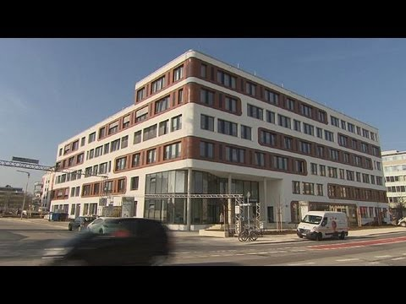
Higher Computing Science - Computer Systems

Slide 91
Higher Computing Science - Computer Systems
Impact on the environment of intelligent heating systems
Smart heating systems use a variety of ways to control the amount of heat required in our homes.
Using activity sensors, some smart systems learn the temperatures that you prefer in certain rooms and at what times.
Monitoring the activity in rooms can mean that the smart system adjusts the heating up or down depending on whether there is unusual activity in the house.
The thermostat is connected to wi-fi and can be manually controlled by using an app on your phone.
This allows you to turn the heating system off if you are not going home or to turn it on so that it is at the optimum temperature if you are coming home early.

Slide 92
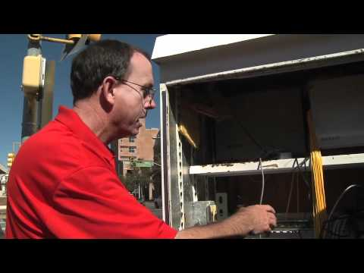
Higher Computing Science - Computer Systems

Slide 93
Higher Computing Science - Computer Systems
Impact on the environment of intelligent traffic control systems
Vehicles are considered one of the main contributing sources of greenhouse gas.
Studies in the European Union showed that transport causes 25% of all carbon dioxide emissions.
Vehicles consume greater amounts of fuel when they are constantly accelerating and braking in traffic jams.
The optimum speed for low fuel consumption and low emissions is between 45 and 65 miles per hour.
Intelligent transport systems use software and hardware, along with information and communications technologies, to improve the efficiency and safety of transport networks. They use a variety of information from cameras and sensors, along with control of traffic signals, to try to keep traffic moving, reducing the amount of harmful emissions.
Cars with individual navigation systems use satellite information on traffic flow to guide drivers away from traffic congestion and on to more free-flowing routes.

Slide 94
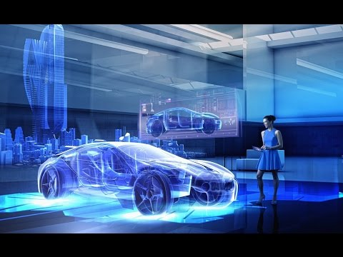
Higher Computing Science - Computer Systems

Slide 95
Higher Computing Science - Computer Systems
Impact on the environment of intelligent Car Management Systems
A number of different car management systems are used to reduce the impact on the environment.
Start-stop systems automatically shut down the engine when the car is not moving — this reduces the amount of time the engine spends idling, reducing fuel consumption and emissions.
The car automatically re-starts when the accelerator is pressed, which is most advantageous for vehicles that spend significant amounts of time waiting at traffic lights or frequently come to a stop in traffic jams.
Engine control units use sensors to ensure the engine’s air/fuel ratio can be controlled very accurately, ensuring optimum fuel consumption and a reduction of carbon dioxide emissions.

Slide 96
Higher Computing Science - Computer Systems
In the booklet
Page 29
Answer the questions.

Slide 97
Higher Computing Science - Computer Systems
Learning Intentions
Learn how the use of Intelligent systems can have both positive and negative impacts on the environment.
Success Criteria
I can explain how the use of Intelligent Heating Systems can impact on the environment.
I can explain how the use of Intelligent Traffic Control Systems can impact on the environment.
I can explain how the use of Intelligent Car Management Systems can impact on the environment.

Slide 98
Higher
Computing Science
11. Computer Misuse Act 1990

Slide 99
Higher Computing Science - Computer Systems
Learning Intentions
Learn how the Computer Misuse Act 1990 is used to recognise offences such as unauthorised access to data, unauthorised altering of data and the making, supplying or obtaining items that can be used in computer misuse offences
Success Criteria
I can explain the legality of unauthorised access to data
I can explain the legality of unauthorised modification of data
I can explain the legality of making, supplying or obtaining anything which can be used in computer misuse offences

Slide 100
Higher Computing Science - Computer Systems
In pairs, discuss the actions on the Computer Misuse Act sheet and decide which are the most serious and which are the least serious.
Logging onto a mate’s account for fun | Writing a computer virus | Using phishing to find out strangers’ account details
Sending someone an email which you know contains a computer virus | Guessing your teacher’s password and changing your exam mark | Going onto an unattended computer and deleting someone’s essay

Slide 101
Higher Computing Science - Computer Systems

Slide 102
Higher Computing Science - Computer Systems
The Computer Misuse Act (1990) recognises the following as offences:
Unauthorised access to computer material.
Unauthorised access with intent to commit or facilitate a crime.
Unauthorised modification of computer material.
Making, supplying or obtaining anything which can be used in computer misuse offences.

Slide 103
Higher Computing Science - Computer Systems
Unauthorised access to computer material
This is the lowest level of offence and is one that many of us might be guilty of at some stage in our school or working lives. Have you ever found, guessed or used someone elses' password to log onto their user area? If you do this and then look at their files, even if you don't change, delete or damage anything, you are still guilty of accessing materials without authorisation - and this is illegal. This offence carries the risk of being sentenced to six months in prison and/or a hefty fine.

Slide 104
Higher Computing Science - Computer Systems
Unauthorised access with intent to commit or facilitate a crime.
The difference between this and the first offence is that the person gaining access to someone elses' system is doing so with the sole purpose of doing something illegal. This might mean that they had to guess or steal the password in order to get into someone's user area or their bank account. They could do this by trial and error or by using special programs such as spyware or keylogging software, or they could use a relatively new technique called 'phishing'. They might want to steal some company secrets or they might want to transfer some money out of your bank account into their own. Anyone caught doing this risks up to a five year prison sentence and/or a hefty fine.

Slide 105
Higher Computing Science - Computer Systems
Unauthorised modification of computer material.
Everyone deletes files from their own system, maybe they no longer need them or maybe they delete them by mistake. This is fine - there was no intent to cause any damage. This offence relates to the deletion or changes made to files with the intent to cause damage to an individual or company. The difference is 'the intent to cause damage'. This offence also covers purposely introducing viruses to other peoples' systems. If you knowingly transmit a virus to others, you are guilty under this section of the Computer Misuse Act. This offence carries a penalty of up to five years in prison and/or a fine.

Slide 106
Higher Computing Science - Computer Systems
Making, supplying or obtaining anything which can be used in computer misuse offences.
Making
This includes the writing or creation of computer viruses, worms, trojans, malware, malicious scripts etc.
Supplying
This part covers the distribution of any of the above material whether you have created it yourself or obtained it from elsewhere. It is an offense to supply or distribute these files to others.
Obtaining
If you purposely obtain malicious files such as as computer viruses or scripts that you know could be used to damage computer systems then you have committed an offence under the Computer Misuse Act.

Slide 107
Higher Computing Science - Computer Systems
In the booklet
Page 32
Answer the scenarios

Slide 108
Higher Computing Science - Computer Systems
Learning Intentions
Learn how the Computer Misuse Act 1990 is used to recognise offences such as unauthorised access to data, unauthorised altering of data and the making, supplying or obtaining items that can be used in computer misuse offences
Success Criteria
I can explain the legality of unauthorised access to data
I can explain the legality of unauthorised modification of data
I can explain the legality of making, supplying or obtaining anything which can be used in computer misuse offences

Slide 109
Higher
Computing Science
12. Security Risks

Slide 110
Higher Computing Science - Computer Systems
Learning Intentions
Learn how data and services can be placed at risk by Tracking Cookies and Denial of Service Attacks
Success Criteria
I can explain cookies, specifically tracking cookies and the risks they can present to personal and professional data.
I can explain how a Denial of Service Attack works, along with its symptoms, effects, costs, types of faults they can cause, as well as reasons for these attacks happening.

Slide 111
Higher Computing Science - Computer Systems
Cookie: An HTTP cookie (also called web cookie, Internet cookie, browser cookie, or simply cookie) is a small piece of data sent from a website and stored on the user's computer by the user's web browser while the user is browsing.
Tracking Cookie: Tracking Cookies are a specific type of cookie that are distributed, shared, and read across two or more unrelated websites for the purpose of gathering information or potentially to present customized data to you.

Slide 112
Higher Computing Science - Computer Systems
A cookie is a small data file created when you access a website. These can be used to store your personal preferences or log in details so you don’t need to re-enter these details. A cookie is stored on the client rather than the server as they are personal to you.
Tracking cookies take this one step further. Your details are recorded and then transmitted back to the cookie’s author. Most are benign and are just gathering marketing information.
On other occasions programmers can set the tracking cookie up to send them usernames and personal details. As well as concerns around identity theft, these cookies can be used to target users with personalised adverts.

Slide 113
Higher Computing Science - Computer Systems

Slide 114
Higher Computing Science - Computer Systems
In the booklet
Page 33
Answer the question

Slide 115
Higher Computing Science - Computer Systems
Denial of Service Attack: A denial-of-service (DoS) is any type of attack where the attackers (hackers) attempt to prevent legitimate users from accessing the service. In a DoS attack, the attacker usually sends excessive messages asking the network or server to authenticate requests that have invalid return addresses.
Symptoms: What will happen that may allow a DOS attack to be identified as taking place.
Bandwidth: the capacity of a wired or wireless network communications link to transmit the maximum amount of data from one point to another over a computer network or internet connection in a given amount of time - usually one second. Bandwidth describes the data transfer rate.
Domain Name Service (DNS): Short for Domain Name System (or Service or Server), a DNS is an Internet service that translates domain names into IP addresses. Because domain names are alphabetic, they're easier to remember.
IP Address: a unique string of numbers separated by full stops that identifies each computer using the Internet Protocol to communicate over a network.

Slide 116
Higher Computing Science - Computer Systems
Denial of service or "DoS" describes the ultimate goal of a class of cyber attacks designed to render a service inaccessible. The DoS attacks that most people have heard about are those launched against high profile websites, since these are frequently reported by the media.
However, attacks on any type of system, including industrial control systems which support critical processes, can result in a denial of service.
When a website suffers a DoS attack, the apparent effect will depend on your perspective. For the average user, it appears that the site has simply stopped displaying content.
For businesses, it could mean that the online systems they depend upon have ceased to respond.
The symptoms of a DoS attack against industrial control systems may include the inability to retrieve sensor data, or control critical processes.

Slide 117
Higher Computing Science - Computer Systems
DoS attacks can range in duration and may target more than one site or system at a time. An attack becomes a 'distributed denial of service', referred to as “DDoS”, when it comes from multiple computers (or vectors) instead of just one. This is the most common form of DoS attack on websites.

Slide 118
Higher Computing Science - Computer Systems
Symptoms of DOS attacks
slows performance of the servers under attack and can completely halt any other access
inability to access resources held on the server

Slide 119
Higher Computing Science - Computer Systems
Effects of DOS attacks
Genuine users are not able to access resources, so may not be able to find the information or carry out the actions they need
Businesses may not be able to carry out time critical actions. They may also suffer reputational damage. Customers may chose to use a competitor.

Slide 120
Higher Computing Science - Computer Systems
Costs of DOS attacks
If unable to complete business in time, there may financial loss in that contracts may not be paid.
Employees may require to work overtime to fix the faults, resulting in additional costs for pay.

Slide 121
Higher Computing Science - Computer Systems
Type of fault caused by DOS attacks
Bandwidth Consumption - Flood of requests fills the connection up to their limit so no other requests can get through. The effect only lasts as long as the attack is maintained.
Resource Starvation - Requests each use a little bit of other resources, like disk space, until the server runs out and is no longer able to function correctly.
Domain Name Service (DNS) Attacks - these attack the servers that route internet traffic so can impact on multiple websites.

Slide 122
Higher Computing Science - Computer Systems
Reasons for DOS attacks
Financial - The attacker may demand payment to stop the attack
Political - The attacker may wish to take down government websites to protest at government actions
Personal - An individual may have a grievance against a company and decide to enact revenge.

Slide 123
Higher Computing Science - Computer Systems

Slide 124
Higher Computing Science - Computer Systems
In the booklet
Page 36
Research a DoS Attack from the past 3 years. Record your findings in the table below.

Slide 125
Higher Computing Science - Computer Systems
Learning Intentions
Learn how data and services can be placed at risk by Tracking Cookies and Denial of Service Attacks
Success Criteria
I can explain cookies, specifically tracking cookies and the risks they can present to personal and professional data.
I can explain how a Denial of Service Attack works, along with its symptoms, effects, costs, types of faults they can cause, as well as reasons for these attacks happening.

Slide 126
Higher
Computing Science
13. Security Precautions

Slide 127
Higher Computing Science - Computer Systems
Learning Intentions
Learn how encryption using public and private keys can be used to secure transmission of data
Learn how Digital Certificates are used to verify the sender of a message
Learn how Digital Signatures are used to verify the sender of a message
Success Criteria
I can explain encryption, including the use of Public and Private Keys.
I can explain how Digital Certificates can be used to ensure data is from a valid sender.
I can explain how Digital Signatures can be used to

Slide 128
Higher Computing Science - Computer Systems
Encryption: Scrambling a message using a secret method (known as a cypher) so that only the sender and recipient (who know the cypher) can decode and read the message.
Cypher: the process of encrypting a message

Slide 129
Higher Computing Science - Computer Systems
Data transmitted over the Internet is very easy to intercept and most of it is text based
In order to keep data secure in transit it is encrypted
A process, called a cypher, is used to scramble the data so that it doesn’t make sense
The cypher is reversible so the original message can be restored if you know the cypher

Slide 130
Higher Computing Science - Computer Systems
Caesar Cypher

Slide 131
Higher Computing Science - Computer Systems
Caesar Cypher

Slide 132
Higher Computing Science - Computer Systems
Caesar Cypher

Slide 133
Higher Computing Science - Computer Systems
Caesar Cypher

Slide 134
Higher Computing Science - Computer Systems
Caesar Cypher
Use the “Caesar Cypher” and “Caesar Cypher “Cracked” Tabs in the Encryption Cyphers Spreadsheet to experiment with the Caesar Cypher.

Slide 135
Higher Computing Science - Computer Systems
Substitution Cypher
A | B | C | D | E | F | G | H | I | J | K | L | M
F | G | E | L | P | I | M | Z | C | R | F | Y | Q
N | O | P | Q | R | S | T | U | V | W | X | Y | Z
H | A | D | B | J | N | S | V | K | O | T | W | U
E A Q D V S P J N

Slide 136
Higher Computing Science - Computer Systems
Cracking the Substitution Cypher
The most common letter in the English language is E, closely followed by T.
In the text above, the most common letter is R, followed by O.
Therefore: Rbo could be T_e or it could be E_t.
What do you reckon the most common word in the English language is?
Rbo rpktigo vcrb bwucja wj kloj hcjd, km sktpqo, cq rbwr loklgo
vcgg cjqcqr kj skhcja wgkja wjd rpycja rk ltr rbcjaq cj cr.
-- Roppy Lpwrsborr

Slide 137
Higher Computing Science - Computer Systems
Cracking the Substitution Cypher
The most common Word in the English Language is THE, so it is highly likely that Rbo is The
A | B | C | D | E | F | G | H | I | J | K | L | M
 |  |  |  | O |  |  | B
N | O | P | Q | R | S | T | U | V | W | X | Y | Z
 |  |  |  |  |  | R
The tpktige vcth hwucja wj kloj hcjd, km sktpqe, cq thwt leklge
vcgg cjqcqt kj skhcja wgkja wjd tpycja tk ltt thcjaq cj ct.
-- Roppy Lpwrsborr
Rbo rpktigo vcrb bwucja wj kloj hcjd, km sktpqo, cq rbwr loklgo
vcgg cjqcqr kj skhcja wgkja wjd rpycja rk ltr rbcjaq cj cr.
-- Roppy Lpwrsborr

Slide 138
Higher Computing Science - Computer Systems
Cracking the Substitution Cypher
The most common Word in the English Language is THE, so it is highly likely that Rbo is The
A | B | C | D | E | F | G | H | I | J | K | L | M
 |  |  |  | O |  |  | B
N | O | P | Q | R | S | T | U | V | W | X | Y | Z
 |  |  |  |  |  | R
The tpktige vcth hwucja wj kloj hcjd, km sktpqe, cq thwt leklge
vcgg cjqcqt kj skhcja wgkja wjd tpycja tk ltt thcjaq cj ct.
-- Teppy Lpwtsbett

Slide 139
Higher Computing Science - Computer Systems
Cracking the Substitution Cypher
The most common Word in the English Language is THE, so it is highly likely that Rbo is The
A | B | C | D | E | F | G | H | I | J | K | L | M
W |  |  |  | O |  |  | B
N | O | P | Q | R | S | T | U | V | W | X | Y | Z
 |  |  |  |  |  | R
The tpktige vcth haucja aj kloj hcjd, km sktpqe, cq that leklge
vcgg cjqcqt kj skhcja agkja ajd tpycja tk ltt thcjaq cj ct.
-- Teppy Lpwtsbett

Slide 140
Higher Computing Science - Computer Systems
Cracking the Substitution Cypher
The most common Word in the English Language is THE, so it is highly likely that Rbo is The
A | B | C | D | E | F | G | H | I | J | K | L | M
W |  |  |  | O |  |  | B
N | O | P | Q | R | S | T | U | V | W | X | Y | Z
 |  |  |  |  |  | R
The tpktige vcth haucja aj kloj hcjd, km sktpqe, cq that leklge
vcgg cjqcqt kj skhcja agkja ajd tpycja tk ltt thcjaq cj ct.
-- Teppy Lpwtsbett

Slide 141
Higher Computing Science - Computer Systems
Cracking the Substitution Cypher
The most common Word in the English Language is THE, so it is highly likely that Rbo is The
A | B | i | D | E | F | G | H | I | J | K | L | M
W |  |  |  | O |  |  | B | C
N | O | P | Q | R | S | T | U | V | W | X | Y | Z
 |  |  |  |  |  | R
The tpktige vith hauija aj kloj hijd, km sktpqe, iq that leklge
vigg ijqiqt kj skhija agkja ajd tpyija tk ltt thijaq ij ct.
-- Teppy Lpwtsbett

Slide 142
Higher Computing Science - Computer Systems
Cracking the Substitution Cypher
The most common Word in the English Language is THE, so it is highly likely that Rbo is The
A | B | i | D | E | F | G | H | I | J | K | L | M
W |  |  |  | O |  |  | B | C
N | O | P | Q | R | S | T | U | V | W | X | Y | Z
 |  |  |  |  |  | R
The trouble with having an open mind, of course, is that people
will insist on coming along and trying to put things in it.
-- Terry Pratchett

Slide 143
Higher Computing Science - Computer Systems
Single Key Cyphers
The challenge with single key cyphers is obvious - they can be “brute forced” open with enough time and processing power. Once cracked, they remain open to any interloper.
A new solution was required as processors become increasingly powerful. This is where Private and Public Key encryption comes in.

Slide 144
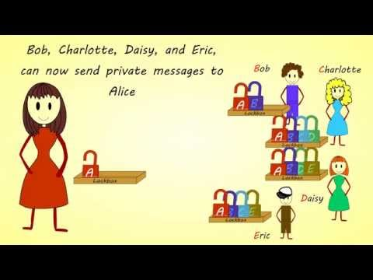
Higher Computing Science - Computer Systems

Slide 145
Higher Computing Science - Computer Systems
Having both systems agreeing on a key that no one else knows becomes an issue
Both systems need to know what the key is without transmitting the key itself
Otherwise any one intercepting the encrypted message also knows the key
Public-key encryption (PKE) solves this problem by using 2 keys
The two keys are mathematically linked
Normally generated from a large, random number

Slide 146
Higher Computing Science - Computer Systems
The two keys are mathematically linked
Normally generated from a large, random number
The public key is known by everyone and is used to encrypt the message
The private key is known only by the recipient and is used to decrypt the message
The cyphers are very complex so that only the private key can decrypt the message
The public key cannot be used to work out what the private key is

Slide 147
Higher Computing Science - Computer Systems
Digital Signatures
A digital signature is a way to ensure that an electronic message or document is authentic.
The signature is created when the message is sent, using a private encryption key, opposite to normal PKE.
The signature is then paired with a public key and sent with the message.
When the message run through the public key the result should match the signature.
If they don’t match then the message has been altered en route, so the message has been intercepted and compromised.

Slide 148
Higher Computing Science - Computer Systems
Digital Certificates
Digital Certificates are the attachment to an electronic message used for security purposes.
It is used to verify that a user sending a message is who they claim to be and to bind their public key to them.
Certificates can only be issued by certain trusted entities including Google, Symantec, and Comodo.
The “lock” icon in your browser shows the status of the certificate.
The lock indicates that the website is backed by a digital certificate and is a genuine website and is not a fake set up by criminals.

Slide 149
Higher Computing Science - Computer Systems
In the booklet
Page 38
Answer the questions
Complete the Computer Systems Self Assessment Booklet

Slide 150
Higher Computing Science - Computer Systems
Learning Intentions
Learn how encryption using public and private keys can be used to secure transmission of data
Learn how Digital Certificates are used to verify the sender of a message
Learn how Digital Signatures are used to verify the sender of a message
Success Criteria
I can explain encryption, including the use of Public and Private Keys.
I can explain how Digital Certificates can be used to ensure data is from a valid sender.
I can explain how Digital Signatures can be used to

