Slide 1
Higher Computing DDD
Database Design and Development

Slide 2
Lesson 1: Analysis End-User and Functional Requirements
Database Design and Development

Slide 3
ANALYSIS (DDD)
During the analysis stage of database development, you should identify the following requirements:
1 End-user requirements:
2 Functional requirements:
These requirements will help:
Clarify the design and implement of the database.
Identify the features to be implemented on the database.
Allow you to evaluate whether the system is fit for purpose after development is complete.

Slide 4
1 End-user requirements:
the end users are the people who are going to be using the database
their requirements are the tasks they expect to be able to do using the database
2 Functional requirements:
processes and activities that the system has to perform
information that the system has to contain to be able to carry out its functions

Slide 5
Database Example
A travel agency wants to create a relational database to store details of bookings for hotels in Scottish holiday resorts.
The database will allow travel agents to view details of hotels and make bookings for customers.
Four separate entities are required:
Hotel (used to store details of hotels in each resort)
Resort (used to store details of Scottish holiday resorts)
Customer (used to store details of customers who make holiday bookings)
Booking (used to store details of hotel bookings)

Slide 6
They have appointed a developer team to carry out an analysis of the database requirements.
The developers ask some of the travel agency staff about the features they would expect to see in the completed database.
The following are a few of the comments made by the staff:
I have to prepare invoices for customers that show the full details of their booking (details should include the hotel and resort name, date, price per person, number of nights, number in party, total cost, customer name and full address) as well as the total cost of the booking.
Customers are interested to know how many 4-star hotels are in resorts that have a train station.
I need to provide customers with details of hotels in different types of resorts, eg coastal or country.
I need to know what hotels are available for a given date (eg start of season) or within a certain price range.
Customers want to see hotel details, together with resort information, listed from cheapest to the dearest.
Customers expect me to give them information about hotels that have a specific star rating. They want me to calculate the total cost of a stay in those hotels, for a specified number of nights and for a certain number of people in the party.
Customers often want to visit a particular resort and ask me to check the availability of hotels with facilities, for example a pool or with different meal plans.

Slide 7
End-user requirements:
Travel agency staff should be able to perform a range of searches to display:
full details of any booking
availability of hotels in a particular resort, with specified facilities (meal plan or pool)
details of hotels in a particular type of resort
details of hotels available for a specified star rating
resorts that have train stations
Functional requirements:
Staff should be able to sort search results in order of ascending order of price and should be able to calculate:
the total cost of any holiday booking
the number of hotels

Slide 8
Lesson 2: Design using Entity Relationship Model Pt 1
Database Design and Development

Slide 9
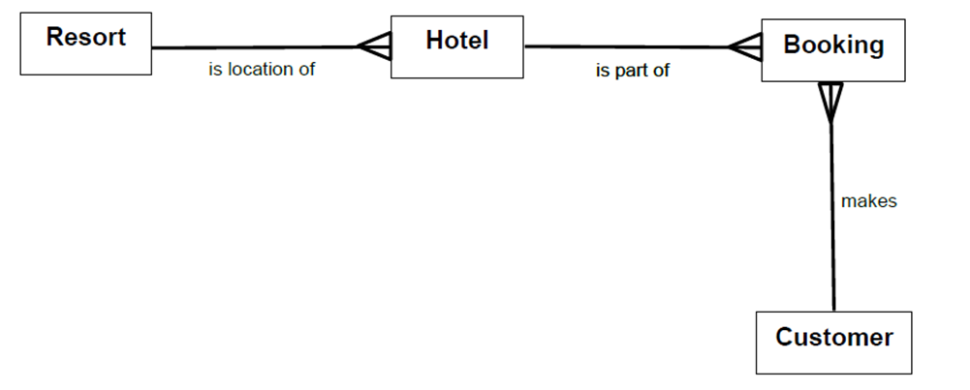
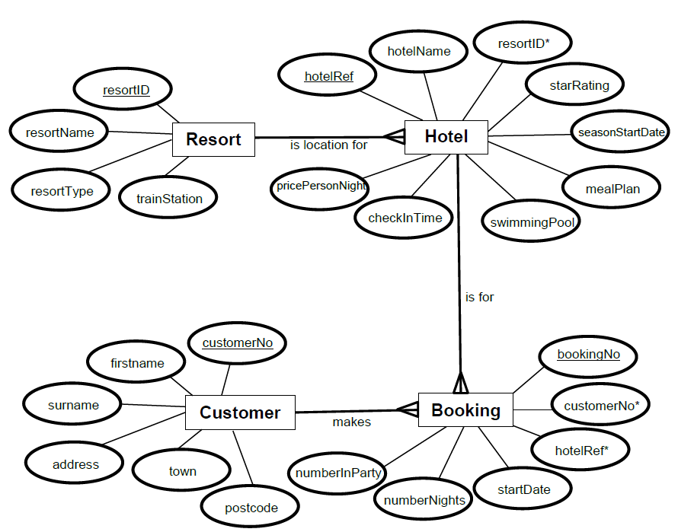

Slide 10
Entity-relationship modelling
In the development of a complex database system, entity-relationship modelling is used to plan the structure of the database.
In entity-relationship modelling, specialist terminology is used to define each component of the model.
This terminology includes:
entity
entity occurrence
attribute
primary key
foreign key
compound key
relationship
cardinality
entity-occurrence diagram
entity-relationship diagram

Slide 11
DEFINITIONS
Entity
An entity is a person, place, thing, event or concept of interest to the business or organisation about which data is to be stored.
For example, in a school, possible entities might be Student, Teacher, Class and Subject.
Entity occurrence
A specific example of an entity is called an instance or entity occurrence.
For example, John Smith, Mary McLeod and Omar Shaheed are all entity occurrences found in the Student entity; English, Computing and Chemistry are all entity occurrences within the Subject entity.

Slide 12
Attribute
An entity is described by its attributes.
Each attribute is a characteristic of the entity.
For example, attributes of the Student entity would include studentID, firstname, surname and dateOfBirth
Primary key
An attribute or combination of attributes that uniquely identifies one, and only one, entity occurrence is called a primary key.
For example, the primary key of the Student entity would be studentID. A primary key is signified by underlining in the entity-relationship diagram.

Slide 13
Foreign key
An attribute in one table that uniquely identifies a row of anther table i.e. a primary key.
A foreign key is signified by an asterisk in the entity-relationship diagram.
Compound key
A compound key is a primary key that comprises two or more attributes. Each attribute that makes up a compound key is a primary key in its own right.
For example, the primary key of the Class entity would be the compound key formed by combining subjectCode + teacherRef + columnID.
In this example, subjectCode would be the primary key of the Subject entity, teacherRef would be the primary key of the Teacher entity and columnID would be the primary key of the Column entity.

Slide 14
Lesson 3: Design using Entity Relationship Model Pt 2
Database Design and Development

Slide 15
Relationship
A relationship is a natural association between one or more entities.
For example, Students learn Subjects and Teachers educate Students.
Cardinality
The cardinality of a relationship defines the number of participants in the relationship.
It states the number of entity occurrences in one entity that are associated with one occurrence of the related entity.
Cardinality can be:
one-to-one
one-to-many
many-to-many

Slide 16
Entity Relationships
One to one 1:1 1:1
One to Many (and Many to One) 1:∞ 1:M
Many to Many (Not common) ∞:∞ M:M
One
One
One
Many
Many
Many

Slide 17
One-to-one relationship
In a one-to-one relationship, each entity occurrence in an entity is associated with one, and only one, entity occurrence within a related entity.
For example, a School is managed by one, and only one, Headteacher, with a Headteacher managing one, and only one, School.
This entity-relationship diagram illustrates the relationship between the two entities School and Headteacher. A description of the relationship can be generated by reading across the diagram in both directions:
Each School is managed by one, and exactly one, Headteacher while each Headteacher manages one, and only one, School.

Slide 18
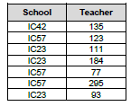
One-to-many relationship
In a one-to-many relationship, each entity occurrence in an entity can be associated with one or more entity occurrences in a related entity.
For example, a School employs many Teachers and each of those Teachers is employed by one School
School
employs
Teacher

Slide 19
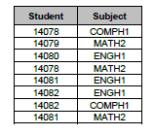
Many-to-many relationship
In a many-to-many relationship, several entity occurrences in an entity can be associated with multiple entity occurrences in a related entity.
For example, many Students study several different Subjects and each of those Subjects is studied by many Students.
Direct many-to-many relationships between two entities cannot be implemented by a relational database system. To overcome this many to many relationships are resolved to one to many relationships
Student
Subject

Slide 20
Lesson 4: Design using Entity Relationship Diagrams
Database Design and Development

Slide 21
Entity Relationship Diagrams
An entity-relationship diagram is a graphical representation of the entities in a system.
It is used to summarise the relationship that exists between two or more entities.
An entity-relationship diagram indicates:
The name of each entity in the system
The name of the relationship between two entities.
The cardinality of the relationship between two entities.
If required, the name of each attribute can be shown.

Slide 22
Entity Relationship Diagrams
The entities on an entity-relationship diagram are represented by labelled rectangles.
If required, the attributes within each entity can be represented as labelled ovals.
The relationship between two entities is represented by the labelled line which is used to join the entities.
Although several different representations can be used, the entity-relationship diagrams in the examples below make use of the ‘crow’s feet notation’ to indicate the ‘many’ side of a relationship.

Slide 23
Entity Relationship Diagrams
This entity-relationship diagram illustrates the relationship between the two entities School and Headteacher.
A description of the relationship can be generated by reading across the diagram in both directions:
Each School is managed by one, and exactly one, Headteacher while each Headteacher manages one, and only one, School.

Slide 24
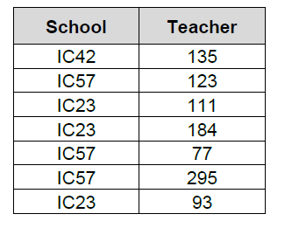
Entity Relationship Diagrams
This entity-relationship diagram illustrates the relationship between the two entities School and Teacher.
A description of the relationship can be generated by reading across the diagram in both directions:
Each School employs one or more Teachers and each Teacher is employed by one, and only one, School.

Slide 25
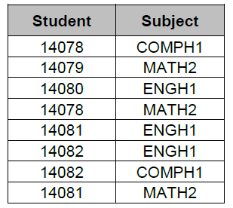
Entity Relationship Diagrams
This entity-relationship diagram illustrates the relationship between the two entities Student and Subject.
A description of the relationship can be generated by reading across the diagram in both directions:
Each Student studies one or more Subjects and each Subject is studied by one or many Students.

Slide 26
Lesson 5: Design using Entity Relationship Diagram Example Holidays Resort
Database Design and Development

Slide 27
Entity Relationship Diagrams – Multi table example
A relational database is used by a travel agency to store details of Scottish holiday resorts and hotels in each resort.
The database also stores details of customers and their hotel bookings.
The Booking, Customer, Resort and Hotel details are arranged in four separate entities.

Slide 28
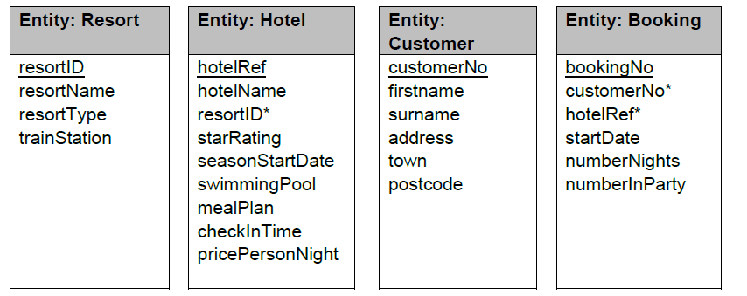
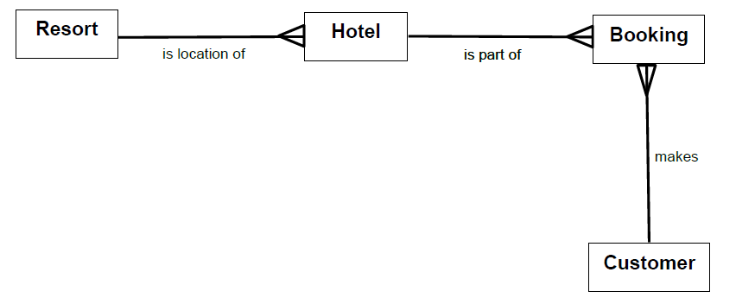
Entity Relationship Diagrams – Multi table example

Slide 30
Lesson 6: Design using Entity Occurrence Diagram
Database Design and Development

Slide 31
Entity Occurrence Diagrams
An entity-occurrence diagram illustrates the relationships between the entity occurrences of one entity, with the entity occurrences within a related entity.
The creation of an entity-occurrence diagram helps to identify the cardinality of the relationship that exists between the two entities.
In an entity-occurrence diagram, each entity is shown as a tall oval.
Inside each entity, each entity occurrence is represented by the value of its identifier and each relationship is illustrated by drawing a line between associated entity occurrences.

Slide 32
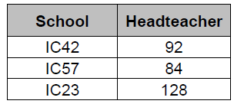
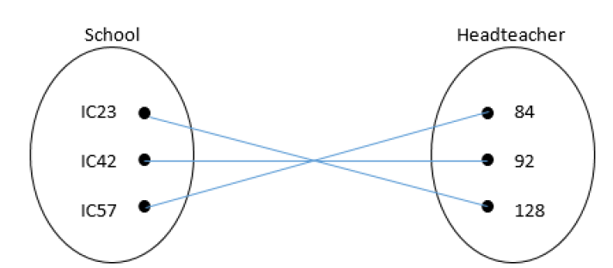
Entity Occurrence Diagrams
The following table indicates which School is managed by which Headteacher and which Headteacher manages which School.
Here is the matching entity-occurrence diagram.
Remember ERD:

Slide 33
From this entity-occurrence diagram, we can see that each occurrence in the School entity has an association with one, and only one, entity occurrence in the Headteacher entity.
Similarly, each occurrence in the Headteacher entity has an association with one, and only one, occurrence in the School entity
This confirms that there is a one-to-one relationship between the School and Headteacher entities.

Slide 34
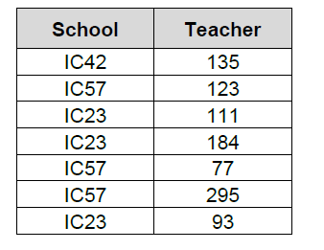
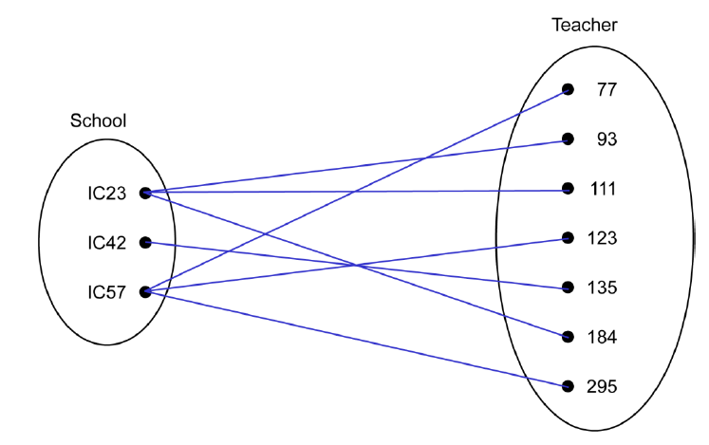
The following table indicates which School employs which Teachers and which Teachers are employed by which School.
Here is the matching entity-occurrence diagram.

Slide 35
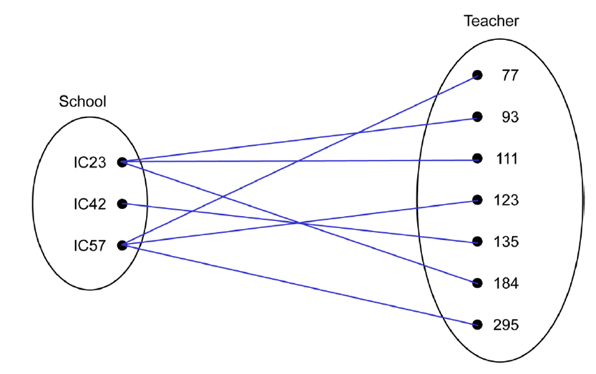
From this entity-occurrence diagram, we can see that each occurrence in the School entity has an association with one or more entity occurrences in the Teacher entity.
We can also see that each occurrence in the Teacher entity has an association with one, and only one, occurrence in the School entity.
This confirms that there is a one-to-many relationship between the School and Teacher entities.

Slide 36
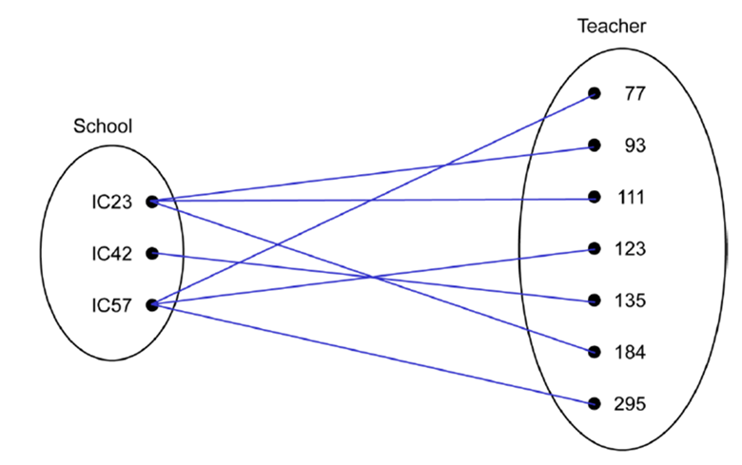
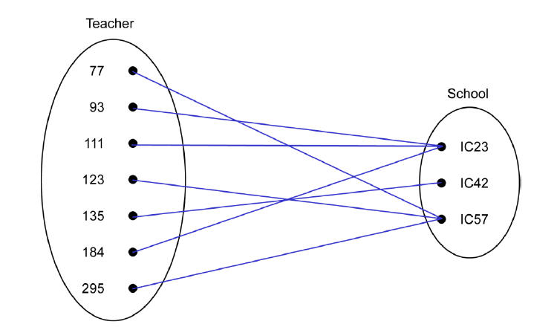
OR

Slide 37
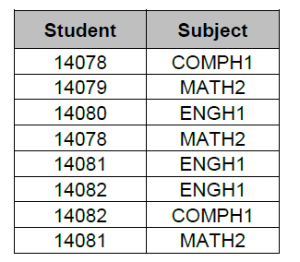
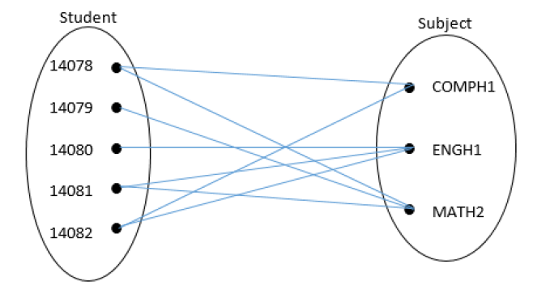
The following table indicates which Students study which Subjects and which Subjects are studied by which Students.
Here is the matching entity-occurrence diagram.

Slide 38
From this entity-occurrence diagram, we can see that each occurrence in the Student entity has an association with one or more entity occurrences in the Subject entity.
We can also see that each occurrence in the Subject entity has an association with one or more occurrences in the Student entity.
This confirms that there is a many-to-many relationship between the Student and Subject entities.

Slide 39
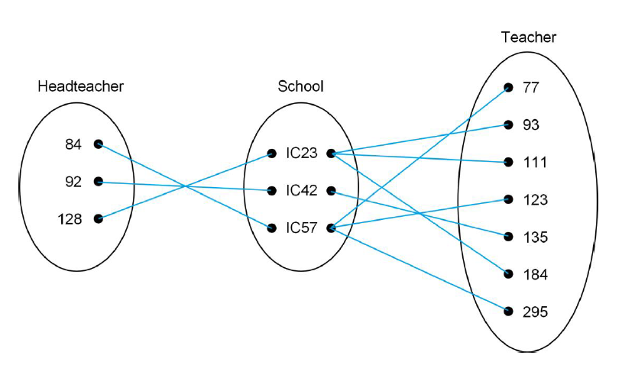
An entity-occurrence diagram may be used to illustrate the relationship between multiple entities as shown below:

Slide 40
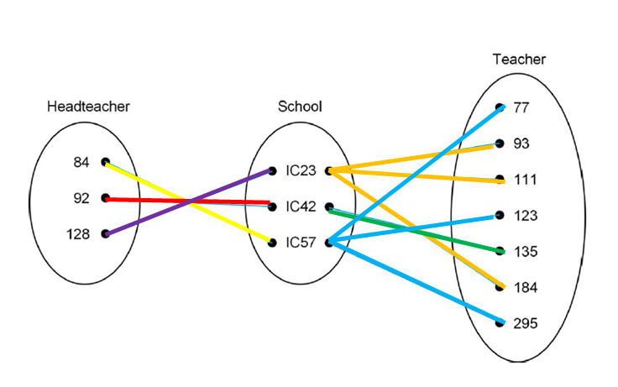
*The use of colour when creating an entity-occurrence diagram can make the diagrams easier to read – this is not part of the Higher arrangements per se but I like it!*

Slide 41
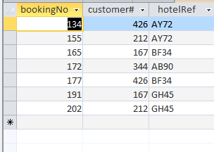
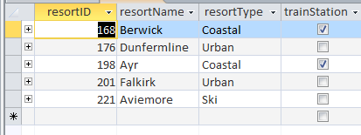
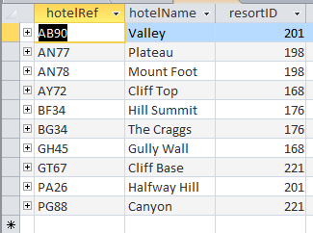
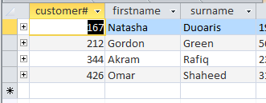
Using the information provided below we can draw the Entity Occurrence Diagram for the Scottish Holiday Resorts Database

Slide 42
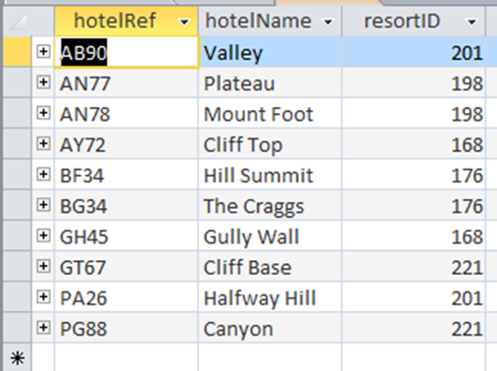
AB90
AN77
AN78
AY72
BF34
BG34
GH45
GT67
PA26
PG88
168
176
198
201
221

Slide 43
AB90
AN77
AN78
AY72
BF34
BG34
GH45
GT67
PA26
PG88
134
155
165
172
177
191
202
168
176
198
201
221

Slide 44
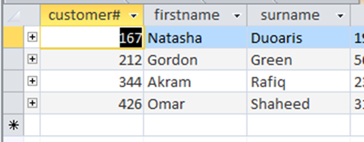
AB90
AN77
AN78
AY72
BF34
BG34
GH45
GT67
PA26
PG88
134
155
165
172
177
191
202
167
212
344
426
168
176
198
201
221

Slide 45
AB90
AN77
AN78
AY72
BF34
BG34
GH45
GT67
PA26
PG88
134
155
165
172
177
191
202
167
212
344
426
168
176
198
201
221

Slide 46
Lesson 7: Query Design using SQL
Database Design and Development

Slide 47
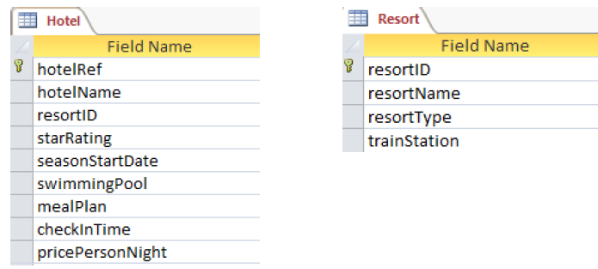
Database Query Design and Solutions - SQL
A travel agency uses a relational database to enable their employees to view details of hotels in Scottish holiday resorts and make bookings for customers.
The details are stored in four separate tables called Hotel, Resort, Booking and Customer.

Slide 48
The design of the SQL query should indicate:
the table(s) needed to provide all of the details required
any field(s) or computated values required
any search criteria to be applied
what grouping is needed (if appropriate)
the field(s) used to sort the data and the type(s) of sort required
If the field name has spaces or a non textual character such as # then square brackets must be used

Slide 49
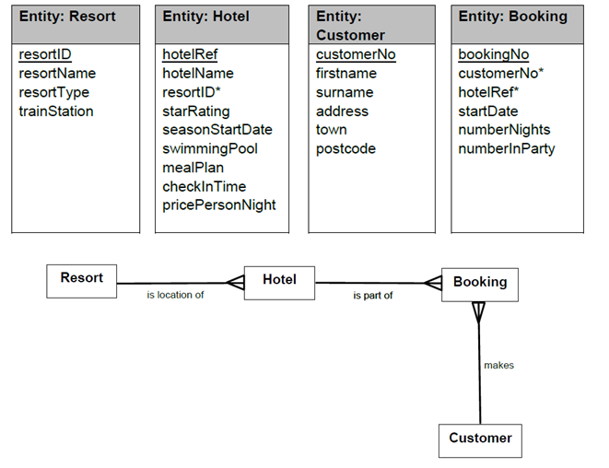
Database Query Design and Solutions - SQL

Slide 50
Database Query Design
Example 1

Slide 51
Database Query Design
Example 2

Slide 52
Queries Entity.EntityOccurrence = Criteria Booking.startDate Booking.customer# = 001 Customer.firstname Customer.surname

Slide 53
For more see:
Database Query Design
Appendix 10

Slide 54
Lesson 8: Wildcards Like “%Toy Story”
Database Design and Development

Slide 55
Wildcards
A wildcard character is used to replace one or more characters in a string.
Wildcards are useful in situations when incomplete information is available and it would be impossible to write a WHERE clause using one of the existing logical operators =, <, >, ≤ or ≥.
Wildcard characters are used with the SQL LIKE operator.
The LIKE operator is used in a WHERE clause to perform search operations.
Two different wildcards can be used:
% (the percent symbol) is used to represent zero, one or multiple characters
_ (the underscore symbol) is used to represent a single character

Slide 56
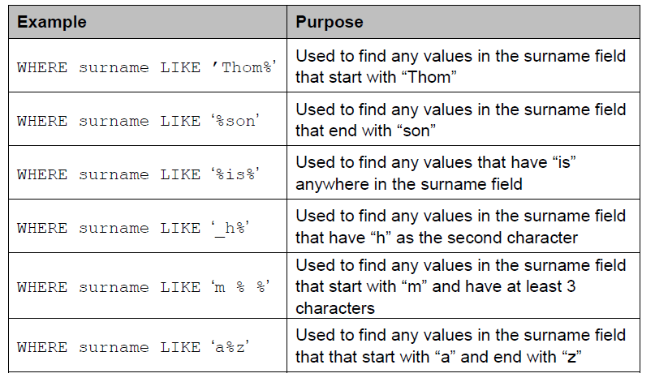
The following are some examples of LIKE used with the wildcards:

Slide 57
In MS ACCESS
WHERE surname LIKE ’Thom*’
Used to find any values in the surname field that start with “Thom”
WHERE surname LIKE ‘*son’
Used to find any values in the surname field that end with “son”
WHERE surname LIKE ‘*is*’
Used to find any values that have “is” anywhere in the surname field
WHERE surname LIKE ‘?h*’
Used to find any values in the surname field that have “h” as the second character
WHERE surname LIKE ‘m * *’
Used to find any values in the surname field that start with “m” and have at least 3 characters
WHERE surname LIKE ‘a*z’
Used to find any values in the surname field that that start with “a” and end with “z”

Slide 58
Lesson 9: Aggregate Functions Min, Max, Count, Sum, Avg
Database Design and Development

Slide 59
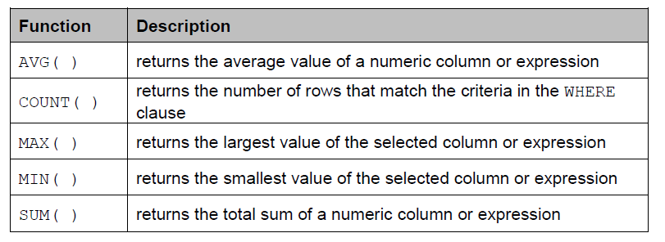
Aggregate functions
Aggregate functions operate on a set of rows to return a single, statistical value.
You apply an aggregate to a set of rows, which may be:
All the rows in a table.
Only those rows specified by a WHERE clause.
Those rows created by a GROUP BY clause (see later).
The most common aggregate functions used are listed below:

Slide 60
In the same way that pre-defined programming functions receive parameter values, SQL aggregate functions require an expression.
This expression is usually a column name but it can be a column name together with an operator.
The following points should be noted:
◻ SUM( ) and AVG( ) can only be applied to numeric data types; MIN( ) and MAX( ) work with characters, numeric, and date/time datatypes; COUNT( ) works with all data types.
◻ All aggregate functions except, COUNT( ), ignore nulls.
◻ COUNT( ) always returns a positive integer or zero. The other aggregate functions return null if the set contains no rows or contains rows with only nulls.
◻ An aggregate expression cannot be used in a WHERE clause.

Slide 61
It is possible to use more than one aggregate expression in a SELECT statement as shown here:
Mixing non-aggregate and aggregate expressions in a SELECT statement is not permitted.
A SELECT statement must contain either all non-aggregate expressions or all aggregate expressions.
The query below is illegal, as it mixes non-aggregate productName with the aggregate function MAX.

Slide 62
Lesson 10: Computed Values & Alias
Database Design and Development

Slide 63
Computed Values (*with aliases)
Arithmetic expressions can be used to compute values as part of a SELECT query.
The arithmetic expressions can contain column names, numeric numbers, and arithmetic operators.
Whenever a value is generated by a query, it is allocated its own column in the query answer table.
A computed value is temporary — it only exists within the query.
Because of this, computed values are not stored in the database, which eliminates the need to store data that can be computed at run-time.

Slide 64
Alias
An alias can be used to give any column in an answer table a temporary name.
Doing this makes the headings in the answer table more readable.
Since it is generated at run-time, an alias only exists for the duration of the query.
An alias is listed in the SELECT list by using the AS statement.

Slide 65
For example, the query below will display the name, price, quantity and cost of each product in a specified order:
Executing the query produces the answer table below:

Slide 66
We can make the answer table more readable by using an alias:
Executing the updated query produces the answer table below:
The column headings in this second answer table are more readable than those in the first answer table, due to the use of aliases in the second query.

Slide 67
Lesson 11: Group By, Update, Order By & Where
Database Design and Development

Slide 68
GROUP BY
The GROUP BY clause is used in a SELECT to form sets (or groups) of records.
It does this by gathering together all records that have identical data in the specified column(s).
When used with an aggregate function, GROUP BY ensures that one result is returned for each set of grouped records.
This makes it possible to mix non-aggregate and aggregate expressions for grouping columns; without GROUP BY, this is not possible.

Slide 69
For example, the query shown below is used to display a list of product categories together with the dearest product in each of those categories.
The category with the cheapest product is listed first.
Note: whenever a single query has both GROUP BY and ORDER BY clauses, the GROUP BY clause always precedes the ORDER BY clause. If the clauses are reversed, a syntax error will be generated.

Slide 70
Update
The UPDATE statement is used to modify the existing records in a table.
The following SQL statement updates the first customer (CustomerID = 1) with a new contact person and a new city.

Slide 71
UPDATE query used to edit more than one field
This query will increase the price of every product, with a name that begins with the letter D, by 10%.
At Higher level, candidates are required to use a single query to change the values stored in more than one field of a database query. The general syntax of this UPDATE query is:
Note: each expression used in the SET clause can be a specific value or an expression (which can, if required, use arithmetic operators). The WHERE clause is optional

Slide 72
Order By
ORDER BY is an SQL Keyword used to allow the ordering of results in either ascending or descending order.
For Example:
SELECT First Name, Surname, Class
FROM Pupil
ORDER BY Surname ASC;

Slide 73
Order By
Sorting multiple columns
It is possible to apply a sort on more than one column.
The first sort would be applied in its entirety, with the second sort only applied if two records in the column used for the first sort have the same value.
For Example:
SELECT First Name, Class, Merit Points
FROM Pupil
ORDER BY Class DESC, Merit Points ASC;

Slide 74
Where
The WHERE clause is used to filter records.
The WHERE clause is used to extract only those records that fulfil a specified condition.
The following SQL statement selects all the customers from the country "Mexico", in the "Customers" table:

Slide 75
Lesson 12: Data Dictionary Pt 1
Database Design and Development

Slide 77
Data Dictionary
Data dictionaries are created during the design phase to define the structure of a database.
Creating relational database management systems can be time consuming, and a data dictionary will act as an efficient reference point during implementation.

Slide 78
Data Dictionary
Data dictionaries contain the following metadata.
name of each entity
name of all attributes associated with each entity
type of data that will be held by each attribute
size of each attribute (taking account of the overall file size to be held in RAM or backing storage)
indication of attributes that will be used as primary or foreign keys during implementation
validation rules that are to be applied to attributes

Slide 79
Entities
In database design, entities represent what will become tables during implementation.
The term 'entity' is used to describe the following:
a person
a place
an object
a thing
Entities are made up of many attributes.

Slide 80
Lesson 13: Data Dictionary Pt 2 PK/FK, Attributes, Sizes
Database Design and Development

Slide 82
Primary Key / Foreign Key
A Primary key is a field used to uniquely identify every record in the database. Sometime primary keys are obvious, for example a car license plate could be used to uniquely identify cars. Often, primary keys are less obvious and it is necessary to create a unique value – often an ID number.
A Foreign key is a primary key from one table that appears in another table to link the two together. The Department ID is the primary key in the Department table that appears as a foreign key in the Staff table to link the two.
PK
FK

Slide 83
Attributes
Attributes are the specific characteristics of an entity. Attributes will become fields during implementation.
As an example, an entity to store information on a patient, may include the following attributes:
Attribute Data Type
Name TEXT
Age NUMBER
Date of birth DATE
Appointment time TIME
Payment Received BOOLEAN

Slide 84
Attribute Size
Size refers to the number of characters required for the attribute. For example a phone number is 11 characters long.
As an example, an entity to store information on a patient, may include the following attributes:
Attribute Data Type SIZE
Name TEXT 30
Age NUMBER 3
Date of birth DATE 8
Appointment time TIME 5
Payment Received BOOLEAN 5

Slide 85
Lesson 14: Data Dictionary Pt 3 Validation
Database Design and Development

Slide 87
Validation
An advantage of electronic databases are the validation checks available:
presence
restricted choice
field length
range

Slide 88
Validation
Presence
A presence check makes the person using the database enter something in this field. They cannot leave it blank. For example, when signing up for a new account on a social media platform, you cannot leave the password field empty.
Restricted choice
Restricted choice cuts down on mistakes by only letting you select an option from a menu or list.

Slide 90
Validation
Field length
Field length restricts the number of characters typed. This can cut down on the total data requirements of the table.
Eg: A typical length check could be used on a phone number which must be 11 digits long.
Range
A range check makes sure data entered is within certain limits.
This could be used to make sure the user enters a number >=1 and <=12 if they were entering their month of birth, or that they enter a number >=11 and <=16 for the database of school pupils between these ages.

Slide 92
Lesson 15: Testing & Evaluation
Database Design and Development

Slide 93
Testing
When testing queries, it is good practice to document expected results and actual results.
A comparison can then be made, with testing passed if the expected result and actual result is the same.
Design → Implement → Test Expected → Test Actual

Slide 94
Evaluation
Fitness for purpose
A database is deemed fit for purpose if it meets the requirements determined at the analysis stage.
The functional requirements and query test results can be used to decide if a database solution is fit for purpose.
If the database is not fit for purpose, it will be necessary to revisit previous phases of the development process.

Slide 95
Evaluation
Accuracy of Output
There is no sense in using a database to store information if the data output is inaccurate.
Your testing should reflect the accuracy of your outputs.
You should also output only the required fields.
Check against the analysis, query design and testing to assess whether you have accurate data.
Inaccurate data may cause costly errors for your client.

