Slide 1
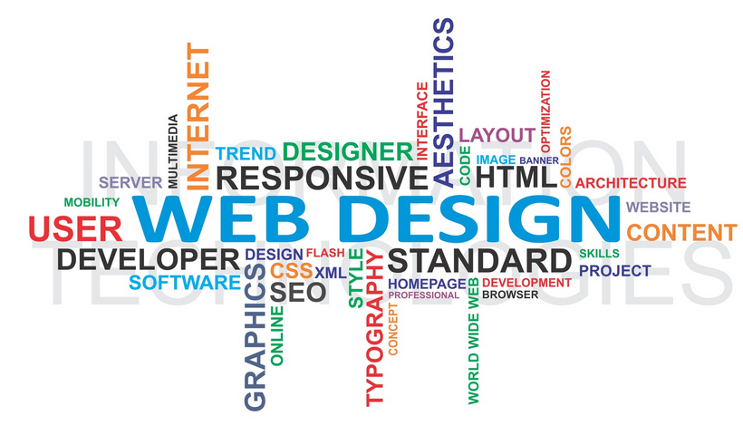
Higher Computing WDD
Web Design and Development

Slide 2










Learning Intention
To understand the process of analysing and designing a website
Success Criteria
To be able to demonstrate the ability to analyse and design a website
WDD Analysis
Lesson 1

Slide 3
WDD: Analysis
During the analysis stage of website development, the following requirements should be identified:
end user requirements
  the end users are the people who are going to be using the website
  their requirements are the tasks they expect to be able to do using the website
functional requirements
  processes and activities that the system has to perform
  information that the system has to contain to be able to carry out its functions
  The need to be accessible on any type of device / browser
These requirements will help clarify the design of the website, identify the features to be implemented on the website and evaluate whether the system is fit for purpose after development is complete.

Slide 4
Learning Intention
To understand the process of designing a website
Success Criteria
To be able to demonstrate the ability to design a website
WDD Design
Lesson 2

Slide 5
Website Design and Development: DESIGN
The design of the structure of a website is vital to ensure that users can easily find information on what could be thousands of individual pages.
Hierarchical structures, using navigational bars, allow navigation through multi-level websites to be logical and straightforward.

Slide 6
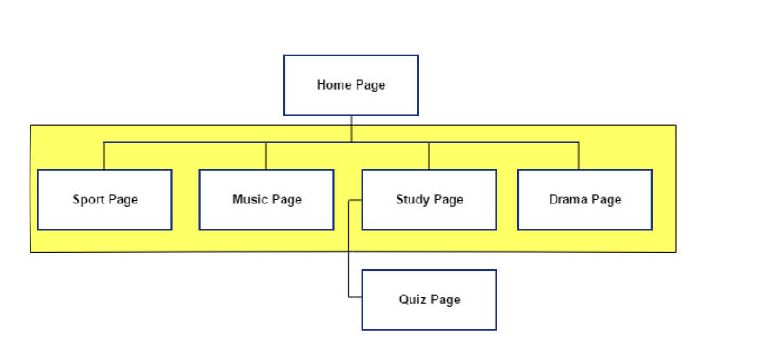
There are many design notations used to demonstrate the navigational structure.
However, the SQA will always use a shaded background to show the pages that are part of the horizontal navigational bar, which are at the top of each page in the site.
The home page naturally is included in the navigational bar.
The vertical lines show the links that are only one way, from top to bottom.
The horizontal lines show the multi-links that link them all together.

Slide 7
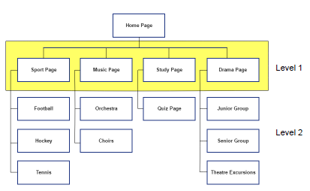
Example
SQA’s School website.
The website will have a multi-level structure, consisting of a home page with a horizontal navigation bar that gives clear links to four main areas (pages).
Each of the four main pages will have links to relevant sub-pages.
The following diagram shows the navigational structure of the proposed new school website:

Slide 8
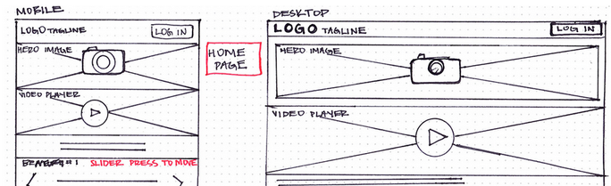
Wireframes
The user-interface planning for the school website should be illustrated using wireframes.
A separate wireframe is needed for each page on a website.
Each wireframe indicates the intended layout of the page and shows the horizontal and vertical position of:
navigational bars
all text elements on the page
any media elements (images, audio clips and video clips)
elements that allow the user to interact with the page
any form inputs
Together with intended position and type of all hyperlinks on the page.

Slide 9
This is the wireframe design for the home page of the School website.

Slide 10
Learning Intention
To understand how to implement HTML to create webpages
Success Criteria
To be able to demonstrate how CSS applies margins, padding and size
WDD – HTML Page Layout
Lesson 3

Slide 11
HTML 5 Page Layout
HTML 5 introduces new elements used to define different areas of a web page. Elements implemented at Higher level are:
<header>
<nav>
<main>
<section>
<footer>
These new elements are called semantic elements as they describe the probable content whereas the <DIV> tag gave no indication of the content

Slide 12
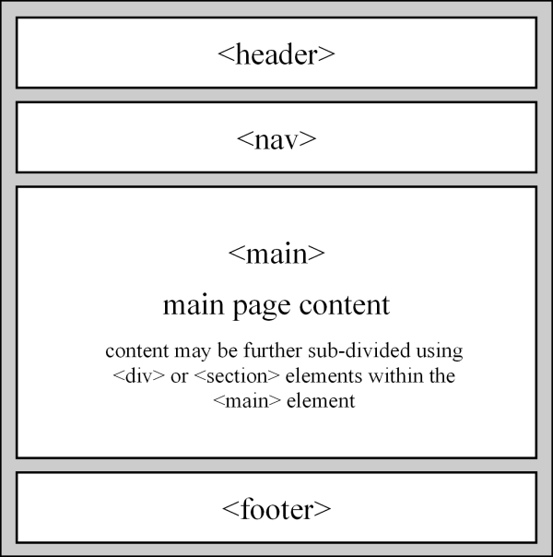
Contains the page banner, often including a title, graphic, company icon or link to the home page.
Contains the navigation bar/links.
Contains the page content: graphics, text, sound and video.
Contains general information, for example links to contact details, FAQs, copyright information or legal agreements.

Slide 13
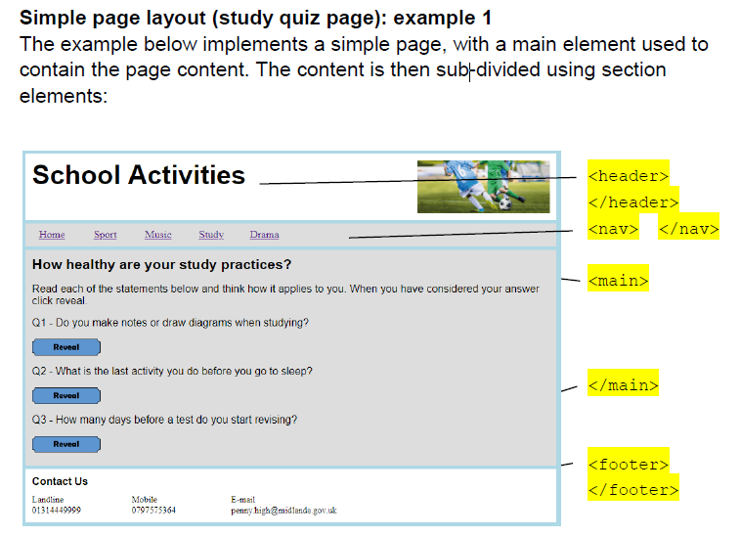

Slide 14
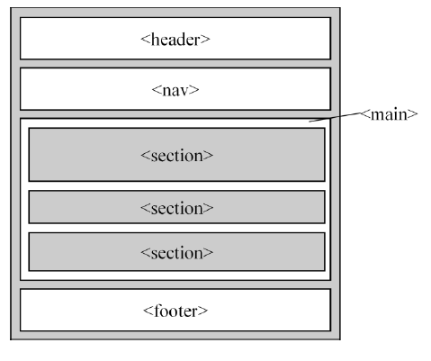
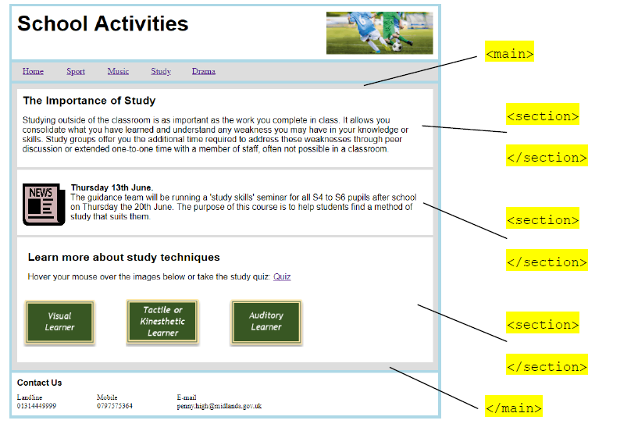
Page layout with sub-divided content (study page)
Page content can be sub-divided into different areas using both <section> and <div> elements. Using both elements allows the sub-divided content to be independently styled, without the need to implement classes or ids:

Slide 15
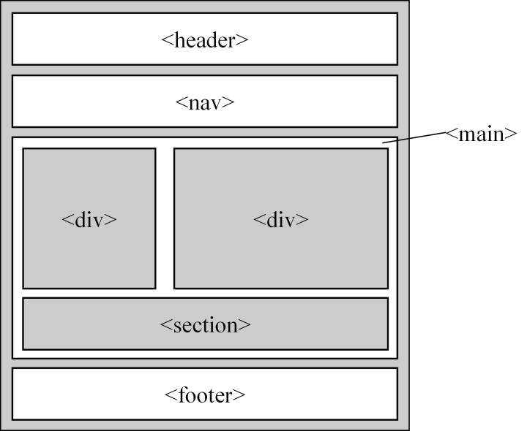
Page layout with side-by-side content (drama page):
Page content can also be styled with CSS, to position page components side-by-side.
In this example, the content has been sub-divided using three section elements, which are then controlled using float and clear CSS declarations:

Slide 16
The drama page shows the area containing the form, positioned to the right of the drama text area using CSS.
<main> — this is used to wrap around all the main content of the page. This is styled a light-grey colour:
<div> — the float left applied to the first div ensures that this area positions itself in line with the first. The margin between the two sections was created by pushing the left-hand edge of this section away from the left-hand edge of the page using margin:330px.
<div> — the first div is styled white and uses float:left and width:300px to implement position and size.
<section> — the style clear:both is use to ensure that the final section sits on a new line and does not overlap the two sections above. The outer edge of the section is not apparent as it uses styles contained within the id ‘newsArticle’ to appear the same light-grey colour as the main element.

Slide 17
Horizontal navigation bar (WDD)
The HTML 5 <nav> element is used to contain website navigation links, usually as a navigation bar. A navigation bar is declared as an unordered list of hyperlinks:
<nav>
<ul>
…
<li>hyperlink</li>
<li>hyperlink</li>
…
</ul>
</nav>
The look and feel of a navigation bar is then created using CSS declarations.

Slide 18
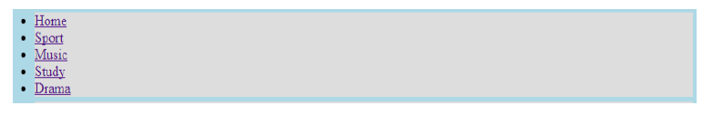
Header
Before CSS declarations are added, the list of HTML hyperlinks are displayed as a simple bullet point list:
HTML
<nav>
<ul>
<li><a href="home.html">Home</a></li>
<li><a href="sport.html">Sport</a></li>
<li><a href="music.html">Music</a></li>
<li><a href="study.html">Study</a></li>
<li><a href="drama.html">Drama</a></li>
</ul>
</nav>

Slide 19
Learning Intention
To understand how HTML use forms
Success Criteria
To be able to demonstrate how html uses forms
WDD - HTML Forms
Lesson 4

Slide 20
HTML — Forms (WDD)
The HTML <form> element defines a form that is used to collect user input:
<form>
.
form elements
.
</form>

Slide 21
HTML 5 can be used to create and perform client-side validation on forms, without the need for JavaScript.
Form elements implemented at Higher level are:
Input
  text
  number
  textarea
  radio
  submit
Select
Where appropriate, form inputs will be validated using length, presence and range checks.

Slide 23
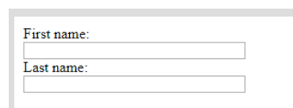
Input: text
The example below implements two text input boxes, including length and presence checks:
<form>
First name:<br>
<input type="text" name="firstname" size="30" maxlength="15" required><br>
Last name:<br>
<input type="text" name="lastname" size="30" maxlength="15" required>
</form>

Slide 24
<form>
First name:<br>
<input type="text" name="firstname" size="30" maxlength="15" required><br>
Last name:<br>
<input type="text" name="lastname" size="30" maxlength="15" required>
</form>
type="text" Identifies input type of the form element as text.
name="firstname" The name attribute is required when a form’s data is submitted to a server for processing. Although submitting a form to a server is not required until Advanced Higher, it is good practice to include the name attribute in all form elements.
size="30" Width of the input box, in characters, when displayed in a browser.
maxlength="15" Length check limiting input to 15 characters.
Required - A presence check is applied to the input.

Slide 25

Number input may be limited to a minimum value, maximum value or both:
Number of Tickets Required (between 1 and 3):
<input type="number" name="tickets" min="1" max="3">
The above code includes the following:
type="number" Identifies input type of the form element as numeric.
min="1" max="3" A range check to ensure values entered are >=1 and <=3.

Slide 26
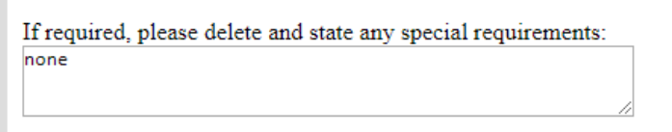
Input: textarea
A larger text box, for use with extended text input, can be implemented using the textarea form element:
If required, please delete and state any special requirements:
<textarea name="message" rows="3" cols="55"> </textarea>
The width and height of the textarea element is set using rows and columns.
If required, a length and presence check can be applied to the above input element.

Slide 27

Input: radio buttons
Radio input can be implemented using multiple input elements of type radio:
Choose your age:<br>
<input type="radio" name="age" value="12 to 14"> 12-14
<br>
<input type="radio" name="age" value="15 or 16"> 15,16
<br>
<input type="radio" name="age" value="17 or over"> over 16
When submitted, the above form would return the name attribute “age” along with one of the listed values: 12 to 14, 15 or 16, 17 or over.
Although Higher forms are not submitted to a server, it is good practice to include both the name and value attributes.
If the <br> elements are omitted from the form, the radio buttons align horizontally.

Slide 28
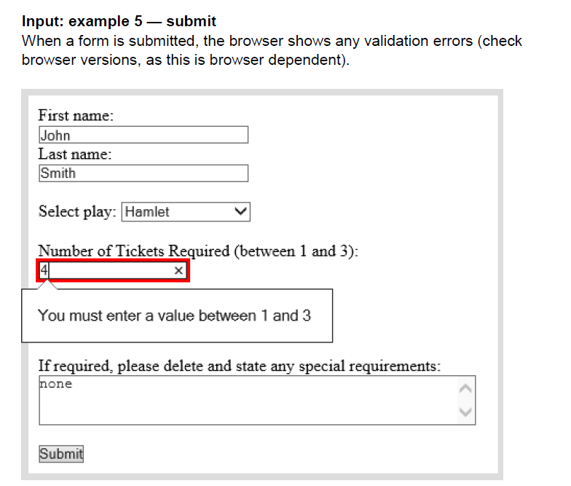

Slide 29
Learning Intention
To understand how HTML use forms
Success Criteria
To be able to demonstrate how html uses forms
WDD - HTML Forms (PT 2)
Lesson 5

Slide 30
Button (onClick)
To allow candidates visual acknowledgement that an action is performed when the submit button is clicked, a JavaScript onclick event can be applied to the button as shown below:
<input type="submit" onclick="alert('Form Entered')" value="Submit">
Visual acknowledgement that the form is submitted can be helpful to candidates who are not yet experiencing a response generated by server-side processing.

Slide 31
Select: drop-down menu
The select element is used to create a list of possible inputs in the form of a drop-down menu. Input choices are placed inside option elements:
Select play:
<select name="play">
<option value="hamlet">Hamlet</option>
<option value="godot">Waiting for Godot</option>
<option value="brothers">Blood Brothers</option>
<option value="curious">Curious Incident</option>
</select>
As previously stated, the name and value attributes are not required at Higher, but it is good practice to include both.

Slide 32
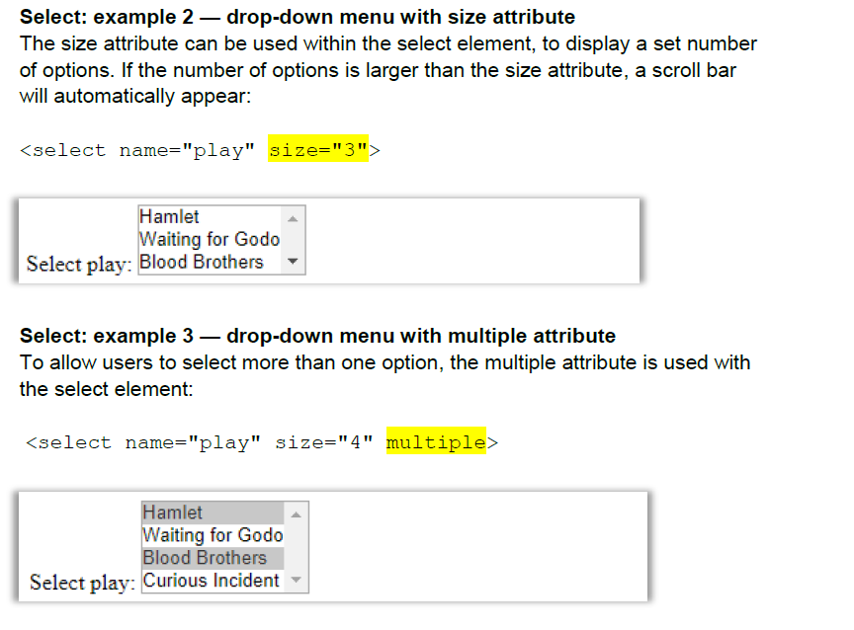

Slide 33
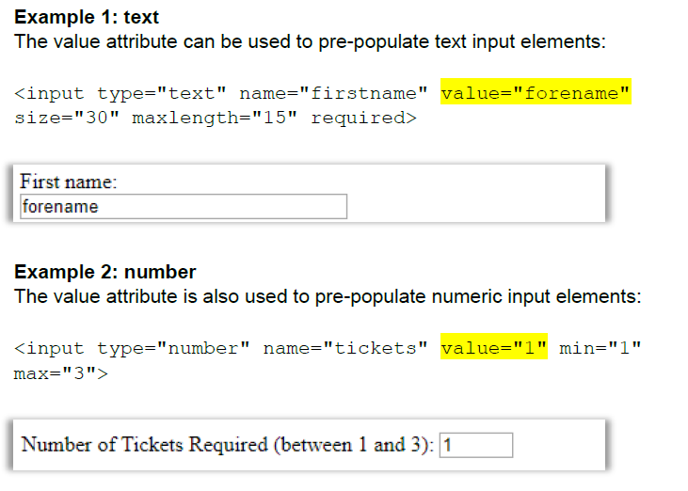

Slide 34
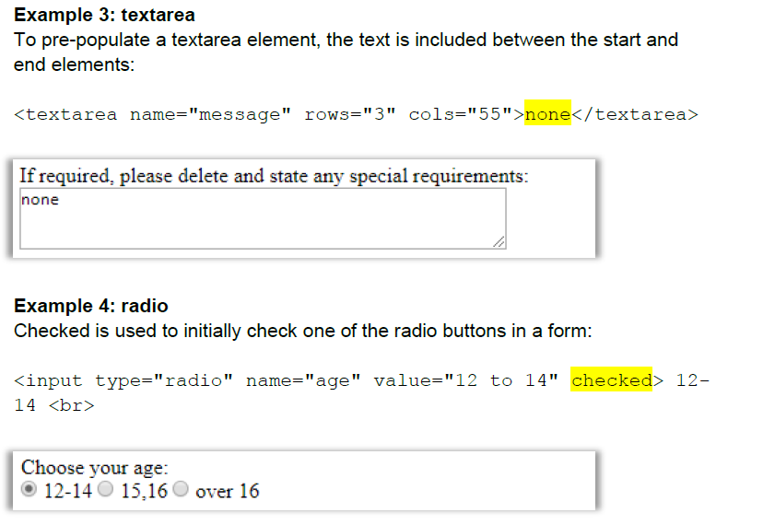

Slide 35
Learning Intention
To understand how HTML use ID Attributes
Success Criteria
To be able to demonstrate how html uses forms
WDD - ID Attribute
Lesson 6

Slide 36
ID Attribute
The ID Attribute specifies a unique id for a HTML element (the value must be unique within the HTML document).
The ID Attribute is most used to point to a style in a style sheet, and by JavaScript to manipulate the element with the specific id.

Slide 37
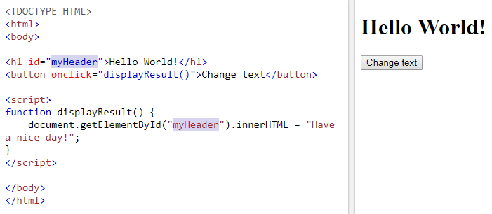
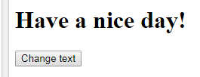
ID Attribute: Example

Slide 38
Learning Intention
To understand how CSS applies margins
Success Criteria
To be able to demonstrate how CSS applies margins
WDD CSS
Lesson 7

Slide 39
Cascading Style Sheets (CSS)
Controlling Appearance and Positioning
The following CSS declarations control the appearance and position of HTML page elements:
margins/padding
display — block, inline, none
float — left, right
clear — both
sizes — height, width

Slide 40
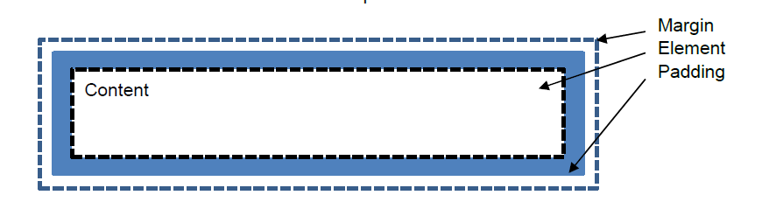
The box model
Margins and padding are used to push content away from the outer and inner edge of elements.
The box model allows us to define the space between elements.
Margin: declares a transparent area around the outside of an element. This pushes the element away from other adjacent elements.
Padding: declares a transparent area inside the edge of the element. This pushes content in from the edge of the element.

Slide 41
Universal selector
Browsers use default settings for margins and padding when displaying HTML elements.
To override these defaults, a universal selector (*) can be used at the top of a stylesheet to set the margin and padding of every element to 0.
{margin:0;padding:0}
Using the universal selector means you only see the margins and paddings that you actually code.

Slide 42
Margins can be declared as:
margin
margin-top
margin-bottom
margin-left
margin-right
These properties may have the values:
auto (calculated by the browser)
length (usually in pixels)
NOTE: Margins can be declared on all four sides of an element simultaneously using the abbreviation: margin:10px .

Slide 43
NOTE: Margins can be declared on all four sides of an element simultaneously using the abbreviation: margin:10px .
10px
10px
10px
10px

Slide 44
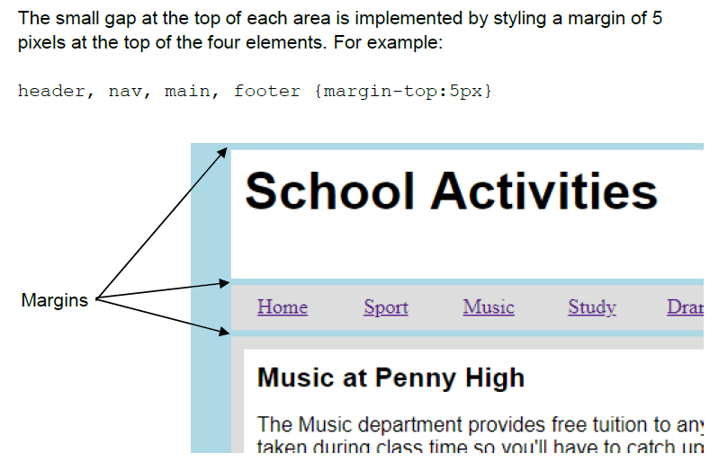

Slide 45
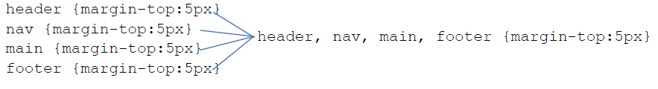
Grouping selectors using commas reduces the amount of code required and is more efficient than writing each CSS declaration separately.
Separate declarations Grouped declaration

Slide 46

Auto margins are used to position an element in the middle of the browser’s window or within another element.
In the example website, the 800 pixel wide page <body> element is always positioned in the middle of the window:
body{margin:auto}

Slide 47
Learning Intention
To understand how CSS applies padding and size
Success Criteria
To be able to demonstrate how CSS applies margins, padding and size
WDD CSS
Lesson 8

Slide 48
Padding can be declared as:
padding
padding-top
padding-bottom
padding-left
padding-right
These properties may have the value:
length (pixels or %)

Slide 49
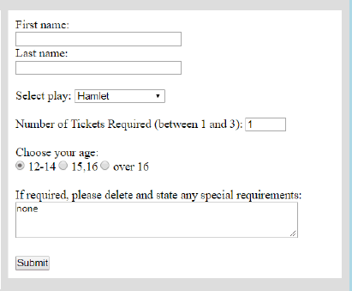
Padding can be declared on all four sides of an element simultaneously using the abbreviation: padding:10px
White space around page content, aids the usability of a web page. Appropriate use of white space can also aid readability of text.
Using padding to move content in from the edge of an element is one method to generate white space.

Slide 50
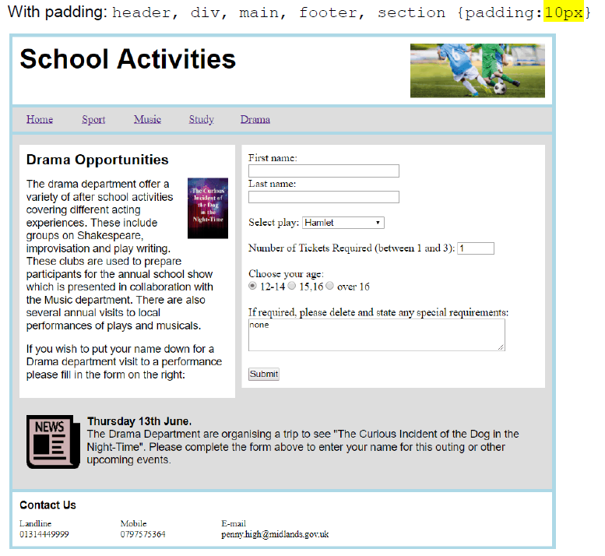
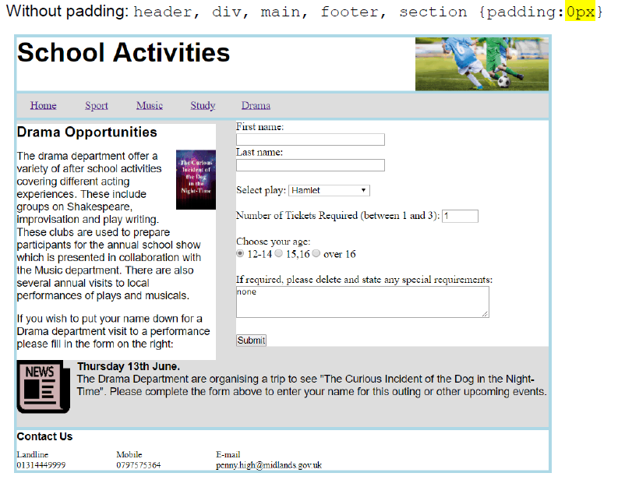

Slide 51
Sizes — height/width (all pages)
Web page design and implementation involves creating areas that either have a fixed size or change size with content or display (changing window size or resolution).
For example in a website, the <body> of each web page may be set to a fixed width of 800px:
body{width:800px}

Slide 52
Sizes — height/width (all pages)
The height of the <header>, <nav> and <footer> elements can be set to a fixed size, remaining constant throughout the website ensuring consistency:
header {height:80px}
footer {height:60px}
nav {height:35px}
NOTE: The <main> element, which holds content of the pages, is not declared as a fixed size, as it changes according to the differing amount of content on each page.

Slide 53
Learning Intention
To understand how CSS applies float and display (block, inline, none)
Success Criteria
To be able to demonstrate how CSS applies float and display (block, inline, none)
WDD CSS
Lesson 9

Slide 54
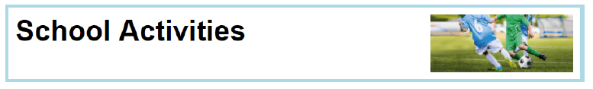
Float — left/right (all pages)
An element can be positioned on the left or right of its container, using the float property.
In the example below, the <img> element has been positioned on the right of its container, the <header> element:
HTML
<header>
<h1>School Activities</h1>
<img class="imageBanner" src="../images/activitiesBanner.jpg">
</header>
CSS
.imageBanner {width:200px;height:80px;float:right}

Slide 55
Float can also be used to word-wrap text around an image, as demonstrated in the drama page below.
The addition of margins creates white space between the graphic and the text.

Slide 56

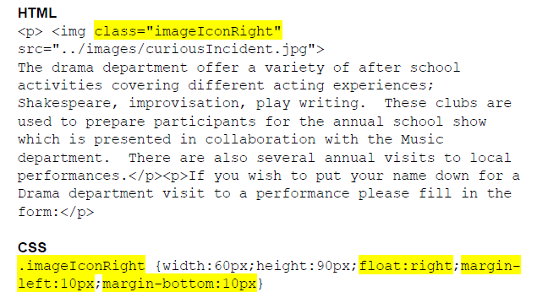
clear:both makes the element drop below any floated elements that precede it in the document.

Slide 57
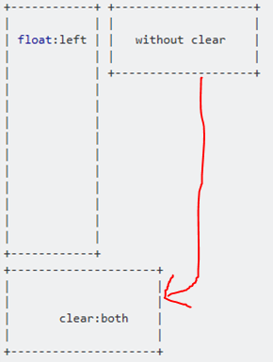
Clear
The effect of floating elements continues until cancelled, using the clear property on a subsequent element.
To ensure that the main page elements <header>, <nav>, <main> and <footer> start a new line and remain unaffected by any float properties applied elsewhere in a page, clear:both is implemented for these elements.
header, nav, main, footer {display:block;clear:both}
clear:both makes the element drop below any floated elements that precede it in the document.
NOTE: You can use clear:left and clear:right individually if required!

Slide 58
Display — block/inline/none
HTML elements have default display values depending on the type of element.
This value specifies how or if an element is to be displayed.
The default display value for most elements is block or inline:
display:block — an element takes up the entire width of its container
display:inline — an element takes up only as much room as necessary
display:none — the element is not visible. The space where the element should be collapses as if there was no content in that place.

Slide 59

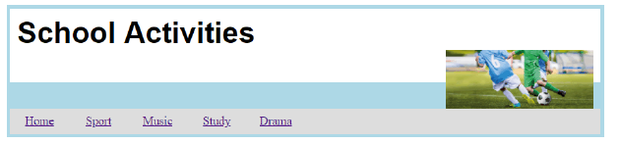
In the <header> element of the example below, the <h1> heading uses display:inline.
This allows the image to be floated level with the heading.
If the <h1> element used display:block it would force the image to float on a new line.

Slide 60
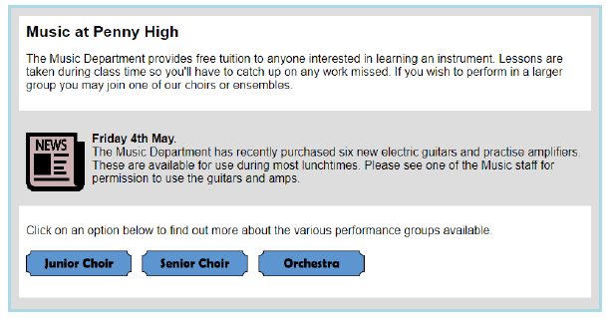
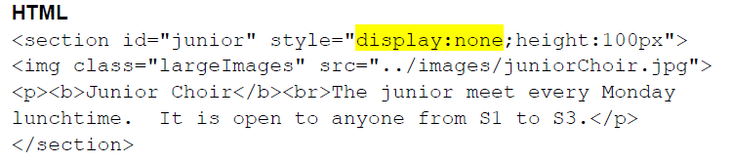
In the music page, display:none is used to hide three <section> elements – The Junior Choir section, The Senior Choir Section and the Orchestra section, when the page loads.

Slide 61
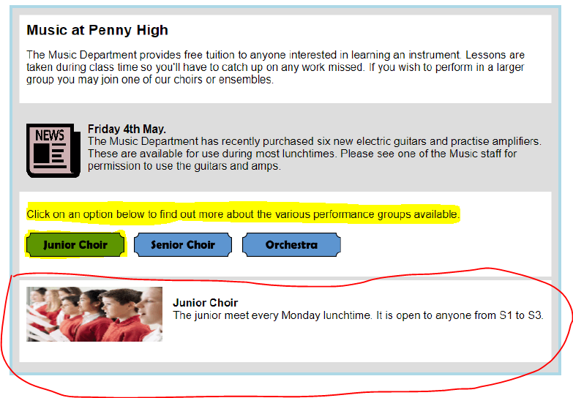
The Junior Choir section is revealed when the ‘Junior Choir’ image on the page is clicked.
This is achieved using a JavaScript onclick event to change the display property of the <section> to block.

Slide 62
Learning Intention
To understand how CSS applies styles to NAV links
Success Criteria
To be able to demonstrate how CSS styles to NAV links
WDD CSS
Lesson 10

Slide 63
List of hyperlinks before and after CSS declarations
The addition of CSS declarations alter the position, look and behaviour of the list to create a navigation bar.
CSS
nav ul {list-style-type:none;}
nav ul li {float:left;width:80px;text-align:center}
nav ul li a {display:block;padding:8px}
nav ul li a:hover {background-color:#000;color:White}

Slide 64
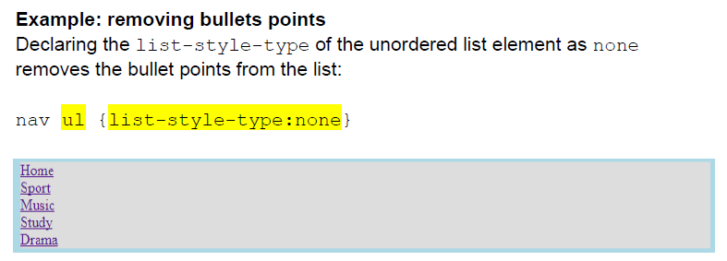
nav ul {list-style-type:none;}
nav ul li {float:left;width:80px;text-align:center}
nav ul li a {display:block;padding:8px}
nav ul li a:hover {background-color:#000;color:White}

Slide 65
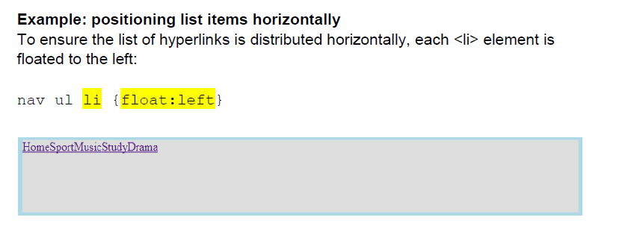
nav ul {list-style-type:none;}
nav ul li {float:left;width:80px;text-align:center}
nav ul li a {display:block;padding:8px}
nav ul li a:hover {background-color:#000;color:White}

Slide 66
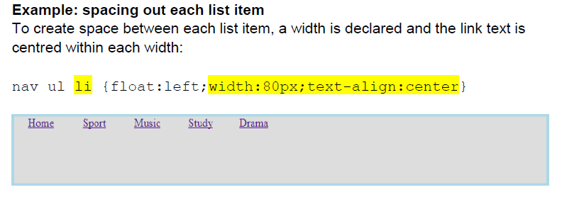
nav ul {list-style-type:none;}
nav ul li {float:left;width:80px;text-align:center}
nav ul li a {display:block;padding:8px}
nav ul li a:hover {background-color:#000;color:White}

Slide 67
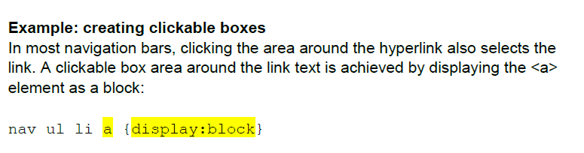
nav ul {list-style-type:none;}
nav ul li {float:left;width:80px;text-align:center}
nav ul li a {display:block;padding:8px}
nav ul li a:hover {background-color:#000;color:White}

Slide 68
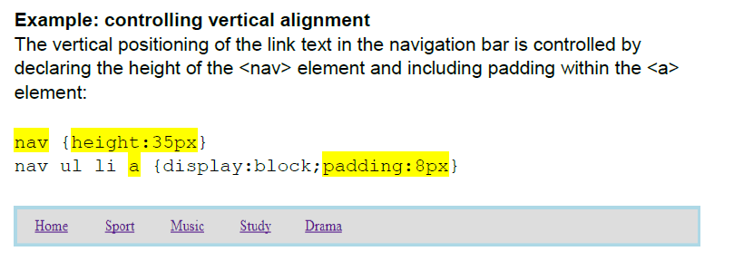
nav ul {list-style-type:none;}
nav ul li {float:left;width:80px;text-align:center}
nav {height:35px}
nav ul li a {display:block;padding:8px}
nav ul li a:hover {background-color:#000;color:White}

Slide 69
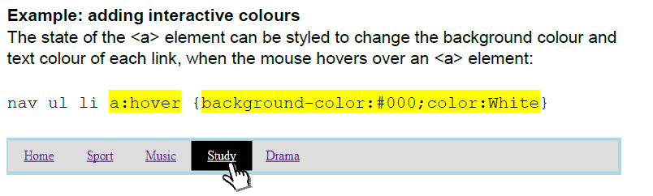
nav ul {list-style-type:none;}
nav ul li {float:left;width:80px;text-align:center}
nav {height:35px}
nav ul li a {display:block;padding:8px}
nav ul li a:hover {background-color:#000;color:White}

Slide 70
Learning Intention
To understand javascript interaction – OnMouseOver & OnMouseOut
Success Criteria
To be able to demonstrate javascript interaction
WDD Javascript
Lesson 11

Slide 71
JavaScript (WDD)
JavaScript events onmouseover, onmouseout and onclick are used to implement interactive web content.
Events are placed within HTML elements as shown below:
<img onmouseover=“ “>
The inverted commas contain the action to be executed when the event takes place.

Slide 72
Possible actions include:
hiding page elements
revealing page elements
changing the position of an element
changing the size of an element
changing the colour of an element
changing the look of text
Actions can be executed by:
referring to the element containing the JavaScript event
referring to a different element, identified by an id
calling a JavaScript function containing the actions

Slide 73
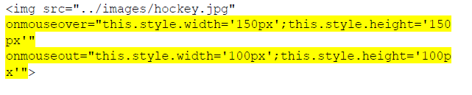
Interactively changing the size of a graphic (example 1)
Inline JavaScript can be used to increase and decrease the size of a graphic, as a mouse pointer passes over and out of a graphic.
This example contains two events, onmouseover, onmouseout used to execute four actions:
width='150px' height='150px' width='100px' height='100px'

Slide 74
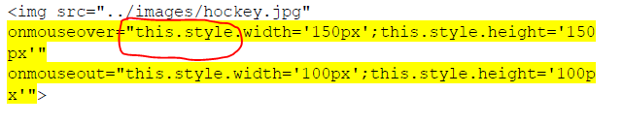
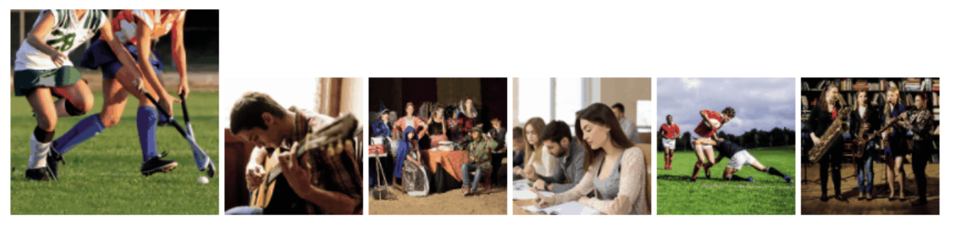
Each action in a JavaScript statement is separated by a semi-colon.
Each action in the above events are prefixed by this.style.
this meaning this element. In example 1 this refers to the graphic (img) element containing the event.
style the style of this element will be altered using a CSS declaration

Slide 75
Interactively changing the size of a graphic example 2
JavaScript functions may be called to increase and decrease the size of a graphic, as a mouse pointer passes over and out of a graphic.
<img src="../images/guitar.jpg" onmouseover="displayLarger(this)" onmouseout="displaySmaller(this)">
The JavaScript functions above are passed the parameter this, referring to the element containing the event displayLarger(this)

Slide 76

The JavaScript functions are placed within a <script> element in the <head> section of the HTML document:
<script>
function displayLarger(my_image)
{my_image.style.width='150px';
my_image.style.height='150px';}
function displaySmaller(my_image)
{my_image.style.width='100px';
my_image.style.height='100px';}
</script>
The parameter is used by each function to implement the same actions as example 1 i.e “this” – “my_image” refers to the current im age the mouse pointer is interacting with.

Slide 77
Implementing example 2 as a function, allows the same code to be called from multiple events:
<img src="../images/drama.jpg" onmouseover="displayLarger(this)" onmouseout="displaySmaller(this)">
<img src="../images/study.jpg" onmouseover="displayLarger(this)" onmouseout="displaySmaller(this)">
<img src="../images/rugby.jpg" onmouseover="displayLarger(this)" onmouseout="displaySmaller(this)">
This reduces the amount of code in the page
Reuses code which is more efficient

Slide 78
Learning Intention
To understand javascript interaction – OnMouseOver & OnMouseOut
Success Criteria
To be able to demonstrate javascript interaction
WDD Javascript
Lesson 12

Slide 79
Creating a rollover image (sports page): example 1
Rollover images can be created using two JavaScript events.
The first event (onmouseover) displays an alternate graphic when the mouse passes over the image element.
The second event (onmouseout) displays the original graphic when the mouse pointer leaves the image

Slide 80
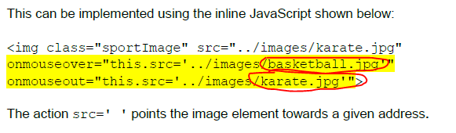
The following is the view in browser when the mouse pointer is not over any image:
The following is the view in browser when mouse passes over the right-hand image:

Slide 81
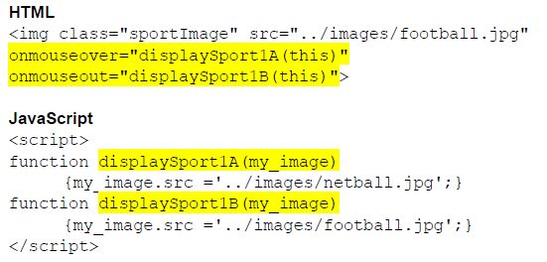
Creating a rollover image (sports page): example 2
A rollover image can also be achieved using two functions.
The first function is called using onmouseover.
The second is called using onmouseout.
Each function is passed the img element as a parameter using this.
As before each function changes the src of the image:

Slide 82

Highlighting text by dynamically changing its colour
Text may be highlighted by changing its style when the mouse pointer passes over the element containing the text.
The example below highlights a paragraph element dark red, by using an onmouseover event:

Slide 83
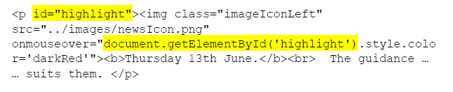
Highlighting text by dynamically changing its colour (study page):
To implement an action on a different page element, an id is required to identify the element the action will be performed on.
An element is identified using document.getElementById(' ')
The example below highlights the paragraph text when the mouse passes over the image contained in the paragraph:

Slide 84
Learning Intention
To understand javascript interaction - OnClick
Success Criteria
To be able to demonstrate javascript interaction
WDD Javascript
Lesson 13

Slide 85
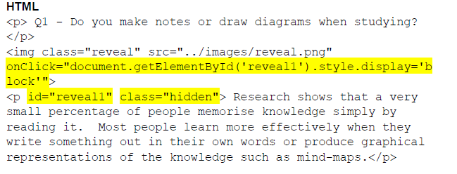
Revealing an element using onclick (study quiz page):
When a web page loads, elements may be initially hidden by applying the CSS declaration display:none.
This can be implemented using an inline or internal style, or by implementing an external style (using a class, as shown below):
CSS
.hidden{display:none}
The graphic element in the example (reveal.png) contains an onclick event that uses the paragraph element’s id to execute the action ‘display=block’ on the paragraph.
The result of this action is that the paragraph becomes visible on the page.

Slide 86
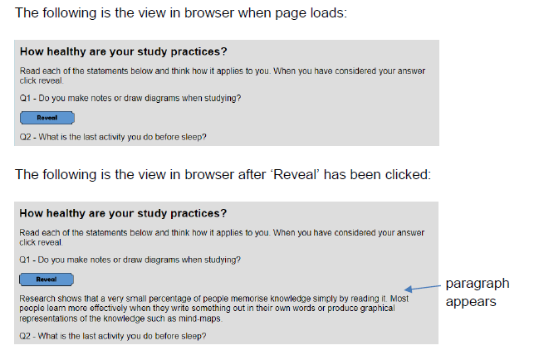

Slide 87
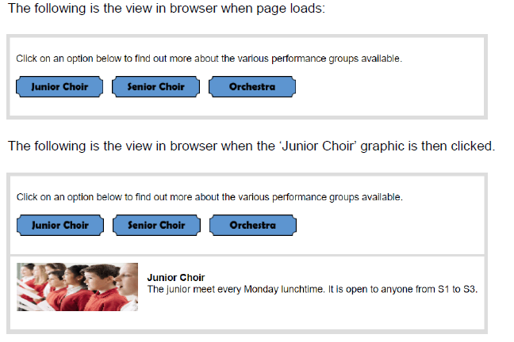
Revealing one of multiple hidden elements using onclick
Image elements, with associated onclick events, can be used to offer users a choice of what they view on a web page.
Each onclick event is used to reveal a hidden <section> element containing a graphic and text relating to each option.

Slide 88
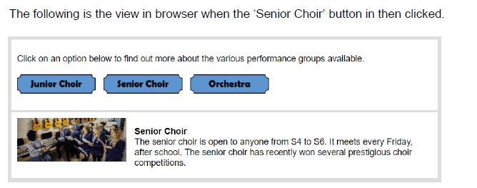
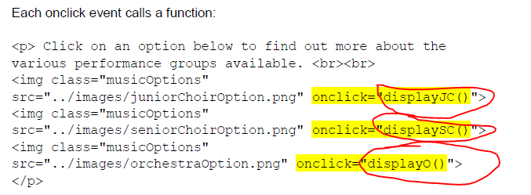

Slide 89
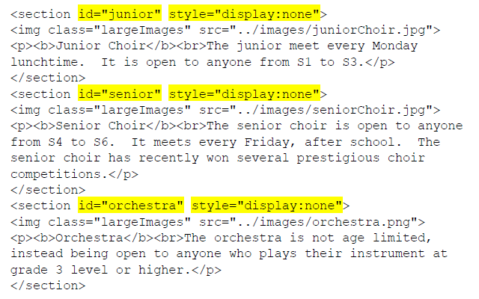
The three section elements, containing the graphic and text to be revealed, are each identified by an id and initially hidden using display:none.

Slide 90
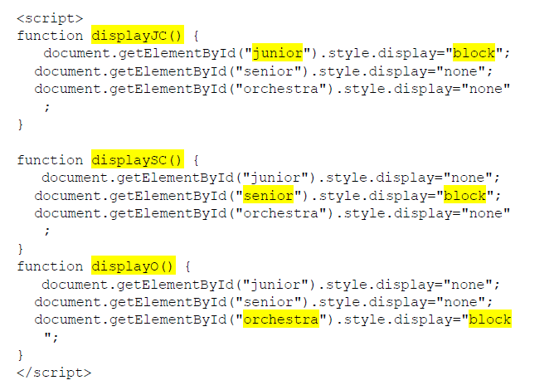
Each of the three JavaScript functions called by the onclick event reveals one of the three <section> elements and hides the other two using three style.display actions:

Slide 91
Learning Intention
To understand usability testing
Success Criteria
To be able to demonstrate usability testing
WDD Usability Testing Lesson 14

Slide 92
Testing (WDD) Usability testing
Usability testing involves systematic observation to determine how well people can use a product.
The goal with usability testing is to recreate real-world scenarios where the tester will actually be able to use your product.
Then, by observing their behaviour, you will be able to understand what could be done better.
Using Low-Fidelity Prototyping helps to eliminate design problems at an early stage, before money has been spent implementing the design.

Slide 93
The testers may be given:
a persona — this may relate to the age or experience that the tester should exhibit
test cases — a set of actions executed to verify a particular feature or function of the website
scenarios — they may be asked to use the website to place an order or book flights

Slide 94
The testers use the low-fidelity prototypes under a variety of conditions, while they are observed.
The observers make notes about any difficulties that the testers experienced and what alterations are required to the website design to make it easier to use the website.

Slide 95

Testing websites
There are a number of tests you should carry out on your website to ensure that it meets the functional requirements.
Input validation:
— Check that every field in a form has the correct validation by trying to get every field on the form to accept incorrect data.

Slide 96
Testing websites
Links and navigation:
— Test the navigational bar links take you to the correct pages
— Test all external links work correctly
— Test that all pages can get back to the home page
— Test all internal links work correctly
— Test to check if there are any orphan pages (pages that are not linked to any others)
Media content:
— Ensure that the text, graphics and video display correctly and in the position in which it was designed to appear.

Slide 97
Compatibility testing
This is when you test your website to ensure that it works in the same way across a range of platforms. Types of compatibility testing include:
Browser testing
It is important that your website will work on all the main browsers, for example Chrome, Firefox, Internet Explorer, Safari, and Opera.
Your customers will not use your website if it does not function properly on their chosen browser.
Device type
You should check that your website is accessible on tablets, smartphones and desktop computers, as there are so many different types of hardware with different size screens available.

Slide 98
Common compatibility testing exposes the following types of problem:
changes in font size
changes in the user interface
alignment issues
changes in CSS style and colour
scroll bar related issues
content or label overlapping
broken tables or frames

