Slide 1
Higher Revision
Traffic Light Revision using Mandatory Content

Slide 2
Watch Points
You can use a watchpoint to stop execution whenever the value of an expression changes.
Without having to predict a particular place where this may happen. (This is sometimes called a data breakpoint.)
The expression may be as simple as the value of a single variable, or as complex as many variables combined by operators.

Slide 3
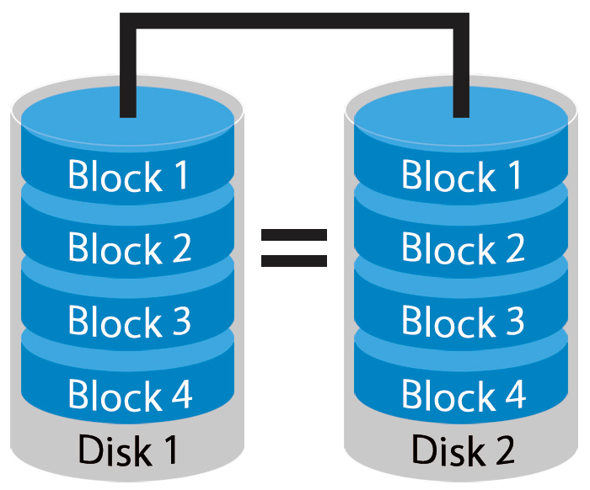
Mirroring (RAID)
Disk mirroring is the replication of logical disk volumes onto separate physical hard disks in real time to ensure continuous availability.
It is most commonly used in RAID 1.

Slide 4
Media Compression
Perceptual Coding – Lossy, elemen
Free lossless audio codec – Lossless, zipping WAV
LZW encoding – Lossless,
DCT encoding -
Interframe/intraframe

Slide 5
Mantissa/Exponent
Mantissa & Exponent in reference to the number of bits used and the effect it has on the other.
3.14
Mantissa
Exponent
1 0011 1010
314
-2
1111 1110
314 * 10⁻²

Slide 6
Precision/Range
Changing the number of bits to represent the mantissa and exponent has the following effects:
Mantissa = Increasing the number of bits for the mantissa will increase the accuracy of the number but decrease the number of bits for the exponent and therefore decrease the range of numbers.
Exponent = Increasing the number of bits for the exponent will increase the range of the numbers but decrease the number of bits for the mantissa and therefore decrease the accuracy of number.
1 | 1 | 1 | 1 | 1 | 1 | 1 | 1 | 1 | 1

Slide 7
Precision/Range
Mantissa = 4 bits
Max Number = 15
Exponent= 4 bits
Max Number = 15
1 | 1 | 1 | 1 | 1 | 1 | 1 | 1
15 * 10¹⁵ = 15 000 000 000 000 000
Mantissa = 7 bits
Max Number = 127
Exponent= 4 bits
Max Number = 31
1 | 1 | 1 | 1 | 1 | 1 | 1 | 1
127 * 10¹ = 1270
Mantissa = 1 bits
Max Number = 1
Exponent= 7 bits
Max Number = 127
1 * 10¹²⁷ = 1 000 000 000 000 000 000 000 000 000 000 000 000 000 000 000 000 000 000 000 000 000 000 000 000 000 000 000 000 000 000 000 000 000 000 000 000 000 000 000 000
1 | 1 | 1 | 1 | 1 | 1 | 1 | 1

Slide 8
Storage Calculations
Audio
File Size = (Sampling Frequency * Sampling Bit Depth) * Length * channels
Video
File Size = (Resolution * bit depth) * Frames per second * length

Slide 9
Offline Storage
Benefits
Always available as no internet connection needed. Eg. USB memory stick.
While offline, data will be more secure as no external access can be made to modify or copy the data.
Data is safe from virus infection.

Slide 10

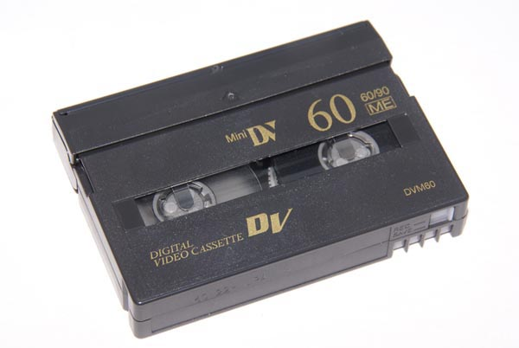
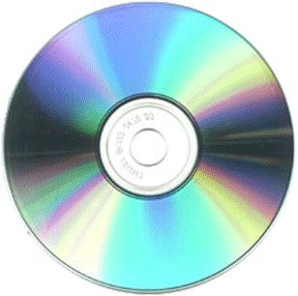
Media storage
DAT (Digital Audio Tape) & DLT (Digital Linear Tape)
Linear storage used for archiving. Computer must read every file in order before retrieving the desired file. DLT generally stores more data.
Optical (CD, DVD, Blu-Ray, R, RW, ROM)
Random access, portable data, tracks made by laser, read by laser. Recordable, re-writable)

Slide 11
Transmission Media
Wired – Ethernet, fibre optic, coaxial, twisted pair. Very fast data transfer speeds. However limited to length of cable, must be built into walls, flooring and under roads (even across ocean floor).
Wireless – IR, bluetooth, wifi, 3G/4G. Radio signals of different strengths and therefore different distances. No need to dig up roads or drill through walls for cables. However lower speeds than wired.

Slide 12


Digital Certificates
Certificate Authority CA
2. Identification Information
2. Identification Information
3. Content including Signed certificate and Key Pair
1. Content Request
4. Content including Signed certificate and Public Key
Content User
(YOU)
Content Owner (Amazon)

