Slide 1
Revision
Part 10
Q46 to Q50 of National 5 Prelim

Slide 2
Revision Part 10
46 | State 3 design notations used in software development. | 3
47 | State the design notation used to create a user interface. | 1
48 | Explain an advantage for using a flow chart. | 1
49 | A program is needed to enter 20 pupils names and exam marks, what type of loop should be used. | 1
50 | Identify another type of loop used in software development. | 1

Slide 3
Revision Part 10
46. State 3 design notations used in software development. (3)
Pseudocode
Structured Diagram
Flow Chart

Slide 4
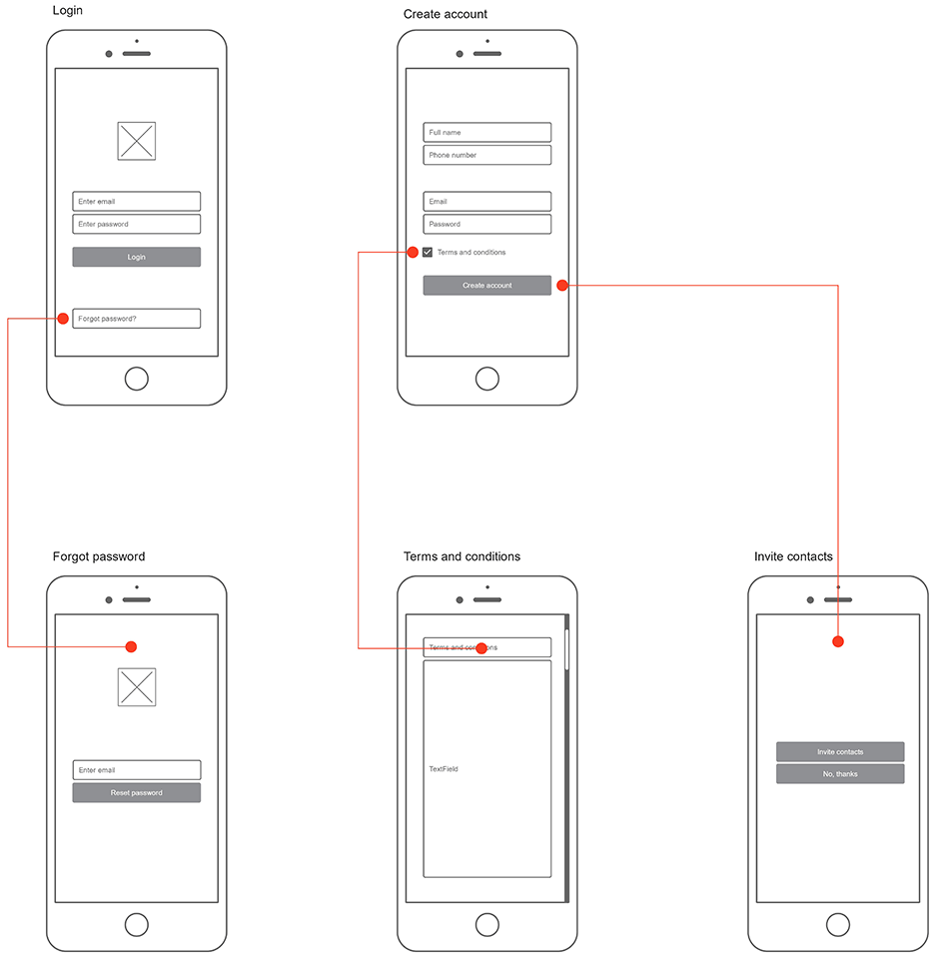
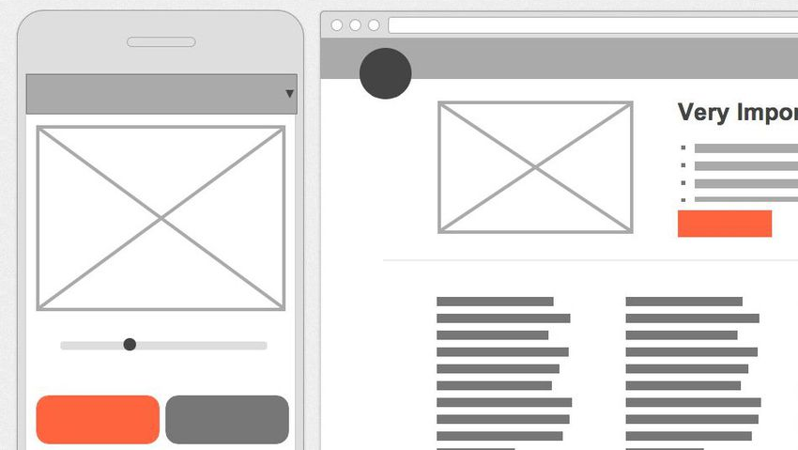
Revision Part 10
47. State the design notation used to create a user interface. (1)
Wireframing

Slide 5
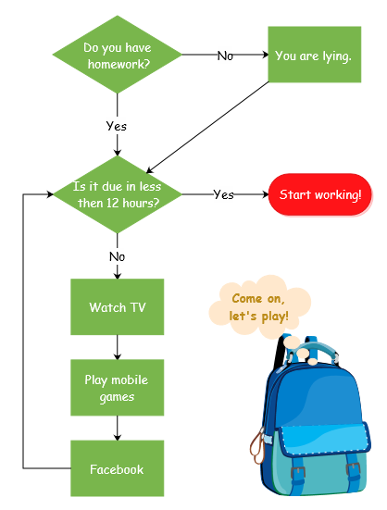
Revision Part 10
48. Explain an advantage for using a flow chart. (1)
It allows you to easily see the
flow of a program, especially
selection constructs and loops.

Slide 6
Revision Part 10
49. A program is needed to enter 20 pupils names and exam marks, what type of loop should be used. (1)
Fixed Loop

Slide 7
Revision Part 10
50. Identify another type of loop used in software development. (1)
Conditional

