Slide 1
Revision
Part 4
Q16 to Q20 of National 5 Prelim

Slide 2
Revision Part 4
16 | Explain what you could do to send an attachment which is over the file size limit. | 1
17 | Explain the advantage to mobile users if you compress the images and videos found on your website. | 2
18 | State 3 guidelines to increase your programs code’s maintainability. | 3
19 | Describe the term “Low Fidelity Prototyping”. | 1
20 | Describe the advantage a relational database has over a flat file database. | 1

Slide 3
Revision Part 4
16. Explain what you could do to send an attachment which is over the file size limit. (1)
You could compress the file so it could be sent. The compressed file should be small enough to be under the email attachment limit.

Slide 4
Revision Part 4
17. Explain the advantage to mobile users if you compress the images and videos found on your website. (2)
Compression should make the images and videos a smaller file size which will mean:
Less data to load saving the mobile user’s data allowance.
Less data to load reducing the wait time for the page to load.

Slide 5
Revision Part 4
18. State 3 guidelines to increase your programs code’s maintainability. (3)
Internal commentary.
Meaningful identifiers.
White spacing/indentation.

Slide 6
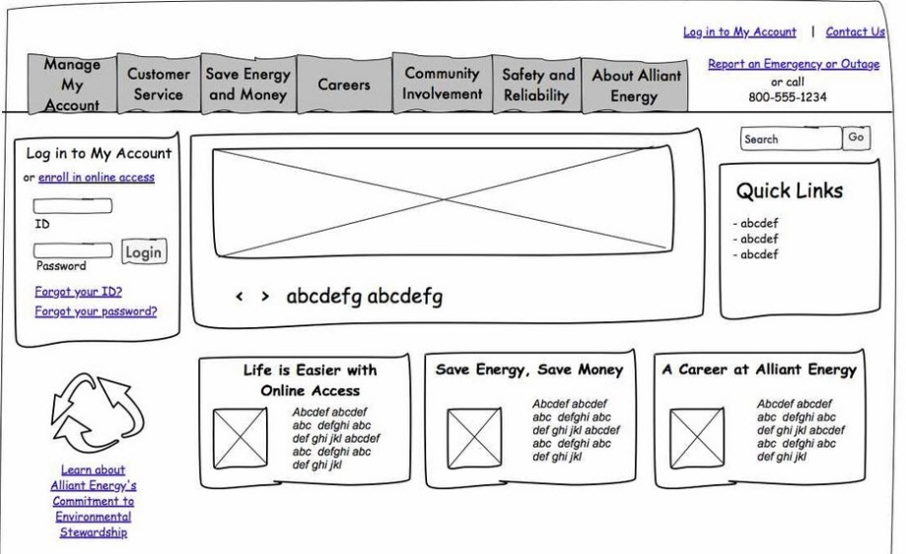
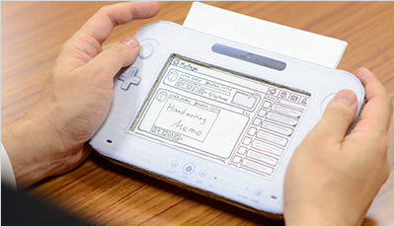
Revision Part 4
19. Describe the term “Low Fidelity Prototyping”. (1)
Low-fidelity prototype is a prototype that is sketchy and incomplete.
Should include some characteristics of the final product shown in a basic form.

Slide 7
Revision Part 4
20. Describe the advantage a relational database has over a flat file database. (1)
No Duplicated Data as the table have been linked and will have relationship between the tables (one to many).

