Slide 1
Revision
Part 5
Q21 to Q25 of National 5 Prelim

Slide 2
Revision Part 5
21 | Describe relative and absolute addressing. | 2
22 | State the name of 3 objects found in vector graphics. | 3
23 | Describe how one of these objects is stored in an image, mention at least 2 key aspects. | 2
24 | Identify an advantage a Vector graphic has over a bitmap graphic. | 1
25 | Describe two tests you could carry out when testing your information system. | 2

Slide 3
Revision Part 5
21. Describe relative and absolute addressing. (2)
Relative – a link to a file/page within the same file system/website.
Eg: /images/picture.jpg or index.html
Absolute - a link to a file/page outside the current file system/website.
Eg: www.bbc.co.uk/home

Slide 4
Revision Part 5
22. State the name of four objects found in vector graphics. (4)
Line
Rectangle
Ellipse
Polygon

Slide 5
Revision Part 5
23. Describe how one of these shapes is stored in an image, mention at least 2 key aspects. (2)
Objects stored using its attributes:
x,y coordinates
Layer level
Line thickness
Line colour
Fill colour
And so on…

Slide 6
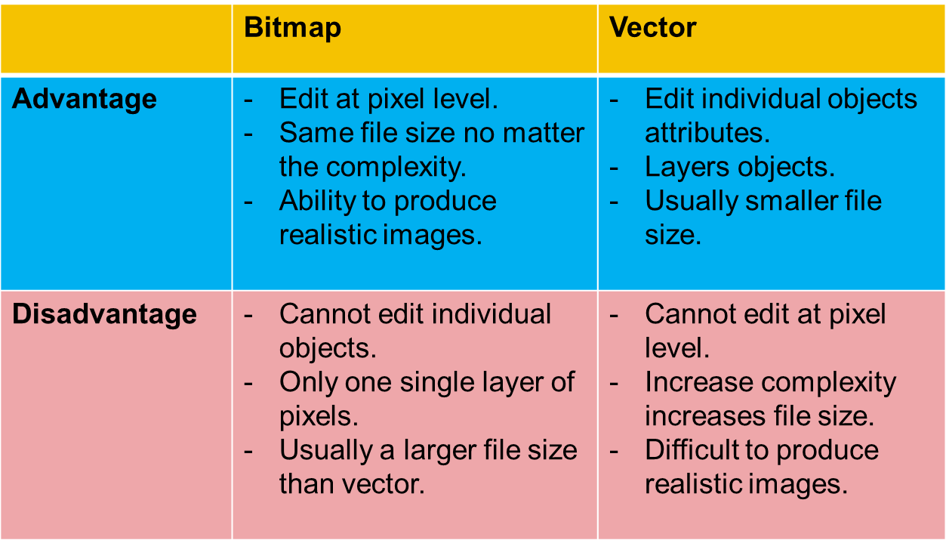
Revision Part 5
24. Identify an advantage a Vector graphic has over a bitmap graphic. (1)

Slide 7
Revision Part 5
25. Describe two tests you could carry out when testing your information system. (2)
Hyperlinks take you to correct location.
Text appears correctly (position, spelling, font).
Image appears correctly (position, resolution, size).
Get customer to test it (beta testing/end user)

