Slide 1


Bannerman High School
BGE Pathways
Session 2017/2018
Respect Responsibility Ambition

Slide 2
Welcome – Pathways Evening
Format of the evening:-
  Mr S Colquhoun (Year Head – S2)
  Graeme Barrett (SDS - Careers)
  Mrs R Guile (Pastoral Care)
  S4 Students – own experience
Respect Responsibility Ambition

Slide 4
A big decision ……..
These choices can ultimately influence what subjects/levels your child completes in S5/6. This will also have a significant impact on what they can do after school.
A lot of help is on offer to support your child in making the right choices.
Respect Responsibility Ambition

Slide 5

FUTURE PATHWAYS
Respect Responsibility Ambition

Slide 6
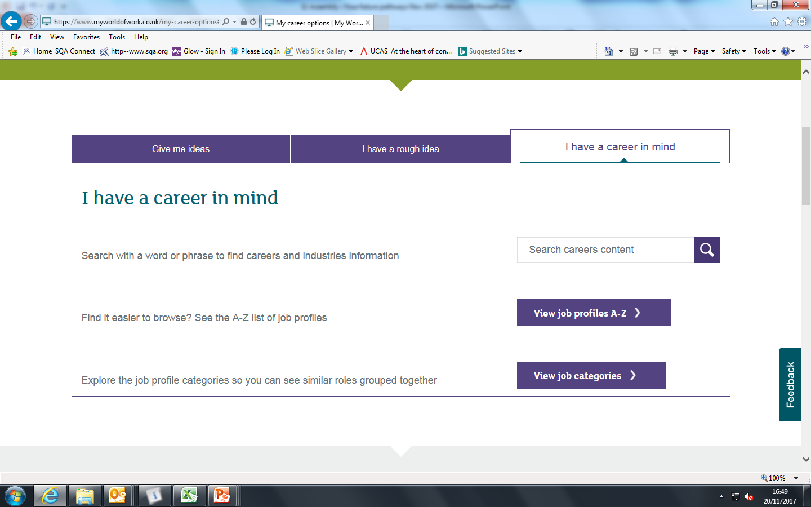
FUTURE PATHWAYS
I have a career in mind ….
Respect Responsibility Ambition

Slide 7
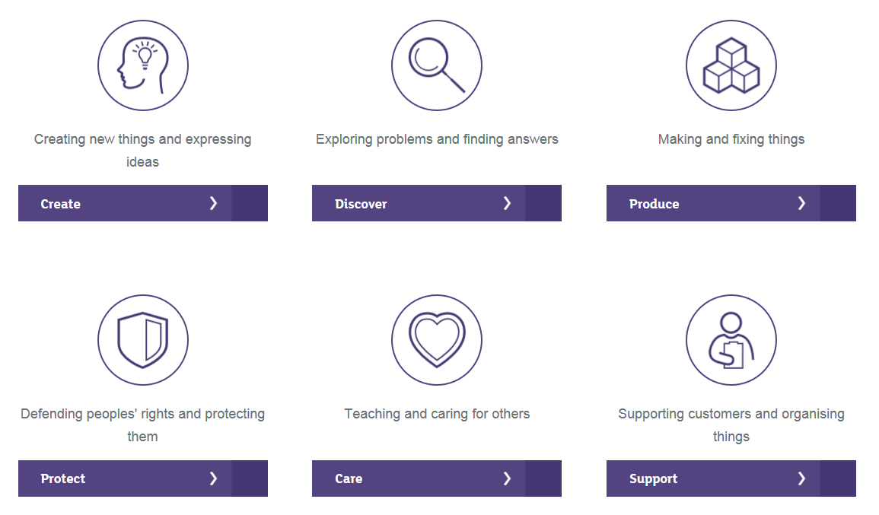
I have a rough idea …..
Respect Responsibility Ambition

Slide 8
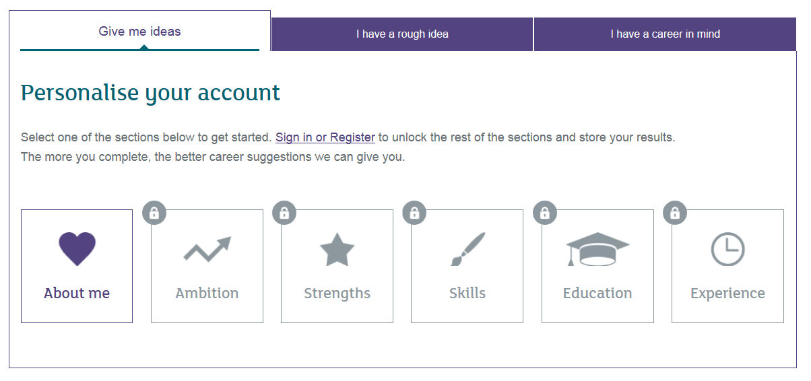
FUTURE PATHWAYS
Give me some ideas ……..
Respect Responsibility Ambition

Slide 9


A
www.myworldofwork.co.uk
B
www.planitplus.net

Slide 10
Graeme Barrett
- Skills Development Scotland -

Slide 11
* Important Dates *
12th – 14th December S2 Assemblies: ‘Your Future Pathways’
9th – 11th January S2 Assemblies: ‘Pathways - Choices’
12th – 19th January Careers Group Talks
(Skills Development Scotland - in class)
16th January Early Secondary Programme –
Glasgow University Workshops
22nd January Pathway Information Issued
22nd January Pathway Information Evening
29th January – 2nd February S2 Interviews – Skills Development Scotland
9th February S2 Reports Issued
26th February S2 Parents’ Evening
26th February Careers Convention (in school)
26th February Pathway Interviews with Pastoral Care teacher begin
9th March Pathway choice forms returned to school
Respect Responsibility Ambition

Slide 12
Mrs R Guile
- PT Pastoral Care -

Slide 13
Next steps in your Learner Journey
Curriculum For Excellence (CfE)
– A two phase model:-
S1 – S3 : Broad General Education (Experiences & Outcomes)
S4 – S6 : Senior Phase (SQA Certification)
Respect Responsibility Ambition

Slide 14
Next steps in your Learner Journey
Continue in the curricular areas of the Broad General Education:
  Languages
  Numeracy and Maths
  Social Studies
  Sciences
  Expressive Arts
  Technologies
  Health and Wellbeing
  Religious and Moral Education
  Wider Achievement /
  Skills for Learning Life & Work
Work towards 8 National Qualifications.
Respect Responsibility Ambition

Slide 15
Programme of work – S3
Teaching programmes in S3 will draw upon:
Any key Level 3 Experiences and outcomes not yet covered
Relevant Level 4 Experiences and outcomes
Appropriate elements of National 4 and 5 units/courses
And will:
Continue to develop the skills for learning, life and work integral to the course and for progression
Develop skills in independent study.
Respect Responsibility Ambition

Slide 16
Period Allocation
Maths 4 periods per week
English 4 periods per week
6 other Subjects 3 periods each
HWB: PSE, PE, RE 5 periods per week (+ 2 Tutor)
Wider Achievement
IDL
Respect Responsibility Ambition

Slide 17
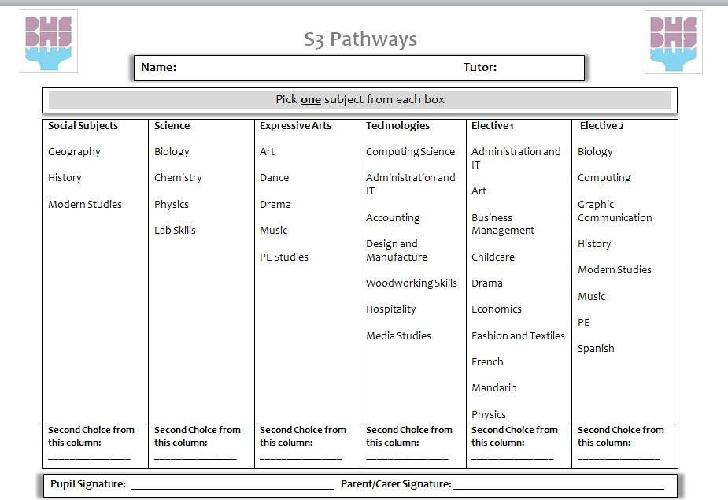

Slide 18
Pathways
Learner Pathways:-
Complete N4 units to gain course award
Complete N4 and begin some N5 coursework
Complete National 5 coursework & external assessment, where applicable, to gain course award
Move into S5, enhancing learning (5 subjects)
Respect Responsibility Ambition

Slide 19
Respect Responsibility Ambition

Slide 20
Respect Responsibility Ambition

Slide 21
Raising Attainment
Attendance
95% attendance = 9 days of absence in a school year = 1 week and 4 days of learning missed
90% attendance = 19 days of absence in a school year = 3 weeks and 4 days of learning missed
85% attendance = 27 days of absence in a school year = 5 weeks and 3 days of learning missed
80% attendance = 36 days of absence in a school year = 7 weeks and 3 days of learning missed
75% attendance = 45 days of absence in a school year = 9 weeks and 1 day of learning missed.
Don’t miss out: attend every day
Respect Responsibility Ambition

Slide 22
Bannerman High School
ATTENDANCE ANALYSIS
 | August 2017 – January 2018
AVERAGE ATTENDANCE % | 92
NO OF PUPILS <90% | 63
% OF PUPILS <90% | 31%
NO OF PUPILS <95% | 119
% OF PUPILS <95% | 58%

Slide 23
Student
Experience

Slide 24



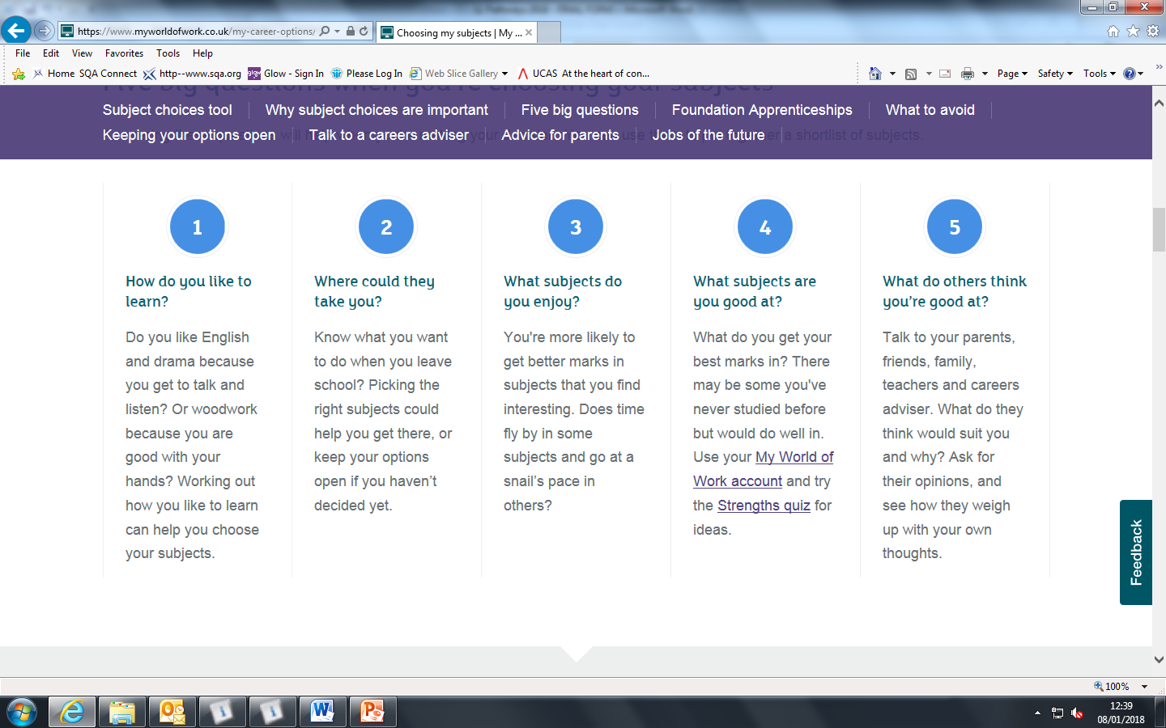


Key questions when choosing subjects ….

Slide 25
What to avoid?
It’s easy to choose subjects for the wrong reasons, too. Pupils should avoid picking subjects just because:-
  They like the teacher – the teacher may change.
  There isn’t much homework – that will change.
  Friends are taking the subject – it might be right for them, but not for you!
  Stereotypes - think something is a boys or girls subject? There is no such thing.
Respect Responsibility Ambition

Slide 26


Please Remember . . . . .
Pathway choices are very important:-
Once chosen subjects cannot be changed
Choices made now affect your child’s future
Research, Research, Research – useful websites:-
www.myworldofwork.co.uk
www.planitplus.net

Slide 27







Slide 28

In a move that could revolutionise the way we buy groceries, Amazon opens its first supermarket without checkouts - human or self-service - to shoppers on Monday.

Slide 29

Feedback Questions
What do you want your child to achieve while at Bannerman?
How can we work together to improve attainment and achievement and close the gap?
What sort of school do you want Bannerman to be?

Slide 30
Questions?

