Slide 1
HTML...CSS...JAVASCRIPT
for Higher Computing Science

Slide 2
Colin Maxwell
colinmaxwell.wordpress.com
@camaxwell
colinmaxwell@fife.ac.uk

Slide 3
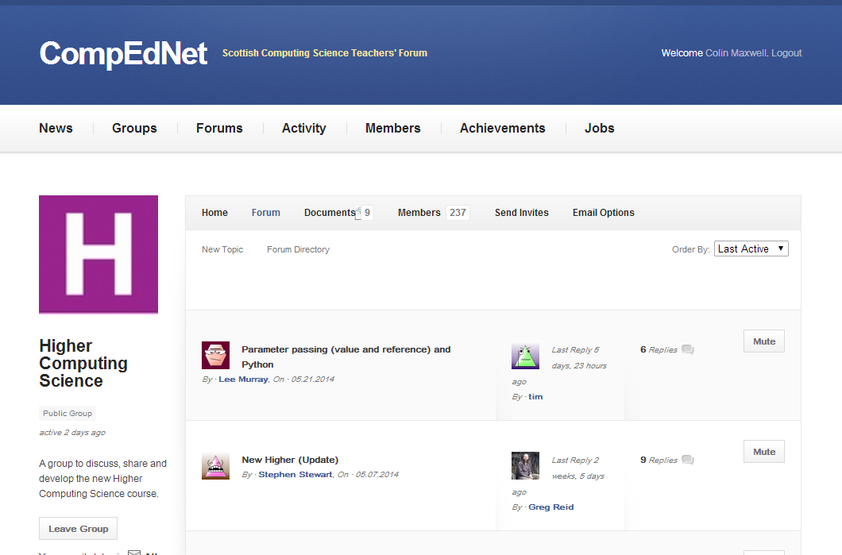

Slide 4
codeacademy.com
w3schools.com
webmaker.org

Slide 5
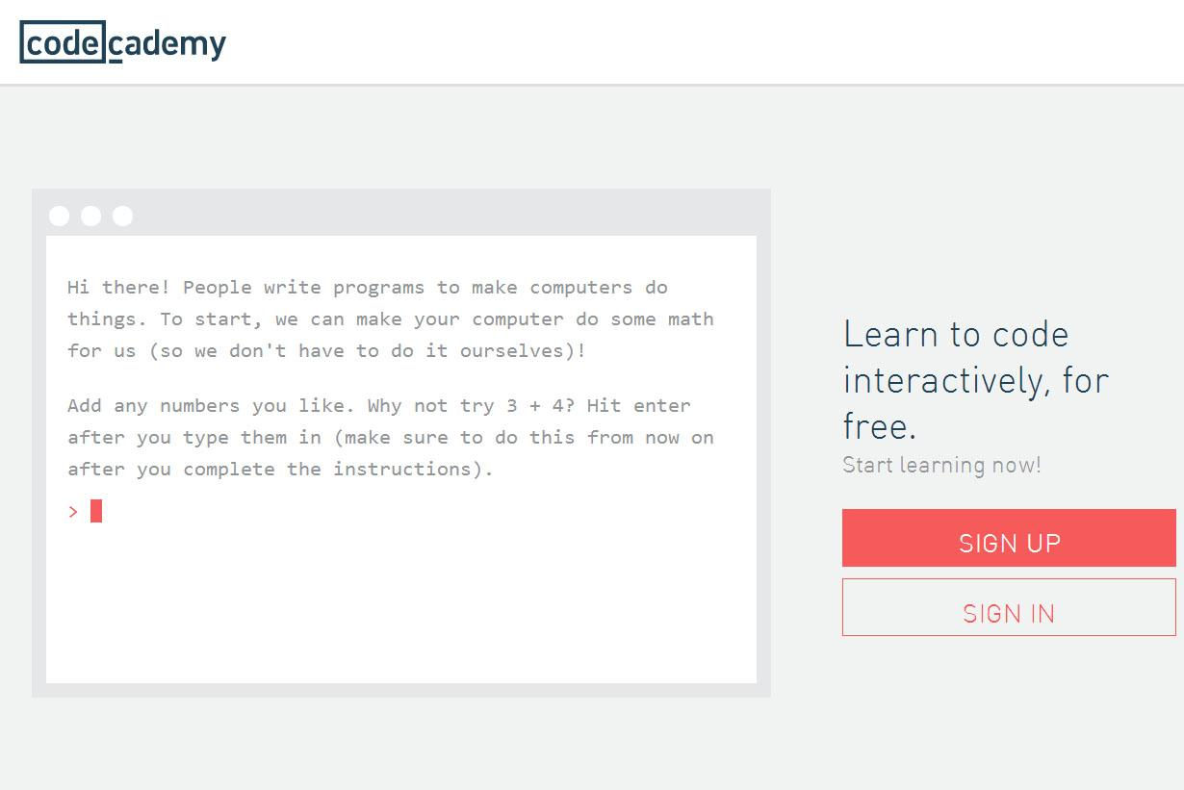

Slide 6
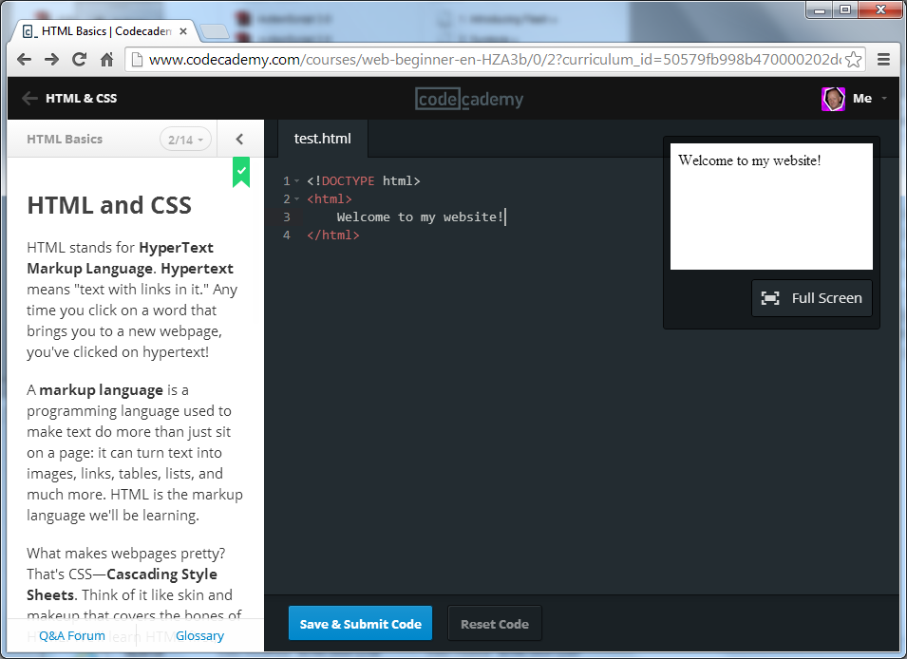
Instructions
Type your code
See the results
Submit your code or Next Lesson

Slide 7
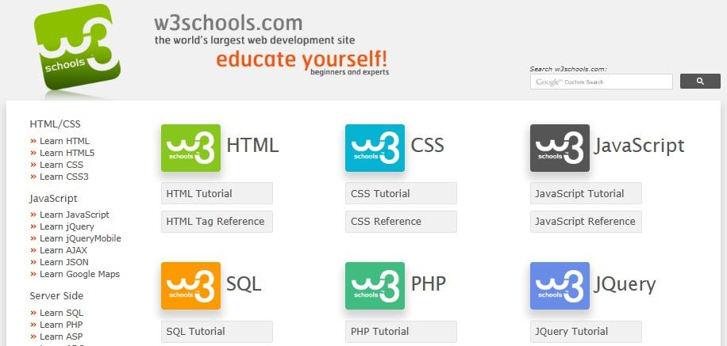

Slide 8
Type your code
See the results
Submit your code

Slide 9
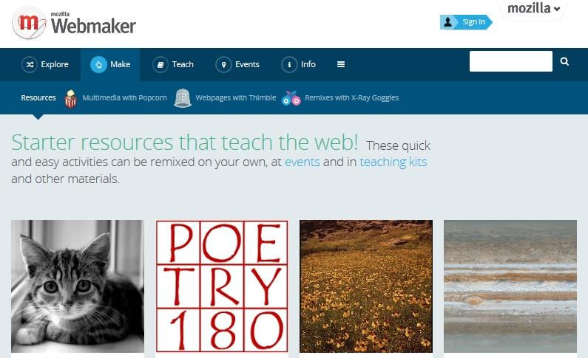

Slide 11
Tools
Web browser (Chrome preferred)
Text editor (Notepad++, Brackets, Sublime, etc)

Slide 12
Brackets
Free (Open Source)
Live HTML Development
JS Debugging (Theseus extension)
Extensions

Slide 13
Teaching Tips
HTML Hacking (HTML)
Defensive Positions (CSS)
Interactive Magic (Javascript)

