Slide 1
Databases
Collection of Information
Fields & Calculated Field
Data Types
Linked Tables & Foreign Key

Slide 2
Collection of Information
Physical Database
Searching can be slow
Editing is difficult
Electronic Database
+ Searching is very fast
+ Editing is very easy

Slide 3
Advantages & Disadvantages
Physical Database
Searching can be slow
Editing is difficult
Electronic Database
+ Searching is very fast
+ Editing is very easy

Slide 4
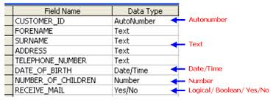
Data Types
Fields can have different data in them.
Eg 1. A name field contains the data type Text
Eg 2. A date of birth field contains the data type date/time
Eg 3. a total field contains a calculated field.

Slide 5
Calculated Field
Pupil Name | Test 1 | Test 2 | Total Marks
Simon Phoenix | 10 | 11 | 21
Hans Gruber | 15 | 17 | 32
For Example:
Total Marks = Test 1 + Test 2

Slide 6
Linked Tables & Foreign Key
When the tables of data are linked together using foreign keys.

Slide 7
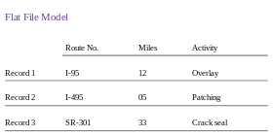
Flat File Database
A flat file database is any creation of a database model (most commonly a table) as a single file.

Slide 8
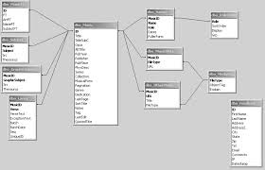
Relational Database
A relational database is a database that has a collection of tables.
The relational database is formally described and organized.

