Slide 1
Misuse of Computers
DoS Attacks
Phishing
Keylogging
Computer Laws/Acts

Slide 2
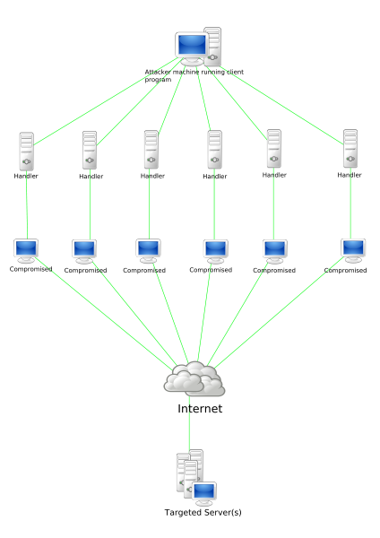
DoS Attacks
DoS Attacks
Denial
Of
Service
Many computers Attack a companies or private server.
The users cannot use their own network.

Slide 3

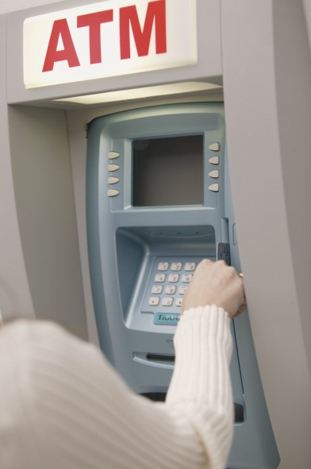
Phishing
When a hacker tries to get you to send your sensitive/private data.
Eg: My Gran receives an fake email from Santander asking her to send them her pin, account number and password because they lost it.

Slide 4
Key logging
A piece of software on your computer recording every key press you make.
So if you order something online it can record your bank details.

Slide 5
Computer Laws/Acts
Computer misuse act – hacking, sending viruses.
Data protection act – Company protecting your data (you are the data subject). Not sending your data to someone else.
Copyright, design and Patents act – downloading files without paying.

