Slide 1
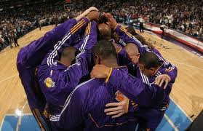
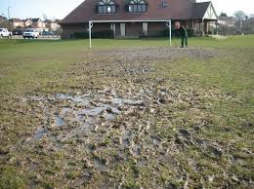
HIGHER PE THE SOCIAL FACTOR

Slide 2
Plagiarism Warning
Throughout this power point there are sample answers. Please note that these sample answers are not to be used as your own work they are for reference only. If you fail to comply with this request you will be at risk of failing the course.

Slide 3
Higher PE Command Words
Describe
(Tell us how to do it!)
Explain
(Tell us why you did it, justify! (+ / -) )
Evaluate
(Better than before? Evidence please!)
Analyse
(Benefits/limitations = result on performance)

Slide 4
The Social Factor There are three main areas within the Social Factor these are: Group Dynamics Cultural / Societal Issues Environmental Issues

Slide 5
What makes a good team?
Have a two minute discussion with a partner and create three key features of what makes a good team.
http://www.bbc.co.uk/education/clips/zhwgd2p

Slide 6
Group Dynamics (What makes a good team)
Co operation
Contributing to the team
Roles / Responsibilities
Team Dynamics
(The interactions that influence the attitudes and behaviour of people when they are grouped with others)
Ethos / Atmosphere
Communication

Slide 7
Group Task / Homework
Analyse the impact Group Dynamics may play (+ or -) during a performance in one of the following sports (6) :
Football
Volleyball
Mixed Badminton Doubles
Assign each group member a part of group dynamics to cover for your chosen sport, collate your answers together and discuss.

Slide 8
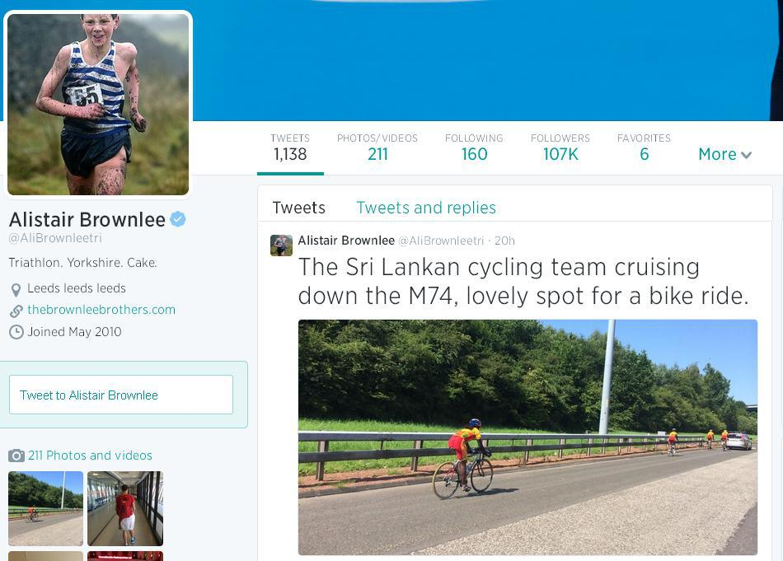
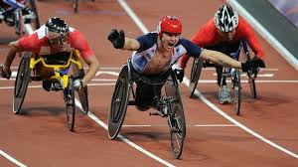
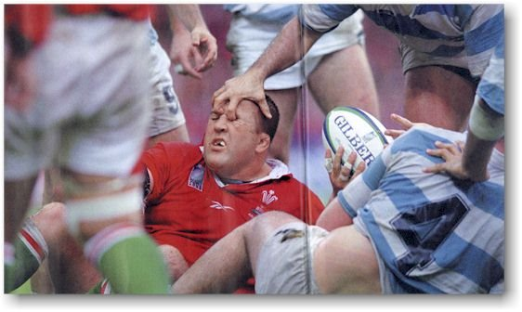
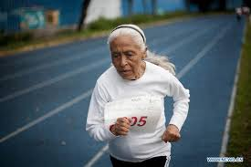
Cultural and Societal Issues

Slide 9
Cultural and Societal Issues
Inclusion
Language
Gender
Etiquette & Fair Play
Respect for others
Conduct of self, players, crowd & officials

Slide 10
Cultural and Societal Issues
Motivation – A reason or reasons for acting or behaving in a particular way
intrinsic motivation
− empathy
− self esteem
− initiative
− self-discipline
− offer, give and accept feedback or guidance
− leadership
extrinsic motivation:
− prestige
− money
− media
− sponsorship
− fame
− peer group pressure

Slide 11
Environmental Issues (Barriers to Participation)

Slide 12
Environmental Issues (Barriers to Participation)
Facilities
Cost
Location
Weather

Slide 13
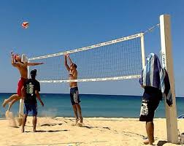
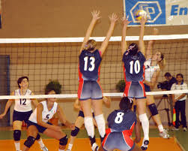
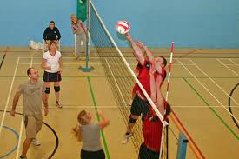
Individual Task
Analyse the impact of the Social factor during a game of Volleyball. (6)
Look at the pictures closely for ideas……….

Slide 14
How can we investigate/test?
Questionnaire
Coach feedback
Self appraisal
Team mates feedback
Environmental Checklist

Slide 15
Questionnaire
The questionnaire below could be used to gain information on your group dynamics.
Key
1 – very poor, 2 – poor, 3 – average, 4 – good, 5 – excellent
A – How good is your team at communicating with each other? 1 2 3 4 5
B – How good is your team at encouraging each other? 1 2 3 4 5
C – How good is your team at helping, giving feedback? 1 2 3 4 5
D – How good is your team at organising practices/drills/training? 1 2 3 4 5
E – How good is your team at displaying sportsmanship/etiquette? 1 2 3 4 5
If each person in your team filled this out and the results were collated, your team would gain valuable knowledge about how well you socially interact.

Slide 16
Self Appraisal Criteria
What was expected to happen?
What worked well?
What didn’t work well?
What have I learned?
What will I do to secure success?
If possible, with a partner one be the coach and one the performer. Answer the above questions individually and then compare answers regarding a recent performance.

Slide 17
Self Appraisal
After one off game
After a training period culminating in a performance
On your own
With a coach, one appraisal each both answering on the performance
For this to be at all reliable and effective you need to be:
Honest
Responsible
Ready to receive constructive criticism

Slide 18
Environmental Checklist
Environmental Aspect | Not at all | Sometimes | Constantly
Weather
Wind
Rain
Sunlight
Heat
Coldness
Frost
External Aspects
Crowd noise
Crowd interaction
Officials performance
Opponents
Non playing team mates
Non playing opponents
Playing Surface
Condition of surface
Length of surface
Width of surface
Self
Footwear
Clothing
Headwear
Accessories

Slide 19
Environmental Checklist
Post performance / training
Carried out by performer
Honesty needed for reliability
Helps identify small factors outwith your control that has impacted performance
Identification of these aids planning for training and next performance
Makes performer more aware of environment and allows then to prepare mentally for challenges ahead.

Slide 20
Individual Task
(a) Describe two different methods that could be used to collect information about
the potential impact of social factors on performance.(4)
(b) Select one of the methods described in part (a).
Explain why you chose to use this method of investigation.(4)

Slide 21
Team Dynamic Development Approaches
Partner/group work team building games
(outwith activity)
Active listening
(wait until person is finished, then think and speak)
Restorative practices
(mediation, acknowledgement of errors)

Slide 22
Team Dynamic Development Approaches
Use of model performers
(watch, listen & analyse)
https://www.youtube.com/watch?v=vM54ePnpiJ8
https://www.youtube.com/watch?v=Mjgi8ue56ac
Defining roles
(leadership, positional duties, sets pieces)
https://www.youtube.com/watch?v=T3znU7suCx0
https://www.youtube.com/watch?v=6bDU3wkh_dU

Slide 23
Cultural and Societal Issues (you can become involved in)
Community initiatives
National / local intervention programmes
National / local events
Rebranding activities

Slide 24
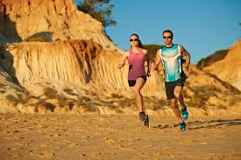
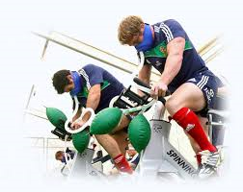
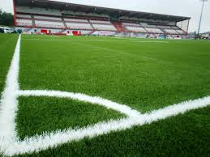
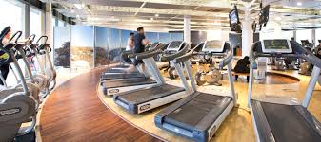
Environmental Issues Development Approaches
Warm Weather training
Altitude training
Preparing for different playing surface
Indoor training due to weather

Slide 25
Monitoring Tools
Diary
Questionnaire
Self-appraisal (compare & Contrast)
Environmental checklist
Team/group feedback
Coach/teacher feedback
Crowd/audience reaction

Slide 26
Why monitor training?
To check it is effective, relevant to development needs, long term targets.
Make sure short term targets are met, progress is being made.
Provide motivation to further improve.
Make adaptations to training if necessary.
Ensure strengths are maintained while weaknesses improved.

Slide 27
Social Scenario………
Games | Gold | Silver | Bronze | Total | Rank
2002 Manchester | 6 | 8 | 15 | 29 | 10
2006 Melbourne | 11 | 7 | 11 | 29 | 6
2010 Delhi | 9 | 10 | 7 | 26 | 10
2014 Glasgow | 19 | 15 | 19 | 53 | 4
Team Scotland enjoyed their most successful games ever in Glasgow. Analyse how the social factor and one other factor may have played a part in this ‘medal bounce’ (8)

Slide 28
Revision
Name 3 methods you could use to investigate within the social factor? (3)
Describe how you carried out one of the methods above for four marks. (4)
List two Group Dynamics issues from the social factor. (2)
Describe one of the Group Dynamics issues and describe how it could affect your performance in any sport of your choice. (4)
Describe a training drill you have done to develop the social factor and how you would progress it. (6)

