Slide 1
The Mental Factor
Higher PE

Slide 2
Plagiarism Warning
Throughout this power point there are sample answers. Please note that these sample answers are not to be used as your own work they are for reference only. If you fail to comply with this request you will be at risk of failing the course.

Slide 3
Higher PE Command Words
Describe
(Tell us how to do it!)
Explain
(Tell us why you did it, justify! (+ / -) )
Evaluate
(Better than before? Evidence please!)
Analyse
(Benefits/limitations = result on performance)

Slide 4
The importance of the Mental Factor
Watch the following clip:
http://www.bbc.co.uk/education/clips/zwbh34j
Discuss this video in a group for 5 minutes answering the following questions:
1 – What do you think is meant by mental toughness and how do you get this?
2 – How can you deal with nerves before a big performance?
3 – Is it good to be nervous before a performance?

Slide 5
Aspects of the Mental Factor
Concentration
Level of arousal (under and over)
Motivation
Decision making
Problem solving
Cue recognition
Processing information
Anticipation
Attention Span
Focus of Attention
Perception
Mental Toughness

Slide 6
Mental Factor definitions
Concentration – The fixing of close undivided attention, ultimate focus.
Level of arousal - How ready a person is to perform appropriate tasks in a timely and effective manner.
Motivation - A reason or reasons for acting or behaving in a particular way.
Decision making - The thought process of selecting a logical choice from the available options.

Slide 7
Mental Factor Definitions Continued
Problem Solving -The process of working through details of a problem to reach a solution.
Cue Recognition - The identification of something as having been previously seen, heard, known, etc.
Processing Information - Being able to think clearly and thoroughly about what has happened and is about to happen

Slide 8
Mental Factor Definition Continued
Anticipation - The action of anticipating something; expectation or prediction.
Attention Span – The period of time concentration and focus is at maximum level.
Focus of Attention – The narrowing of the senses and mind centred on one being.
Perception - The ability to see, hear, or become aware of something through the senses.
Mental Toughness – The desire to succeed in the face of overwhelming difficulty.

Slide 9
Individual Task
Evaluate your Mental strengths and development needs in comparison to a model performer. (4)
Always relate your evidence back to a model performer. Some useful sentence starters below.
Unlike the model performer I …… where as they……… I on the other hand don’t, as a result……….
Like the model performer l…………

Slide 10
How can we investigate/test in the Mental factor ?
Questionnaires / Observation Schedules
Self Reflection Sheet
SCAT (Sport Competition Anxiety Test) http://www.brianmac.co.uk/scat.htm
Profile of mood states (POMS)
http://www.brianmac.co.uk/poms.htm

Slide 11
Questionnaire / Ob Schedule
Badminton – Mental Factor Questionnaire | ALWAYS |  | SOMETIMES |  | NEVER
 | 1 | 2 | 1 | 2 | 1 | 2
I am in the ready position when I am receiving service (Anticipation)
I take my time and stand in the correct place when I am the server (Concentration)
I am aware of the score and know which side of the court to be on for the next service (Attention Span)
I try to return to the BASE position after each shot in a rally (Motivation)
I am trying to move my opponent around the court during a rally (Decision Making)
This can be filled in by a skilled observer or by the performer if they are using Video footage
Questions can be changes to suit performers needs
Questions can be linked to certain aspects of the Mental Factor to analyse any weaknesses

Slide 12
Self Reflection Sheet
Game 1
Key – 1 – Not at all 2 – A little 3 – Sometimes 4 – More so than normal 5 – All the time
Loss of Concentration | 1 | 2 | 3 | 4 | 5
Poor Decision Making | 1 | 2 | 3 | 4 | 5
Lack of Cue Recognition | 1 | 2 | 3 | 4 | 5
Lack of Motivation | 1 | 2 | 3 | 4 | 5
Slow Anticipation | 1 | 2 | 3 | 4 | 5
Performer fills this in themselves after a performance has ended.
This hopefully ensures reliability
Gives clear and instant feedback to the performer
Criteria is chosen by performer to make it specific to their needs

Slide 13
Personal Task
Carry out each of the following tests at home and write down your scores.
SCAT (Sport Competition Anxiety Test) http://www.brianmac.co.uk/scat.htm
Profile of mood states (POMS)
http://www.brianmac.co.uk/poms.htm

Slide 14
Sport Competition Anxiety Test Questions
Statement | Rarely | Sometimes | Often
Competing against other People/Teams is socially enjoyable
Before I compete - I feel uneasy
Before I compete - I worry about not performing well
I am a good sportsman when I compete
When I compete - I worry about making mistakes
Before I compete - I am calm
Setting a goal is important when competing
Before I compete - I get a queasy feeling in my stomach
Just before competing - I notice my heart beats faster than usual
I like to compete in games that demands a lot of physical energy
Before I compete - I feel relaxed
Before I compete - I am nervous
Team sports are more exciting than individual sports
I get nervous wanting to start the game
Before I compete - I usually get uptight

Slide 15
Individual Task
Describe two investigation methods you have used to assess the Mental Factor. (4)
Explain why it is important to collect information on the Mental Factor before completing a development programme. (4)

Slide 16
Development Approaches (Training)
Relaxation techniques
Mental rehearsal
Positive self talk
Thought blocking

Slide 17
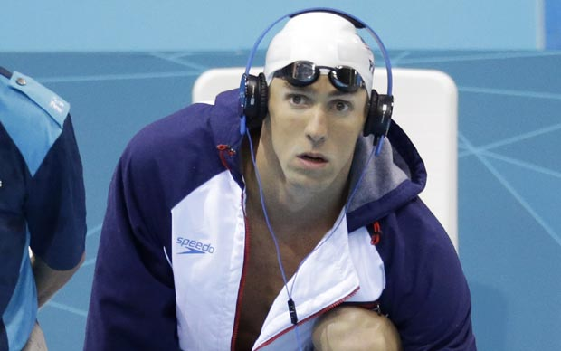
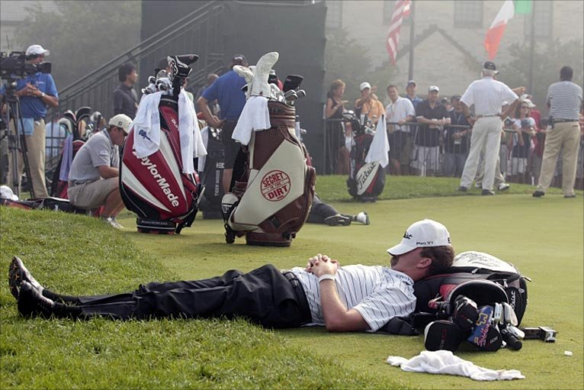
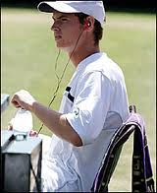
Relaxation Techniques
Music, sleep, meditation anything to de stress yourself
This is mostly done pre performance, but can be very useful mid performance to lower levels of anxiety and arousal.
Most sportsmen and women listen to music pre match, this helps calm nerves and aids concentration

Slide 18
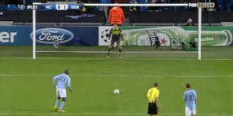
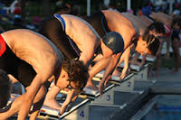
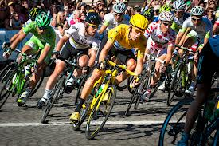
Mental Rehearsal
Used to prepare mind for tactics, skills, fitness requirements, environment, crowd distractions etc.
Aim is to relax performer when situation that has been rehearsed arises so that they can perform effectively to a high standard.
Footballers mentally prepare and rehearse before taking a penalty kick, the swimmer rehearses their dive technique, the cyclist rehearses tactics etc.

Slide 19
Mental Rehearsal
This development approach can also be used to focus your mind on what you need to do to be successful. Lynsey Sharp, in the Glasgow Commonwealth Games 800m (pictured left) used these two key phrases to remind her of her objectives and tactics in order for her to perform at her best.
Why do you think she wrote them on her hand?
When do you think she read it in relation to the race?
How could this help her perform better?

Slide 20
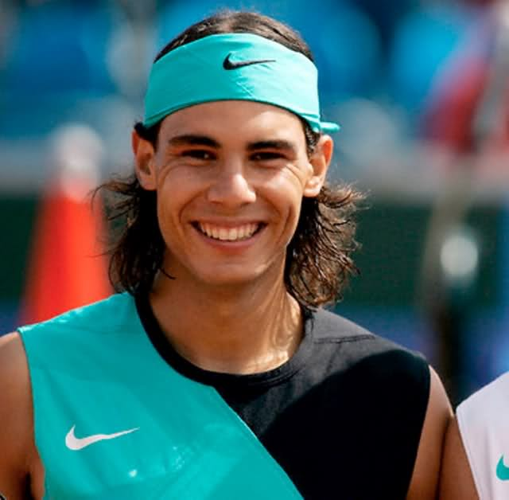
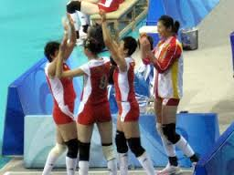
Positive Self Talk
If you watch Rafael Nadal play tennis you will likely hear him say ‘Vamos’ = ‘come on’ this motivates him to before better etc.
Volleyball teams always high five and praise one another after every point to boost morale, no matter the point outcome.
https://www.youtube.com/watch?v=kPY8s292Q-U

Slide 21
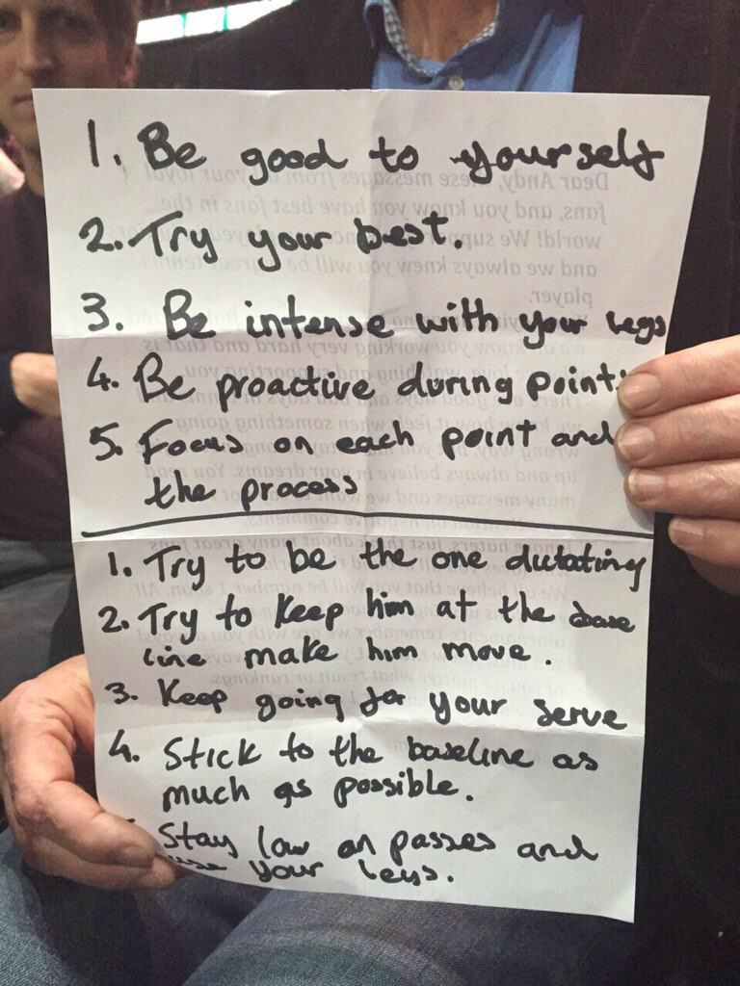
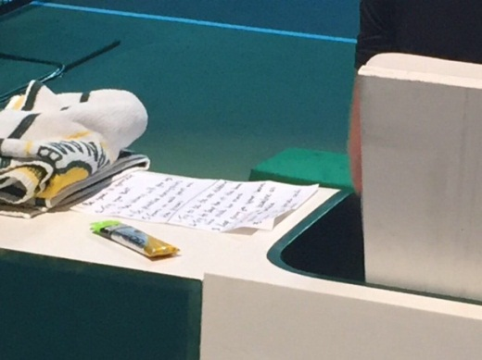
Positive Self Talk
Use supportive phrases to boost motivation and arousal.
Look at Andy Murray’s method of using positive self talk & mental rehearsal (Rotterdam ATP 2015)

Slide 22
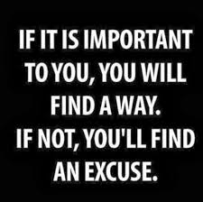
Thought Blocking
This means any negative thoughts are immediately turned into a positive, this has a great effect on happiness, motivation, concentration, level of arousal etc
If you think negative thoughts you will perform negatively
Positive Mental Attitude (PMA)

Slide 23
Development Approaches Task
Describe two approaches you have used to develop the Mental Factor (4)
Evaluate the impact of one approach on your performance. (2)

Slide 24
1 Developing Example, 2 Marks
Activity – Badminton
Approach – Mental Rehearsal
Format – Ladder tournament, 2 minute games
The training approach l used was Mental Rehearsal. In this you prepare what you are going to do before you do it. You play out all scenario’s in your mind and select the best one. This requires deep thought and time to complete. I did this during a 2 minute game ladder tournament.
Before each point I would rehearse what I was going to do. If it was my service I would think carefully about where to play it to and rehearse in my mind what I needed to do to execute this accurately, I would also plan my next shot in anticipation of the return. Additionally, If I was returning the serve I would rehearse what I would do if it was a short serve or a long serve. I did this quickly and consistently before each point using the time taken to retrieve the shuttle to rehearse.

Slide 25
How can we monitor our development?
To make sure our training is effective and is making us better there are several methods we can use to check on this.
Training Diary
Re do SCAT test, compare to old results
Re do Observation schedule’s
Coach feedback
Compare match results, before and after development plan.
Self reflection / personal thoughts

Slide 26
Why monitor?
To check training content is effective, relevant to development needs, long term targets.
Make sure short term targets are met, progress is being made.
Provide motivation to further improve.
Make adaptations to training if necessary.
Ensure strengths are maintained while weaknesses improved.

Slide 27
Individual Task
(a) Explain the purpose of monitoring and evaluating performance. (2)
(b) Explain at least two difficulties that might be encountered when monitoring and evaluating the impact of mental factors on performance. (6)

Slide 28
Mental Test
Complete these questions in your jotter, you do not need to write the question.
1 – List three methods you can use to monitor your development?
2 – Name 4 aspects of the mental factor?
3 – What does SCAT as in the SCAT test stand for?
4 – Visualisation, mental rehearsal, rational thinking, positive self talk are all forms of what?
5 – What does Cue Recognition mean?

