Slide 1
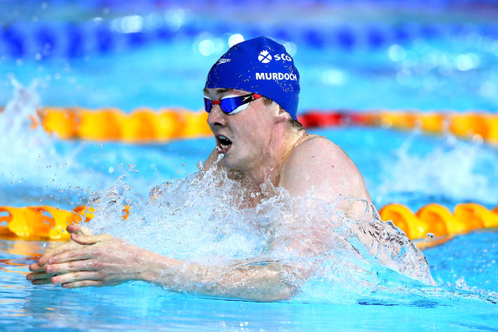
The Physical Factor
Higher PE

Slide 2
Plagiarism Warning
Throughout this power point there are sample answers. Please note that these sample answers are not to be used as your own work they are for reference only. If you fail to comply with this request you will be at risk of failing the course.

Slide 3
Higher PE Command Words
Describe
(Tell us how to do it!)
Explain
(Tell us why you did it, justify! (+ / -) )
Evaluate
(Better than before? Evidence please!)
Analyse
(Benefits/limitations = result on performance)

Slide 4
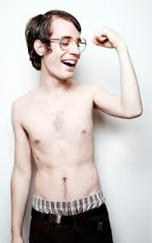
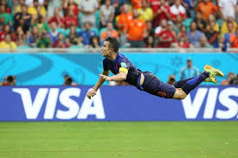
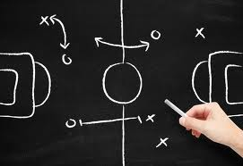
The three areas of the physical factor……
Skills
Tactics
Fitness

Slide 5
Fitness

Slide 6
Aspects of Fitness
There are two sections within fitness, these are:
Physical Fitness
Skill Related Fitness

Slide 7
Physical fitness definitions
Aerobic endurance – The ability of the heart lungs and full body to work for an extended period of time.
Anaerobic endurance - A form of endurance characterized by the absence of oxygen, high intensity situations.
Speed Endurance – Maintaining high or above average speed for an extended period of time
Flexibility – The range of movement across a joint
Strength – The amount of force a muscle or group of muscles can exert in one effort.
Muscular endurance – The ability of a muscle or group of muscles to work for a extended period of time.
Speed – To cover a distance or a movement in a short period of time.
Power – The combination of speed and strength

Slide 8
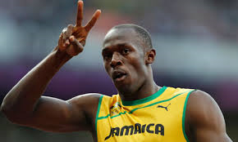
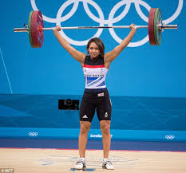
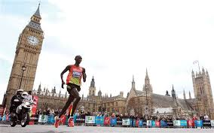
Individual Task
Select one aspect of Physical Fitness. Analyse how one of the performer’s below may need the aspect chosen to be successful in their sport. (2)

Slide 9
Methods of Collecting Data
How can I Investigate Fitness?
Standardised Fitness Tests (SFT)
Time Related Observation Schedules (TROS)

Slide 10
Standardised Fitness Tests
Aerobic endurance – Cooper Test, Bleep Test, Yoyo test
Anaerobic endurance - Cunningham & Faulkner Endurance test, (www.brianmac.co.uk/cunandf.htm )
Power – Standing Long jump, vertical jump
Muscular endurance – 60sec press-up, sit-up, plank etc test
Speed Endurance – 150m sprint test
Flexibility – Sit and Reach test
Strength – Handgrip Dynamiter, 1 rep max test
Speed – 30m sprint test
*Results compared to national averages to assess performance level at present.

Slide 11
Time Related Observation Schedule
Game 1 | In position to play shuttle (Aerobic End/ Speed) | Effective Overhead Clear (M E/Power) | Effective Smash (M E/Power) | Fluent lunge to play shuttle (Flexibility)
0-1
1-2
2-3
Total
Purpose is to see how fitness deteriorates
Filled out over 3 matches back to back without rest
Opponents to be of similar standard
Skilled / trained assessor to fill in either during or after game.
Broken into time zones to allow greater clarity and analysis
*please note, not all fitness aspects are covered in this (TROS).

Slide 12
Fitness Task
(a) Describe two methods you used to gather information about your performance from the physical factor. (4)
Or……..
(b) Outline two ways in which you examined your physical fitness. (4)
Pick one of the questions above to answer.

Slide 13
Physical Fitness Task
Success criteria for both questions as they are virtually the same, the only difference would be (a) could be answered using skills or tactics based analysis.
State one of the recognised methods of gathering data and discuss the purpose of this method.
Describe how you carried out this method, what you actually did. Who did you play and why? How many games? Test criteria? Test rules? Who recorded video? Time of day? Before or after training? Match conditions?
Repeat for second method.

Slide 14
Why Gather Information?
Watch this video all about fitness testing and the purpose’s of doing so.
https://www.youtube.com/watch?v=xk3gpxFU7DU
Group discussion
What is the point in doing fitness tests, do they really matter?
When should we do fitness tests?
What means more to you, setting higher fitness test scores or winning trophies/ competitions? Why?

Slide 15
Why Gather Information?
Identify strengths and development needs
Goal / Target setting
Comparisons for before and after training possible
Select appropriate development approaches

Slide 16
Physical Fitness Group Task
Choose one physical fitness investigation method you have used. Try to come up with three benefits of using it to collect information and two limitations the method has.

Slide 17
Possible Benefits……
Clear feedback for you to see strengths and weaknesses relatively soon after performance
Motivation to improve due to score, classification
Test criteria is the same so it is reliable
Short term and long term targets can be set as a result
Training programme aimed to specifically target weaknesses can be formulated

Slide 18
Possible limitations…..
Lack of time to complete
Different opponents, training partners
Untrained observers
Rules / test criteria not fully observed
Environment, time of day, lack of facility etc.
Negativity due to boredom
Honesty?

Slide 19
Development Approaches for Physical Fitness
Aerobic / Anerobic Endurance – Fartlek training, Interval Training, Continuous Training
https://www.youtube.com/watch?v=G0flp8uS1Eg
Muscular Endurance – Circuit Training
Speed – Sprints, Weights, Plyometric’s
https://www.youtube.com/watch?v=8LuZWIkOqrQ
Strength – Weight training
Power – Body weight / weight training, Explosive drills specific to sport demands.

Slide 20
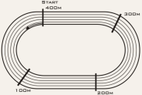
Fartlek Training Example
20 minutes continuously jogging around the track, in the sprint zone’s 100% speed must be used. The sprint zone’s are marked with lines. After 20 minutes they will get 5 minutes rest then repeat this 3 times.

Slide 21
Why use Fartlek?
Easily adapted to suit your facility and set up.
Easily progress to make more complex or easier if needed.
Includes realistic high intensity bursts similar to your activity eg, Football, Badminton, Rugby Etc.
Will dramatically improve aerobic and anaerobic endurance.
Challenging mentally and physically.

Slide 22
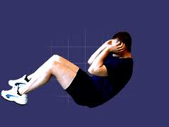
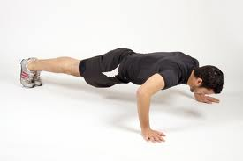
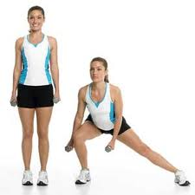
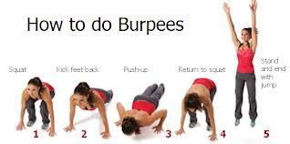
Circuit training Example
1 minute per exercise, 1 minute rest between exercises. Complete all exercises in order 3 times.
1.
3.
4.
2.

Slide 23
Why use Circuit Training?
Exercises can be adapted to suit needs
Fun and challenging
Will develop muscular endurance greatly
Can be done with team mates or on own
Easy to set up and execute

Slide 24
Power Example
The video you are about to watch shows a training session to develop power in the legs which helps jumping & kicking.
https://www.youtube.com/watch?v=QrUxLSGJrTk

Slide 25
Why use plyometrics/body weight/weights exercises?
Will really improve power in specific areas of body
Fun and challenging
Can be easy to set up
Targets and scores can be easily made to set targets
Will have minor benefits to other aspects of fitness.

Slide 26
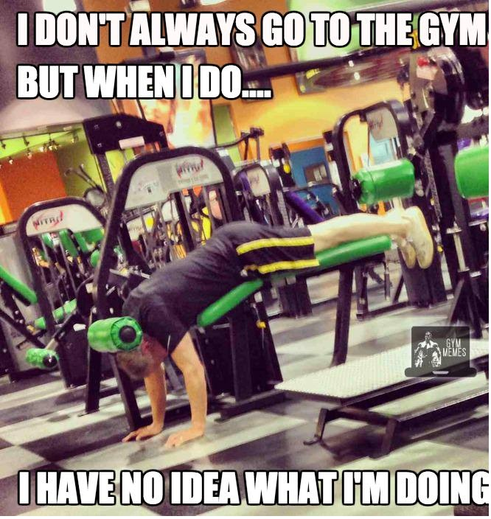
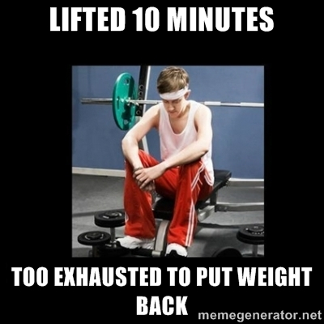
The Principles of Training
When creating a training programme, you need to go about it sensibly, you need to follow some simple guidelines.
https://www.youtube.com/watch?v=Upqjp6I5eOE

Slide 27
Principles of Training
In order for training to be effective and relevant you need to apply the Principles of Training:
Specificity – Weakness, sport, role in sport.
Progressive Overload – Gradually making training more complex, can be done by (F.I.D)
Frequency – how many times you train
Intensity – how hard you train
Duration – how long you train for
Reversibility - adapting training various reasons, injury, lack of facility etc.

Slide 28
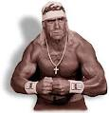
Remember…….
For you to improve at anything within sport you must gradually make your training more difficult or else you will just plateau!

Slide 29
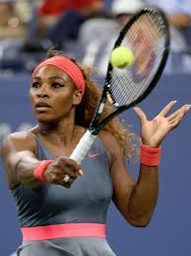
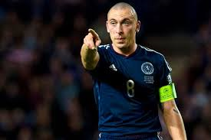
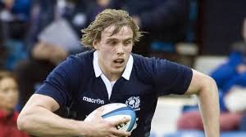
Fitness Task
Design a development plan focussed on an area of physical fitness for one of the performer’s above. The plan should be 3 weeks long with a minimum of three training sessions of 30 minutes per week.

Slide 30
Fitness Task 2
Explain why you chose your selected method’s of training. (4) Eg. Fartlek training to improve aerobic endurance, why did I use this?
Describe some possible decisions you might have to make after the first week of training? (2)

Slide 31
Phases of Training
There are three phases of training:
Micro – pre season
Macro – during season
Miso – transition
During these phases the types of training vary greatly.
Discuss and list five reasons why Micro training must be different to Macro training. Then discuss why Miso training is important at all give two reasons to support your thoughts.

Slide 32
Skill Related Fitness Defined
AGILITY– Is the ability to move the body quickly and precisely.
BALANCE - Is the ability to maintain the centre of gravity above the base of support. Static balances require You HOLD a position. Dynamic balance requires you to maintain balance in ever changing circumstances
CORE STABILITY – Strength in the mid region of your body allowing balanced movement
REACTION TIME – Is the time taken between the recognition of a signal and the start of your movement.
CO-ORDINATION - Is the ability to control movements smoothly and fluently. Groups of muscles must work in sequence to produce an effective performance.

Slide 33
Personal Task
Select three aspects of Skill Related Fitness. Explain the need for these aspects of (SRF) within your chosen sport. (6)
Extension Task
Using the three aspects of (SRF) you spoke about in your previous answer, draw and describe a training drill or practice that would develop your ability in all three aspects from your chosen sport.

Slide 34
Methods of Investigating (SRF)
General observation schedule
Scatter diagram
Digital analysis
Coach feedback
Skills testing

Slide 35
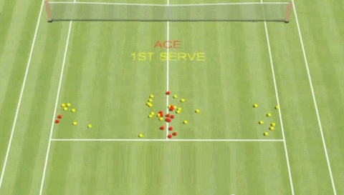
Scatter Diagram
Gives a clear picture of end product which can be related to (SRF) aspects
Can be easily compared to a model performer or re tested at a later date
Targets can be easily set as a result of this test.

Slide 36
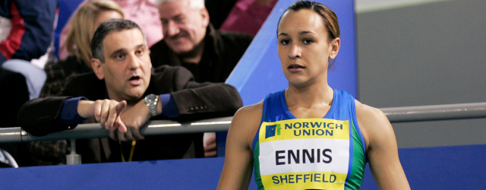
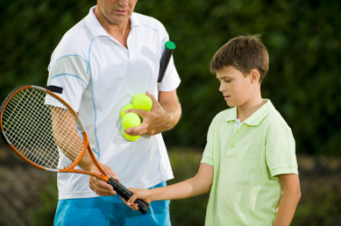
Coach Feedback
Useful during a performance, after a performance or in an isolated training session.
The feedback Jessica Ennis is getting was during the high jump phase of the Heptathlon, all aspects of (SRF) are needed to a high degree to be successful.
What aspects of (SRF) are most likely to be discussed by the tennis coach?

Slide 37
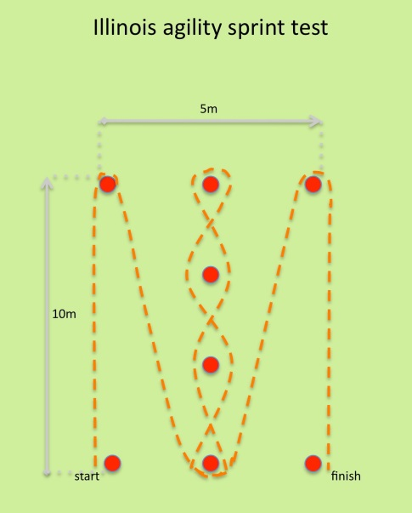
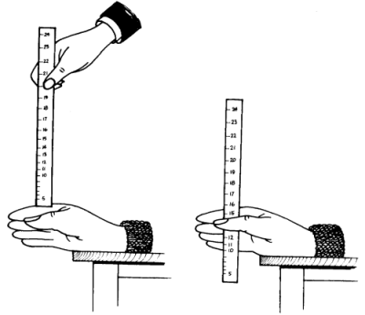
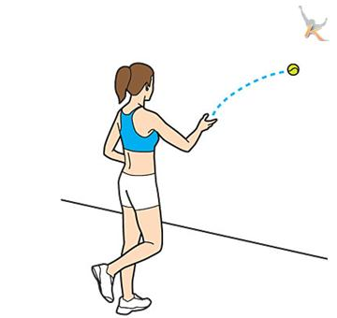
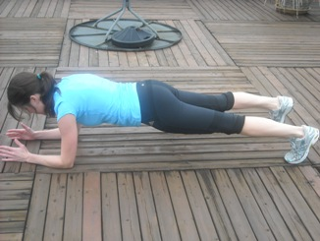
Some (SRF) Tests
Which aspect of (SRF) matches the picture?

Slide 38
Monitoring Tools
Training Diary
Results from matches
Video analysis
Observation schedules
Coach feedback

Slide 39
Why monitor training?
To check training is effective, relevant to development needs, long term targets.
Make sure short term targets are met, progress is being made.
Provide motivation to further improve.
Make adaptations to training if necessary.
Ensure strengths are maintained while weaknesses improved.

Slide 40
Monitoring Training Task
Question 1
Describe one method you have used to monitor training. (4)
Question 2
Evaluate the impact this method of monitoring has had on your performance. (4)

Slide 41
Skills

Slide 42
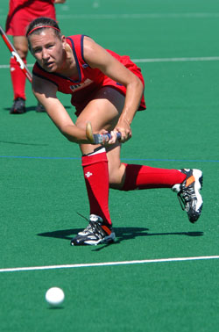
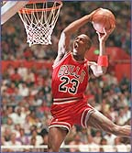
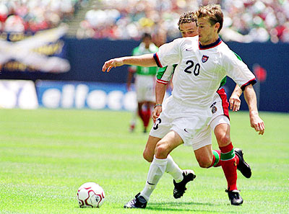
What are Skills & Techniques?
A skill tells you the purpose of the movement, E.g. “passing”.
A technique is the way of performing a skill, E.g. push pass, hit or reverse pass in Hockey. The technique tells you “how” a pass was made.
S & T’s?

Slide 43
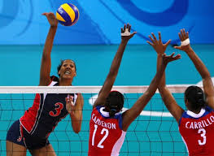
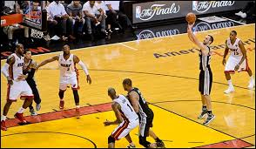
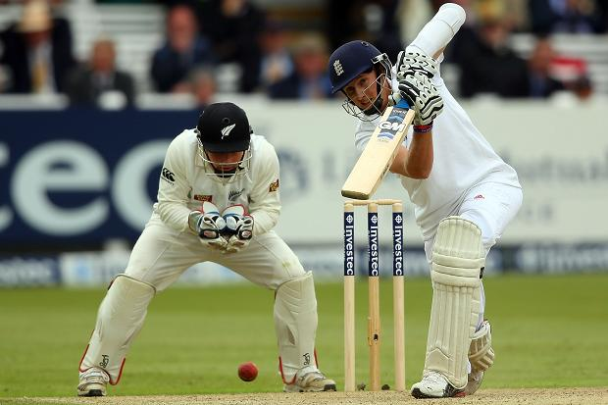
Easy and Complex Skills
Easy Skills Complex Skills
Few judgements to be made Many judgements
Undemanding Demanding
Little co-ordination needed Co-ordination vital
Simple movements Complicated movements
Easy environment (no opposition) Difficult environment
Complex or simple - Why? Evidence? Discuss!

Slide 44
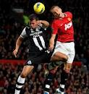
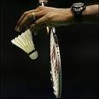
Open and closed skills
Skills are classed as ‘open’ if they are performed in unpredictable situations, such as dribbling the ball in Basketball or heading the ball in Football.
Skills are classed as closed if they are performed in controlled situations, such as the Tee off shot in Golf or a serving in Badminton.

Slide 45
Stages of Skill Learning
There are 3 important stages when learning and developing skills
These are:
Cognitive stage
Associative stage
Autonomous stage

Slide 46
The Cognitive Stage
The performer needs to:
Get a mental picture of the skill or technique to aid learning
Understand the basics of what is to be learned
Break the skill down, prep, act, recovery
Receive information in small chunks, this will aid information processing
Receive corrective feedback

Slide 47
The Associative Stage
The performer can:
Understand what is expected in performing the skill
Focus on improving the basics learnt
Handle more specific information
Attempt to recognise and correct their own errors (kinaesthetic awareness)
Make better sense of external feedback given, due to an enhanced knowledge of the skill’s sub routines.

Slide 48
The Autonomous Stage
The performer can now:
Select and apply skills without conscious thought
Perform skills to a consistently high degree
Detect own errors and adapt/refine performance accordingly
Concentrate more on tactics and strategies

Slide 49
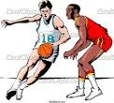
What stage of learning are you at?
Pick a skill/technique from an activity of your choice.
Describe a practice/training drill that you could do for each stage of learning for the same skill.
Use the example below to help you:
Basketball – Dribbling
Cognitive Stage Practice – Walking/light jog dribbling the ball through a slalom of cones.
Associative Stage Practice – Dribbling at pace through the cones, under pressure eg. A race against another person or a passive defender trying to chase you down.
Autonomous Stage Practice – Dribbling through cones against an active defender.

Slide 50
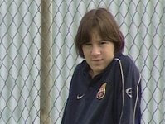
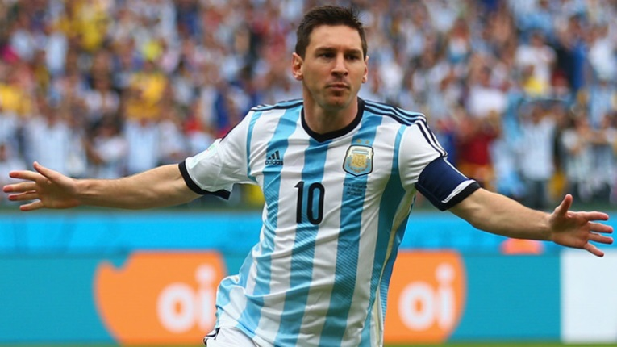
Cognitive to Autonomous
Technical Qualities
Timing
Rhythm
Consistency
Special Qualities
Imagination
Flair
Creativity
Quality of Performance
Fluency
Effort
Accuracy
control

Slide 51
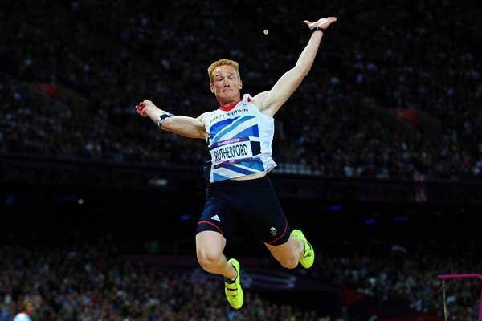
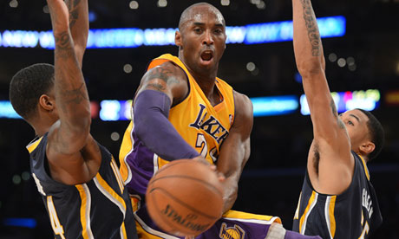
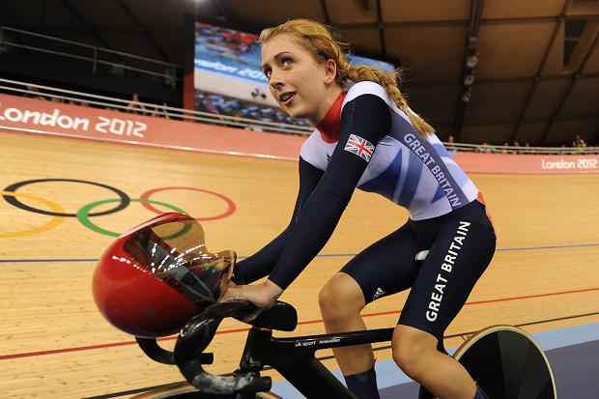
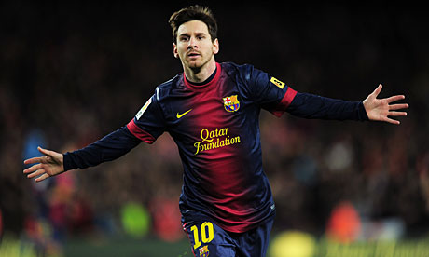
Select one of the sports people and write a paragraph in your jotter detailing the technical or special qualities they have. Explain how these qualities have led them to achieve high degrees of success in their sport. Give examples of their qualities and how they use them.

Slide 52
Methods of investigation
How can I investigate my skills?
Games skills analysis (Ob Schedule)
Video analysis
Skills tests
Coach feedback

Slide 53
Games Skills Analysis
Here is an example of a basic Games Skills Observation Schedule. You would need a skilled assessor to fill this out for you as they can identify each skill easily.
Skill | Successful | Unsuccessful | Total
Shooting
Dribbling
Passing
Re Bounding
At the end of the game you would total each skill to find what is your strength and weakness.

Slide 54
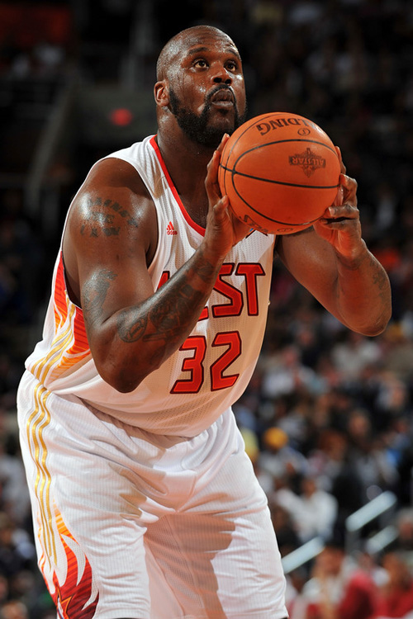
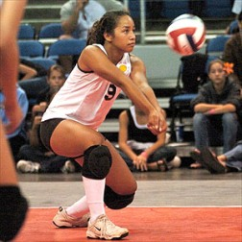
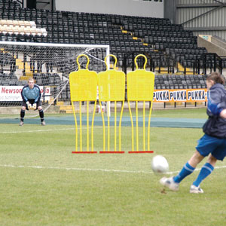
Skills Tests
Skills are isolated in non pressured environments and measured against certain criteria for success, more often than not this success criteria will be derived from a model performance.

Slide 55
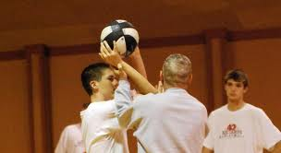
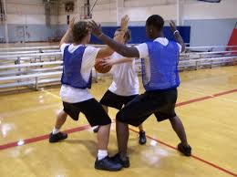
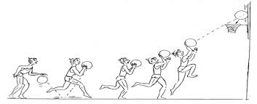
Training Approaches (Skills)
Shadowing
Pressure Drills
Gradual Build Up

Slide 56
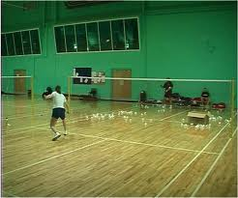
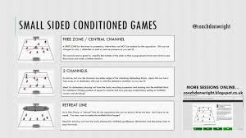
Training Approaches (Skills)
Repetition Drills
Conditioned Games

Slide 57
Skill Training Example
Training Approach – Repetition Drill
Skill – Shooting
Technique – Lay –up
Drill – I would perform 10 lay up’s with my right hand beginning my run up from the same spot each time. There is no defender. After each set of 10 Lay Up’s I will record how many l get in in my training diary. I will do 5 sets in total. To make this drill more complex I could add in a passive defender or set myself targets to achieve.

Slide 58
Skills Training Task
Describe one development approach you have used to develop your skills. (4)
Evaluate the impact of using the development approach on your performance. (4)

Slide 59
Principles of Effective practice
So that your practice is of the best quality each time you should incorporate the principles of effective practice, These will stop training from becoming boring, too easy or difficult or not make any real progress in getting better. The principles are:
Progression
Work to rest ratio
SMARTER target setting

Slide 60
Principles of Effective Practice
SMARTER – Goal Target Setting
S – Specific, to stage of learning, activity or task
M – Measurable, this helps the performer assess their progress and set comparisons to model performers
A – Agreed, usually between coach and performer to ensure appropriate methods of practice have been selected
R – Realistic, challenging targets, not too hard or easy
T – Time-phased, a set time to reach a goal or certain level of performance
E – Exciting, keeps the performer motivated, use of variety and challenge needed here
R – Recorded – ensures commitment to practice and to skill development. Clear feedback.

Slide 61
Monitoring Tools
Training Diary
Results from matches
Video analysis
Observation schedules
Coach feedback
Skills tests

Slide 62
Tactics

Slide 63
Tactics
There are two main areas within tactics, these are:
Performance considerations
Principles of play

Slide 64
Performance Considerations
Things to think of:
Your own strengths & weaknesses
Your team’s strengths & weaknesses
The type of surface you are using
The weather
Previous performance’s, matches against opponent etc.

Slide 65
Principles of Play
These are things to think about during and before the game, they are more technical than performance considerations.
Principles of play are:
Width
Depth
Delay

Slide 66
Methods of Collecting Data
How can I investigate my tactics?
Match tactics Ob Schedule
Video analysis
Coach feedback
Knowledge of results

Slide 67
Tactics Task
Choose one of the following tactics:
The Offside trap - Football
High & Long Serve - Badminton
Two player block - Volleyball
Man to man marking - Basketball
For your chosen tactic which form of gathering data (testing) would be most effective for you to use, explain your answer in detail.(4)

Slide 68
Development Approaches
Passive / active defenders as opponents
Walk / jog / run through drills
Conditioned Games

Slide 69
Tactics Task 1
Select an Activity
Use the tactical development methods to create 3, 45 minute training sessions for your activity. Try to vary the type and difficulty of training approach to keep motivation and interest high during the session. You may use diagrams. Please give as much detail as possible. (9)

Slide 70
Monitoring Tools
Training Diary
Results from matches
Video analysis
Observation schedules
Coach feedback

