Slide 1
The Emotional Factor

Slide 2
Plagiarism Warning
Throughout this power point there are sample answers. Please note that these sample answers are not to be used as your own work they are for reference only. If you fail to comply with this request you will be at risk of failing the course.

Slide 3
There are five aspects in the emotional factor
These are:
Happiness / Sadness
Anger
Fear
Trust
Surprise

Slide 4
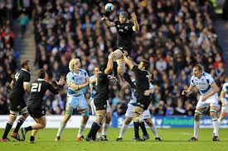
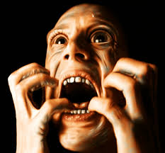
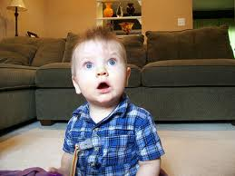
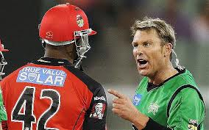
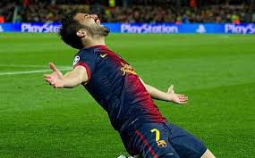
Match the pictures to the aspect
In your jotter write which picture matches the relevant aspect of the Emotional factor
A
Happiness
E
Fear
Trust
Anger
Surprise
B
C
D

Slide 5
Emotional Factor Task
Discuss each aspect of the emotional factor in your group. Come up with one example of when this aspect may occur during a game of Basketball. One person from your group will feedback your group’s answers to the class. Here are some examples, you may not use these!!
Happiness – You scored an absolute stoater of a jump shot to win the match!
Fear – A giant was man marking you and was overly aggressive in defence.
Surprise – You won a rebound against the giant.
Anger – The referee did not see you being fouled by the giant.
Trust – A taller more physical player decided to mark the giant on your defence.

Slide 6
How can the emotional factor affect performance?
Here are some ways in which the following factors may impact performance.
Happiness / Sadness – May have an impact on confidence, self belief, you may doubt your own ability. You may be more optimistic or pessimistic.
Anger – Will impact on self control, decision making, clarity of thought.
Fear – Will impact on decision making, confidence, nerves.
Trust – This will affect self respect, respect for team mates, confidence I your own ability and others to execute roles/tasks etc.
Surprise – This will impact on decision making , resilience, confidence.

Slide 7
Task
Choose three aspects from the Emotional factor. In your jotter write how each aspect had an impact on your performance in any sport of your choosing. The same sport must be used for each factor. (6)

Slide 8
Task Sample Answer
The three aspects from the Emotional factor l will discuss are Happiness, Anger and Fear, l will use Basketball as my sport.
Happiness had an affect on my performance as scoring an impressive lay up made me feel good about myself and boosted my confidence to attempt the shot again which I did repeatadly. My teammates also congratulated me on this making me feel happy and boosting my confidence, l was now able to play to the best of my ability.

Slide 9
Sample Answer Cont.
Anger affects my decision making at times, especially when the referee makes bad decisions. This leads to me not thinking clearly and making simple mistakes such as shooting when I should pass to a team mate in a far better position. I can also get angry at my team mates when they do not pass the ball, this causes disharmony and a negative atmosphere in the team which is not positive.

Slide 10
Sample Answer Cont.
Fear contributes a great deal to my performance particularly when playing tough opponents, I feel under pressure to play well and this makes me feel un easy and begin to doubt my ability when compared to the opponent. Fear also affects me when taking free throws as I can get nervous and loose concentration resulting in me missing the shot.

Slide 11
Methods of Investigating……..
Disciplinary Record
Questionnaire / Self Reflection
Coach Feedback
Profile of Mood States Test (POMS) http://www.brianmac.co.uk/poms.htm

Slide 12
Emotional Questionnaire
Here is an example of an emotional questionnaire for elite level sportspeople:
http://www.midss.org/content/sport-emotion-questionnaire
PS, its at bottom of page, word doc.

Slide 13
Disciplinary Record
Below is an example of a Basketball disciplinary record. A skilled assessor needs to fill this in as they know what to look for and are a reliable source.
Foul Type | Game 1 | Game 2 | Game 3
Technical (unsporting)
Personal (types of contact)
Flagrant (violent conduct)
Shooting (illegal prevention)

Slide 14
Task
Describe one method you used to investigate the Emotional factor, explain how you carried out this investigation in detail. (4)
Explain and justify why you chose this method of investigation (4)

Slide 15
Task break down
Question 1
Name the method you used. Explain how you went about executing this method, tell us what you did, when you did it & how you did it etc. (2)
Provide evidence from the method to prove you actually did it, such as: questions from the questionnaire, things your coach would assess you on, POMS questions / test criteria. Diagrams are allowed. (2)
Question 2
Ease of use?
Reliable source?
Can be easily re tested after training?
Shows strengths / weaknesses?
Instant feedback?
Gives motivation to improve?

Slide 16
Task
Describe one method you used to investigate the Emotional factor, explain how you carried out this investigation in detail. (4)
Explain and justify why you chose this method of investigation (4)

Slide 17
Development Approaches
Here are some approaches you can use to develop weak areas of the Emotional Factor:
Team meetings / talks.
Self Talk – The 3 R’s, Recognise, Regroup & Refocus.
Mental Rehearsal
Conflict Management techniques
Rewards , prizes, bonus’s (Internal & External).

Slide 18
Team Meetings/Talks
Most team meetings are done before a game. The coach will review opponents, discuss tactics for the upcoming game.
However, team meetings can also be used for:
Post match analysis
Players to air their grievances etc, express their feelings, settle any on pitch disputes etc.
Share their opinions
Team Talks
Pre game / Mid game, re enforce tactics, motivation.
Post game, immediate feedback.

Slide 19
Self Talk the 3 R’s
Recognise, Regroup and Re focus.
These three aspects can be done during training drills for each sport. They would be most effective during pressurised situations / drills or conditioned / training games or during real matches.
Their aim is to make you realise what you are doing poorly, quickly think of positive thoughts to settle your mind / emotions and continue on. Top level sports people do this regularly during breaks in their performance.

Slide 20
Conflict Management
You are about to watch a video on how business’s deal with conflict between their employee’s. As you are watching the video think about how many of the strategies used can be applied to sport. You may well have had experience of this.
http://www.meettheboss.tv/video/pt-4-how-we-manage-conflict-google

Slide 21
Development Needs Task
Your friends Football team has just lost 5-0 to their local rivals. During the game two players received Red cards for violent conduct and abusive language. The player who used abusive language did so after arguing with your Goalkeeper after a mix up in communication between the two leading to a goal. Both players had to be separated to prevent a fight. In addition one of your team mates has told you that they think two of the players in the team are not good enough and doesn’t want them to play. The manager has also blamed some players publicly for poor performances resulting in serious disharmony in the team.
As a group, discuss which development approach would aid this team the best, provide 3 reasons why you think this is the case.

Slide 22
Monitoring Emotional Development
Here are methods that can be used to monitor your development throughout the Emotional Factor.
Training Diary to record thoughts and feelings
Disciplinary record’s, compare and contrast
Questionnaire’s, compare and contrast
Coach feedback

Slide 23
Revision
Q 1 – Explain how the Emotional factor impacted on your performance, use any sport of your choice (4)
Q 2 – Discuss one method that you used to investigate within the Emotional Factor. Describe how you carried out this method. (4)
Q 3 – Justify your decision to use this method of investigation (4)
Q 4 – Review the information you gathered, making reference to your performance strengths and development needs. (4)
Q 5 – In detail describe a development approach you used to improve you development need(s), explain a training session you did using this method and how you would progress it. (4)

