Slide 1
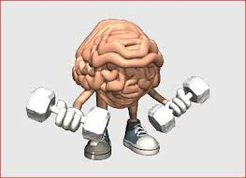
The Mental factor

Slide 2
Plagiarism Warning
Throughout this power point there are sample answers. Please note that these sample answers are not to be used as your own work they are for reference only. If you fail to comply with this request you will be at risk of failing the course.

Slide 3
Cycle of Analysis (How do we get better at....)
Investigate
(Testing/observing)
Analyse
(Interpret results, pinpoint strengths & weaknesses)
Develop
(Training to develop weaknesses)
Evaluate
(Re testing, observing, has training worked?)

Slide 4
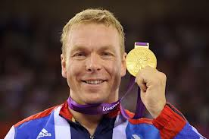
Sir Chris Hoy
Watch this short video clip, where Sir Chris Hoy speaks about the importance of the mental factor on performance. Try to think how much the mental factor effects your performance before during and after you match/performance.
http://www.bbc.co.uk/learningzone/clips/preparing-for-a-cycle-sprint-race-positive-mental-attitude/5653.html

Slide 5
Aspects of the Mental Factor
Concentration
Level of arousal
Motivation
Decision making
Problem solving
Cue recognition
Processing information

Slide 6
Group task
For each aspect within the mental factor discuss and create a definition for each one. To help you think of times when you may have used that factor during a sporting performance
Eg. – Processing information – Being able to think clearly and thoroughly about what has happened and is about to happen

Slide 7
Mental Factor definitions
Concentration – The fixing of close undivided attention, ultimate focus.
Level of arousal - How ready a person is to perform appropriate tasks in a timely and effective manner.
Motivation - A reason or reasons for acting or behaving in a particular way.
Decision making - The thought process of selecting a logical choice from the available options.

Slide 8
Mental Factor Definitions Continued
Problem Solving -The process of working through details of a problem to reach a solution.
Cue Recognition - The identification of something as having been previously seen, heard, known, etc.
Processing Information - Being able to think clearly and thoroughly about what has happened and is about to happen

Slide 9
Group Revision Test
What are the seven aspects within the mental factor?
C___________________
L_____ O_ A__________
M______________
D___________ M___________
P_____________ S________________
C__ R________________
P______________ I_____________

Slide 10
The importance of the Mental Factor
Watch the following clip:
http://www.bbc.co.uk/education/clips/zwbh34j
Discuss this video in a group for 5 minutes answering the following questions:
1 – What do you think is meant by mental toughness and how do you get this?
2 – How can you deal with nerves before a big performance?
3 – What causes you to have nerves?

Slide 11
10 minute task
Pick two sports and two aspects from the Mental Factor. Explain how these factors impacted your ability to perform in both sports.(4)
(State what happened and then what came about as a result!)

Slide 12
Individual Task
Task 1
Evaluate which three Mental Factors are most important for successful performance in Badminton? Why?
Task 2
For each factor you have chosen above, describe two situations during a Badminton match where you used these factors.

Slide 13
How can we investigate/test in the Mental factor ?
SCAT (sport competition anxiety test) http://www.brianmac.co.uk/scat.htm
Questionnaires
Self Reflection Sheet
Profile of mood status (POMS)
http://www.brianmac.co.uk/poms.htm

Slide 14
Self Reflection Sheet
Game 1
Key – 1 – Not at all 2 – A little 3 – Sometimes 4 – More so than normal 5 – All the time
Loss of Concentration | 1 | 2 | 3 | 4 | 5
Poor Decision Making | 1 | 2 | 3 | 4 | 5
Lack of Cue Recognition | 1 | 2 | 3 | 4 | 5
Lack of Motivation | 1 | 2 | 3 | 4 | 5
Slow Anticipation | 1 | 2 | 3 | 4 | 5
Performer fills this in themselves after a performance has ended.
This hopefully ensures reliability
Gives clear and instant feedback to the performer
Criteria is chosen by performer to make it specific to their needs

Slide 15
Questionnaire
Badminton – Mental Factor Questionnaire | ALWAYS |  | SOMETIMES |  | NEVER
 | 1 | 2 | 1 | 2 | 1 | 2
I am in the ready position when I am receiving service
I take my time and stand in the correct place when I am the server
I am aware of the score and know which side of the court to be on for the next service
I try to return to the BASE position after each shot in a rally
I am trying to move my opponent around the court during a rally
This can be filled in by a skilled observer or by the performer if they are using Video footage
Questions can be changes to suit performers needs
Questions can be linked to certain aspects of the Mental Factor to analyse any weaknesses

Slide 16
Development Approaches (Training)
Relaxation techniques
Mental rehearsal
Positive self talk
Thought blocking

Slide 17
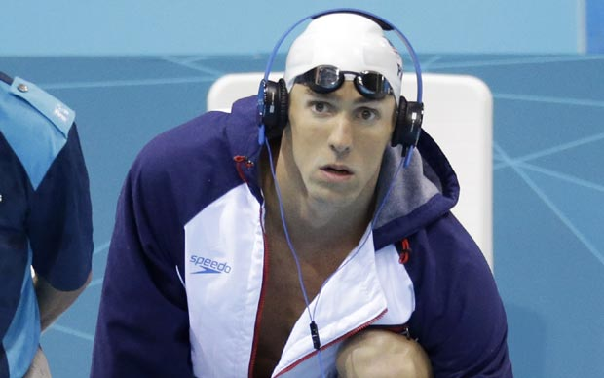
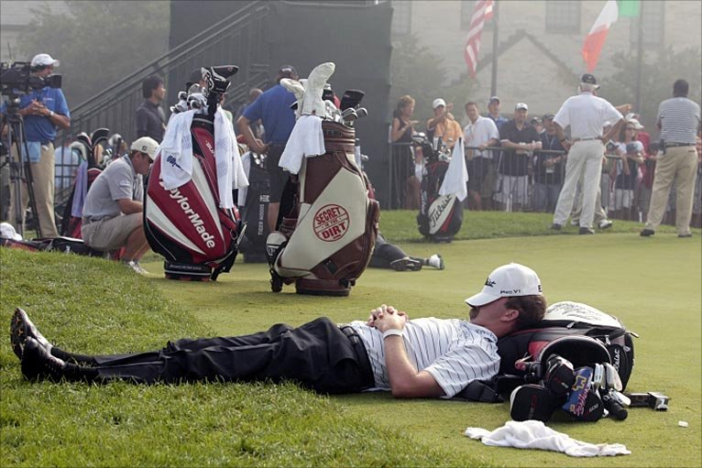
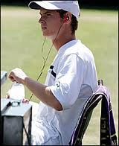
Relaxation Techniques
Music, sleep, meditation anything to de stress yourself
This is mostly done pre performance, but can be very useful mid performance to lower levels of anxiety and arousal.
Most sportsmen and women listen to music pre match, this helps calm nerves and aids concentration

Slide 18
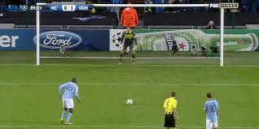
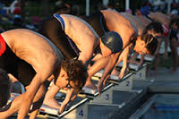
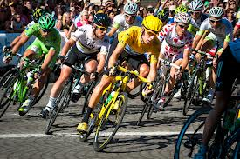
Mental Rehearsal
Used to prepare mind for tactics, skills, fitness requirements, environment, crowd distractions etc.
Aim is to relax performer when situation that has been rehearsed arises so that they can perform effectively to a high standard.
Footballers mentally prepare and rehearse before taking a penalty kick, the swimmer rehearses their dive technique, the cyclist rehearses tactics etc.

Slide 19
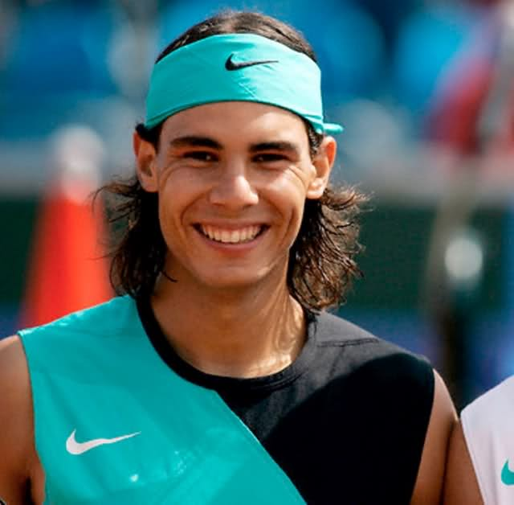
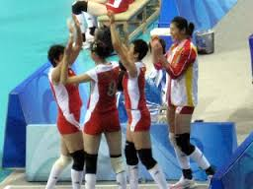
Positive Self Talk
Uses supportive phrases to boost motivation and arousal
If you watch Rafael Nadal play tennis you will likely hear him say ‘Vamos’ = ‘come on’ this motivates him to before better etc.
Volleyball teams always high five and praise one another after every point to boost morale, not matter the point outcome.

Slide 20
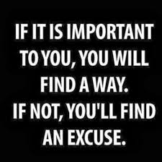
Thought Blocking
This means any negative thoughts are immediately turned into a positive, this has a great effect on happiness, motivation, concentration, level of arousal etc
If you think negative thoughts you will perform negatively
Positive Mental Attitude (PMA)

Slide 21
Pressure Drills
Puts performer under high intensity situations
Over exaggerates real game scenario’s or specific skills
Forces performer to concentrate fully to be successful
Watch the video below and see how a basic skill can be exaggerated to develop concentration.
https://www.youtube.com/watch?v=GqUPIE0bdsw

Slide 22
Mental factor development approaches group task
Create a twenty minute training session to improve any aspect from the Mental Factor. You may use more than one development approach if you wish.

Slide 23
Training in the mental Factor
One method you could use is conditioned games in a ladder tournament format, the condition is each game lasts two minutes making games short and pressurised. Within the two minutes you would adopt one of the training approaches, such as mental rehearsal or rational thinking and after each point you would practice your chosen training approach before the next point.
Here is a sample answer:
The training approach is used was mental rehearsal, this helped me to improve my concentration. I played in a ladder tournament with each game lasting two minutes. After each point I would rehearse what I was going to do in the next point. If I was serving I would think carefully about where to place the service and rehearse in my mind what I needed to do to execute this accurately. If I was returning the serve I would rehearse what I would do if it was a short serve or a long serve. By doing this my concentration improved greatly and I was not distracted by any external factors.

Slide 24
Individual Task
Describe what your major weakness was within the mental factor and two approaches you used to improve this area of weakness. Describe what you actually did and how you did it. In addition, explain what result it had on your performance.

Slide 25
How can we monitor our development?
To make sure our training is effective and is making us better there are several methods we can use to check on this.
Training Diary
SCAT test, compare to old results
Observation schedule’s
Coach feedback
Match results
Self reflection / personal thoughts

Slide 26
Why monitor?
To check it is effective, relevant to development needs, long term targets.
Make sure short term targets are met, progress is being made.
Provide motivation to further improve.
Make adaptations to training if necessary.
Ensure strengths are maintained while weaknesses improved.

Slide 27
Mental Test
Complete these questions in your jotter, you do not need to write the question.
1 – List three methods you can use to monitor your development?
2 – Name 4 aspects of the mental factor?
3 – What does SCAT as in the SCAT test stand for?
4 – Visualisation, mental rehearsal, rational thinking, positive self talk are all forms of what?
5 – What does Cue Recognition mean?

