Slide 1
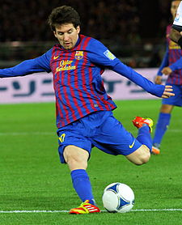
The Physical Factor

Slide 2
Plagiarism Warning
Throughout this power point there are sample answers. Please note that these sample answers are not to be used as your own work they are for reference only. If you fail to comply with this request you will be at risk of failing the course.

Slide 3
Cycle of Analysis (How do we get better at....)
Investigate
(Testing/observing)
Analyse
(Interpret results, pinpoint strengths & weaknesses)
Develop
(Training to develop weaknesses)
Evaluate
(Re testing, observing, has training worked?)

Slide 4
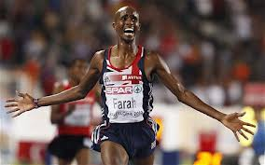

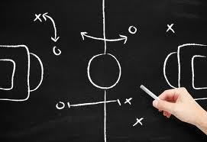
The three areas of the physical factor……
Fitness
Skills
Tactics

Slide 5
Fitness

Slide 6
Aspects of Fitness
There are two sections within fitness, these are:
Physical Fitness
Skill Related Fitness

Slide 7
Physical Fitness
These are all the aspects of physical fitness, copy them into you jotter.
Aerobic endurance (CRE)
Anaerobic endurance
Speed endurance
Flexibility
Strength
Muscular endurance
Speed
Power
Write these in your jotter now!

Slide 8
Individual Task
For each aspect of physical fitness create a definition and write it in your jotter. Try to not use the word your are defining in your description.
Once you are finished swap jotters with a partner and mark each others answers.

Slide 9
Physical fitness definitions
Aerobic endurance – The ability of the heart lungs and full body to work for an extended period of time.
Anaerobic endurance - A form of endurance characterized by the absence of oxygen, high intensity situations.
Speed Endurance – Maintaining high or above average speed for an extended period of time
Flexibility – The range of movement across a joint
Strength – The amount of force a muscle or group of muscles can exert in one effort.
Muscular endurance – The ability of a muscle or group of muscles to work for a extended period of time.
Speed – To cover a distance or a movement in a short period of time.
Power – The combination of speed and strength

Slide 10
Methods of Collecting Data
How can I investigate Fitness?
Standardised fitness tests
Time related observation schedules
Digital/Video analysis
Heart rate monitor

Slide 11
Standardised Fitness Tests
Aerobic endurance – Cooper Test, Bleep Test, Yoyo test
Anaerobic endurance - Cunningham & Faulkner Endurance test, (www.brianmac.co.uk/cunandf.htm )
Power – Standing Long jump, vertical jump
Muscular endurance – 60sec press-up, sit-up, plank etc test
Speed Endurance – 150m sprint test
Flexibility – Sit and Reach test
Strength – Handgrip Dynamiter, 1 rep max test
Speed – 30m sprint test

Slide 12
Group Task
The following slide contains pictures of physical fitness tests. As a group decide which picture matches each aspect of physical fitness. There is however one picture and one aspect of physical fitness missing, can you work it out?
You have 2 minutes…..

Slide 13
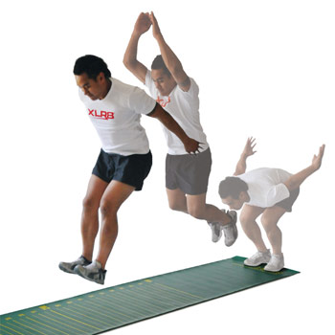
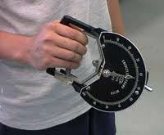
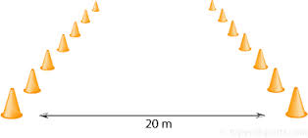
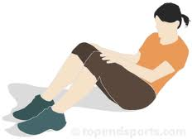
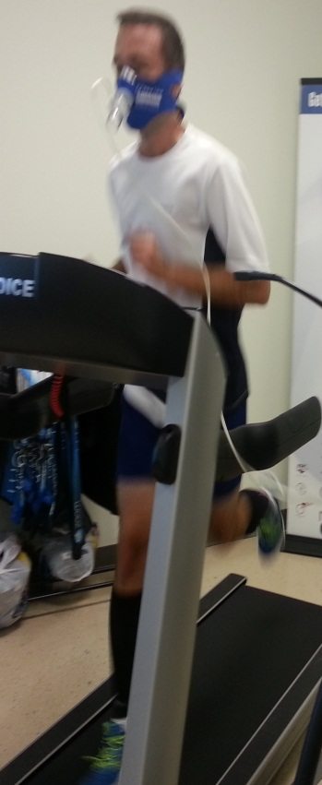
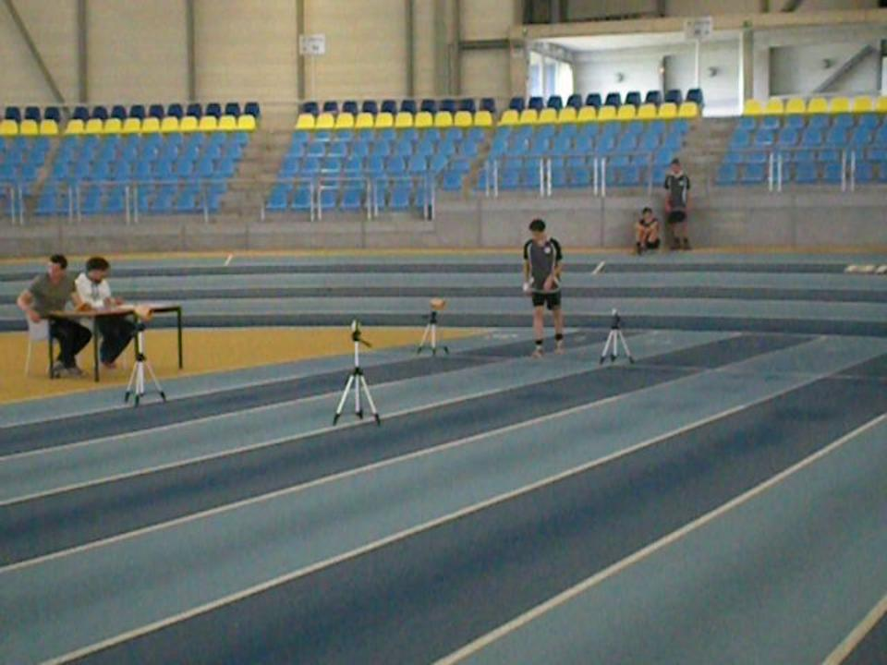

Which aspect and matching test is missing?

Slide 14
Fitness Task 1
In your jotter write down the name of four fitness tests you know of. Choose one, draw and label a diagram of how you would conduct this test.
Fitness Task 2
Describe what you think the word standardised means, as in standardised fitness tests.

Slide 15
Time Related Observation Schedule
Time (minutes) | Aerobic Endurance | Speed | Power | Flexibility | Strength
0-3
3-6
6-9
Purpose is to see how fitness deteriorates
Filled out over 3 matches back to back without rest
Opponents to be of similar standard
Skilled / trained assessor to fill in
Broken into time zones to allow greater clarity and analysis
*please note, not all fitness aspects are covered in this (TROS).

Slide 16
Physical Fitness Task
Revise the methods of how you can investigate your physical fitness.
Task
Describe one method of investigating physical fitness. (3)
How do you do it, not why you do it!
What do you need to do it?
What are the rules?

Slide 17
Development Approaches
Aerobic / Anerobic Endurance – Fartlek training, Interval Training, Continuous Training
http://www.howcast.com/videos/506933-Fartlek-Tempo-and-Hill-Training-Running
Muscular Endurance – Circuit Training
Speed – Sprints, Weights, Plyometric’s
Strength – Weight training
Power – Body weight / weight training, Explosive drills specific to sport demands.

Slide 18
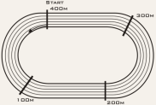
Fartlek Training Example
20 minutes continuously jogging around the track, in the sprint zone’s 100% speed must be used. The sprint zone’s are marked with lines. After 20 minutes they will get 5 minutes rest then repeat this 3 times.

Slide 19
Why use Fartlek?
Easily adapted to suit your facility and set up.
Easily progress to make more complex or easier if needed.
Includes realistic high intensity bursts similar to your activity eg, Football, Badminton, Rugby Etc.
Will dramatically improve aerobic and anaerobic endurance.
Challenging mentally and physically.

Slide 20
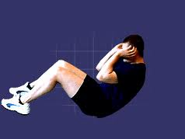
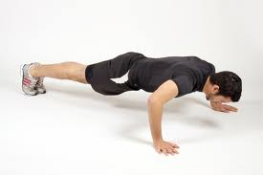
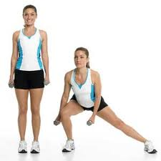
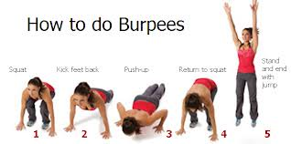
Circuit training Example
1 minute per exercise, 1 minute rest between exercises. Complete all exercises in order 3 times.
1.
3.
4.
2.

Slide 21
Why use Circuit Training?
Exercises can be adapted to suit needs
Fun and challenging
Will force muscles to work for long periods of time to improve them
Can be done with team mates or on own
Easy to set up and execute

Slide 22
Power Example
The video you are about to watch shows a basic exercise to develop power in the legs which helps jumping & kicking.
http://www.stack.com/video/84638804001/develop-jumping-power-with-texas-am-track-and-field/
What exercises could you use to develop upper body power?

Slide 23
Why use plyometrics/body weight exercises?
Will really improve power in specific areas of body
Fun and challenging
Can be easy to set up
Targets and scores can be easily made to set targets
Will have minor benefits to strength anaerobic endurance

Slide 24
Principles of Training
In order for training to be effective and relevant you need to apply the Principles of Training:
Specificity – Weakness, sport, role in sport.
Progressive Overload – Gradually making training more complex, can be done by (F.I.D)
Frequency – how many times you train
Intensity – how hard you train
Duration – how long you train for
Reversibility - adapting training various reasons, injury, lack of facility etc.
S.P.O.F.I.D.R

Slide 25

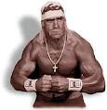

Remember…….
For you to improve at anything within sport you must gradually make your training more difficult or else you will just plateau!

Slide 26
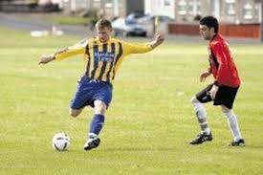
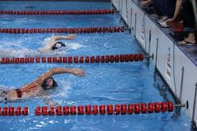
Fitness Scenario’s….
Read the statements of the people below. Design a 20 minute training session for each person in your jotter using a relevant development approach.
‘The goal was my fault. I should’ve closed him down and blocked the shot or at least made a tackle. Now we’re one down with two minutes left to play’
‘Can’t believe I’m going to be second again. I ‘ve got nothing left, my shoulders are really sore, I couldn’t pull as hard as before’

Slide 27
Fitness Task
In your jotter, draw a 3 week training programme. The programme must develop one aspect of physical fitness only and it must show progressive overload. You must have 3 fitness training sessions per week with the first session lasting 20 minutes.

Slide 28
Fitness Task 2
Discuss why you chose your selected method of training to develop your weakness. (4)
Describe the decisions you had to make after the first week of training? (2)

Slide 29
Skill Related Fitness
These are the aspects of Skill Related Fitness, write them down in your jotter:
Agility
Balance
Core stability
Reaction time
Coordination

Slide 30
Skill Related Fitness Defined
AGILITY– Is the ability to move the body quickly and precisely.
BALANCE - Is the ability to maintain the centre of gravity above the base of support. Static balances require You HOLD a position. Dynamic balance requires you to maintain balance in ever changing circumstances
CORE STABILITY – Strength in the mid region of your body allowing balanced movement
REACTION TIME – Is the time taken between the recognition of a signal and the start of your movement.
CO-ORDINATION - Is the ability to control movements smoothly and fluently. Groups of muscles must work in sequence to produce an effective performance.

Slide 31
Personal Task
Select three aspects of Skill Related Fitness, write a paragraph in your jotter as to why you need a high degree of ability within these aspects to perform successfully from any sport you wish. Make reference to particular skills from you chosen sport where these aspects of skill related fitness are needed greatly.
Extension task
Using the three aspects of Skill related fitness you spoke about in your previous answer, draw and describe a training drill or practice that would develop your ability in all three aspects from your chosen sport.

Slide 32
Monitoring Tools
Training Diary
Results from matches
Video analysis
Observation schedules
Coach feedback

Slide 33
Why monitor training?
To check it is effective, relevant to development needs, long term targets.
Make sure short term targets are met, progress is being made.
Provide motivation to further improve.
Make adaptations to training if necessary.
Ensure strengths are maintained while weaknesses improved.

Slide 34
Skills

Slide 35
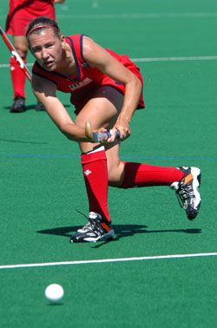
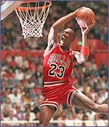

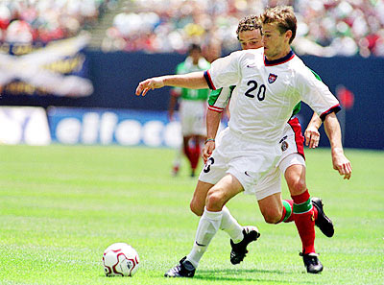
What are Skills & Techniques?
A skill tells you the purpose of the movement, E.g. “passing”.
A technique is the way of performing a skill, E.g. push pass, hit or reverse pass in Hockey. The technique tells you “how” a pass was made.
Task 1
In your jotter write down two skills from the following activities and
two different techniques for each skill.

Slide 36
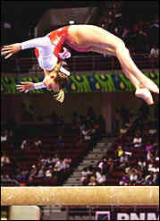
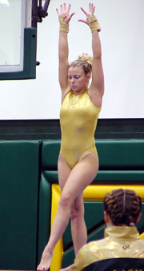
Easy and Complex Skills
Easy Skills Complex Skills
Few judgements to be made Many judgements
Undemanding Demanding
Little co-ordination needed Co-ordination vital
Simple movements Complicated movements
Easy environment (no opposition) Difficult environment
Which one of these skills is easier to perform?
A back flip is more difficult (complex)
than balancing on one leg (easy).

Slide 37
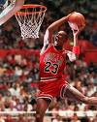
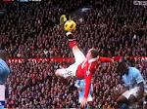
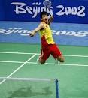



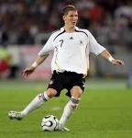
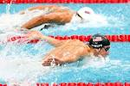
Task
Match the pictures of the Easy and Complex skills together from each activity.
For each activity, name the complex skill and the simple skill. Write these in your jotter.

Slide 38
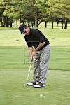
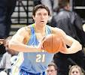
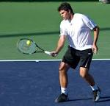
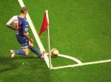


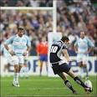

Odd one out……….
Spot the two complex skills in amongst the simple skills………………....
Why are the Volley in Tennis & Spike/Smash in Volleyball the complex skills?

Slide 39

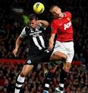

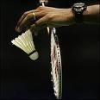
Open and closed skills
Skills are classed as ‘open’ if they are performed in unpredictable situations, such as dribbling the ball in Basketball or heading the ball in Football.
Skills are classed as closed if they are performed in controlled situations, such as the Tee off shot in Golf or a serving in Badminton.

Slide 40
Stages of Skill Learning
There are 3 important stages when learning and developing skills
These are:
Cognitive stage
Associative stage
Autonomous stage

Slide 41
The Cognitive Stage
The performer needs to:
Get a mental picture of the skill or technique to aid learning
Understand the basics of what is to be learned
Break the skill down, prep, act, recovery
Receive information in small chunks, this will aid information processing
Receive corrective feedback

Slide 42
The Associative Stage
The performer can:
Understand what is expected in performing the skill
Focus on improving the basics learnt
Handle more specific information
Attempt to recognise and correct their own errors (kinaesthetic awareness)
Make better sense of external feedback given, due to an enhanced knowledge of the skill’s sub routines.

Slide 43
The Autonomous Stage
The performer can now:
Select and apply skills without conscious thought
Perform skills to a consistently high degree
Detect own errors and adapt/refine performance accordingly
Concentrate more on tactics and strategies

Slide 44
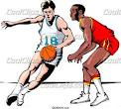
What stage of learning are you at?
Pick a skill/technique from an activity of your choice.
Describe a practice/training drill that you could do for each stage of learning for the same skill.
Use the example below to help you:
Basketball – Dribbling
Cognitive Stage Practice – Walking/light jog dribbling the ball through a slalom of cones.
Associative Stage Practice – Dribbling at pace through the cones, under pressure eg. A race against another person or a passive defender trying to chase you down.
Autonomous Stage Practice – Dribbling through cones against an active defender.

Slide 45
Methods of investigation
How can I investigate my skills?
Games skills analysis
Video analysis
Skills tests
Coach feedback

Slide 46
Games Skills Analysis Sheet
Here is an example of a basic Games Skills Observation Schedule. You would need a skilled assessor to fill this out for you as they can identify each skill easily.
Skill | Successful | Unsuccessful | Total
Shooting
Dribbling
Passing
Re Bounding
At the end of the game you would total each skill to find what is your strength and weakness.

Slide 47
Coach Feedback and Video analysis
Try to think about the importance of both of these methods of investigating as you watch the video. How could you carry out these methods? Why are they good to use? What makes them reliable as a source of investigation?
http://www.bbc.co.uk/education/clips/zs74q6f

Slide 48
Skills Task
In your jotter draw a games skills analysis observation sheet that you could use for a sport of your choice. Make sure this includes the major skills of the game alongside success criteria. Remember this is another form of observation schedule but focusses on skills, not fitness.

Slide 49
A simple Question…….
Describe one method you used to investigate your performance within the physical factor (skills)? (3)
As a group or with a partner, write an answer to this question, remember it is worth 4 marks.
How did you do it?
Rules?
Equipment needed?

Slide 50
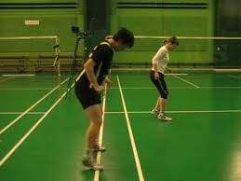
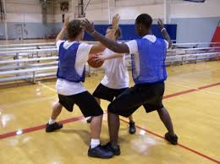
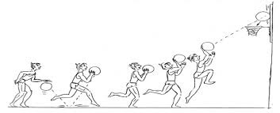
Training Approaches (Skills)
Shadowing
Pressure Drills
Gradual Build Up

Slide 51
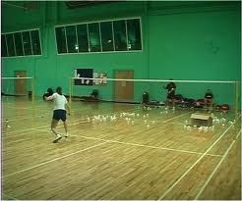
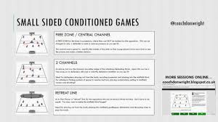
Training Approaches (Skills)
Repetition Drills
Conditioned Games

Slide 52
Skills Training Task
Select a skill from your chosen Sport. Using relevant development approaches, design a 20 minute training session to improve that skill.

Slide 53
Skill Training Example
Training Approach – Repetition Drill
Skill – Shooting
Technique – Lay –up
Drill – I would perform 10 lay up’s with my right hand beginning my run up from the same spot each time. There is no defender. After each set of 10 Lay Up’s I will record how many l get in in my training diary. I will do 5 sets in total. To make this drill more complex I could add in a passive defender or set myself targets to achieve.

Slide 54
Principles of Effective practice
So that your practice is of the best quality each time you should incorporate the principles of effective practice, These will stop training from becoming boring, too easy or difficult or not make any real progress in getting better. The principles are:
Progression
Work to rest ratio
SMARTER target setting

Slide 55
Principles of Effective Practice
SMARTER – Goal Target Setting
S – Specific, to stage of learning, activity or task
M – Measurable, this helps the performer assess their progress and set comparisons to model performers
A – Agreed, usually between coach and performer to ensure appropriate methods of practice have been selected
R – Realistic, challenging targets, not too hard or easy
T – Time-phased, a set time to reach a goal or certain level of performance
E – Exciting, keeps the performer motivated, use of variety and challenge needed here
R – Recorded – ensures commitment to practice and to skill development. Clear feedback.

Slide 56
Monitoring Tools
Training Diary
Results from matches
Video analysis
Observation schedules
Coach feedback

Slide 57
Tactics

Slide 58
Tactics
There are two main areas within tactics, these are:
Performance considerations
Principles of play

Slide 59
Performance Considerations
This basically means the things you need to think about before your performance in order to select and apply a suitable tactic.
Things to think of:
Your own strengths & weaknesses
Your team’s strengths & weaknesses
The type of surface you using
The weather
Previous performance’s, matches against opponent etc.

Slide 60
Principles of Play
These are things to think about during and before the game, they are more technical than performance considerations. Principles of play are:
Width
Depth
Delay

Slide 61
Methods of Collecting Data
How can I test my tactics?
Match tactics Ob Schedule
Video analysis
Coach feedback
Knowledge of results

Slide 62
Tactics Task
Choose one of the following tactics from Football:
The Offside trap
Short direct passing
The Long ball
Man to man marking
Zone Defence
Create an observation schedule you could use to investigate your team’s level of performance in this tactic.

Slide 63
Development Approaches
Passive / active defenders as opponents
Walk / jog / run through drills
Conditioned Games
Conditioned Rallies
Repetition Drills

Slide 64
Monitoring Tools
Training Diary
Results from matches
Video analysis
Observation schedules
Coach feedback

Slide 65
Investigating in the physical factor
There are many methods you can use to investigate your performance within the physical factor these could be:
Standardised fitness tests
Time related observation schedules
Games skills analysis Observation schedule
Tactics observation schedule
Video analysis
Coach feedback

Slide 66
A simple Question…….
Describe one method you used to investigate your performance within the physical factor? (4)
As a group or with a partner, write an answer to this question, remember it is worth 4 marks.

Slide 67
A simple answer………..
One method I chose to investigate my performance within the physical factor was a Time Related Observation Schedule. I played three 9 minute matches back to back without rest, I wanted to really push and test my fitness. (1) I also played opponents of similar ability to me so that they were not tired and so that the games would be challenging.(1)
Firstly l got my coach to fill out the sheet as they know what to look for. The sheet was filled with fitness criteria such as speed, power, flexibility & aerobic endurance. When my coach saw a skill linked to the aspect of fitness played well they would place a tick in the appropriate column and if it was done poorly it would be a cross.(1) To add to this I inserted rows related to the times of the match. This allowed me to see how my fitness deteriorated as the games went on.(1)

Slide 68
Another simple question……..
Describe why you chose your method of investigating within the physical factor? (4)
As a group or with a partner write an answer to this question, remember it is worth 4 marks

Slide 69
Another simple answer…..
I chose a time related observation schedule because l knew my coach would be reliable to fill it in accurately as they know the fitness demands of Badminton.
Secondly I knew that I would clearly be able to identify my strengths and weaknesses at the end of the process allowing me to then formulate a training programme.
I also knew that it would be fairly easy to set up and also to retest after I complete my training programme.
Moreover, l knew that it would give me motivation to improve as l recently lost some matches due to being tired, this means my fitness is poor and needing improvement.

Slide 70
Revision
What is a complex skill?
Name 3 aspects of physical fitness and a test for each.
Give three reasons why it is important to monitor training?
Describe for four marks, how you carried out a (TROS).
Name two development methods for improving skills?
Describe your strengths within the physical factor.
Detail your development needs within the physical factor.

