Slide 1
The Social Factor
What are they?
How Do we investigate/test?
How can we train/develop?

Slide 2
Plagiarism Warning
Throughout this power point there are sample answers. Please note that these sample answers are not to be used as your own work they are for reference only. If you fail to comply with this request you will be at risk of failing the course.

Slide 3
What makes a good team?
Watch this video thinking about how the social factor can impact on a team:
http://www.bbc.co.uk/education/clips/zhwgd2p

Slide 4
The Social Factor There are three main areas within the Social Factor these are: Group Dynamics Cultural / Societal Issues Environmental Issues

Slide 5
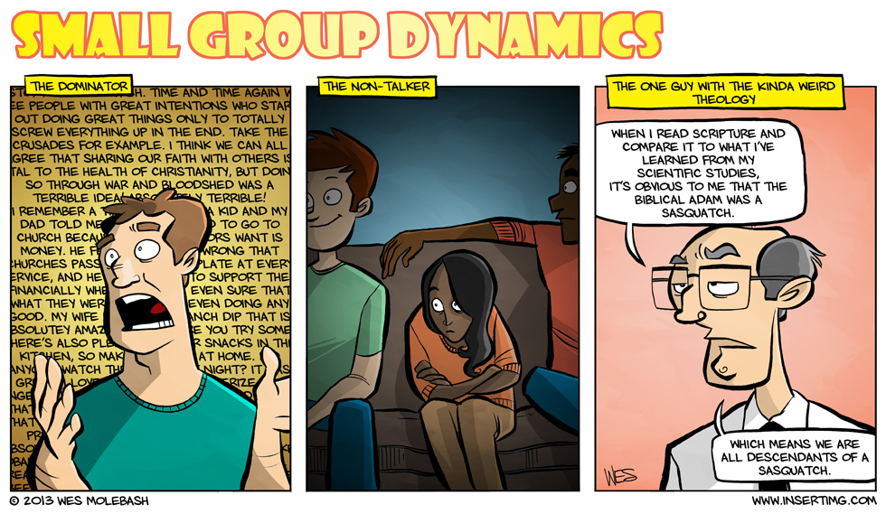
Group Dynamics

Slide 6
Group Dynamics
Co operation
Contributing to the team
Roles/responsibilities
Team dynamics
Ethos / atmosphere
Communication

Slide 7
Group Task
As a group decide which is the most important aspect of group dynamics eg. Co-operation.
Give two reasons to support your answer
Choose a spokesperson for your group to speak in front of the class to share your group’s thoughts.

Slide 8
Individual Task
Select one aspect from Group Dynamics.
Write about a time from Volleyball where this aspect led to a positive outcome on your whole performance. Then write for the same aspect a negative and what happened to your whole performance as a result. (2)

Slide 9
Cultural and Societal Issues

Slide 10
Cultural and Societal Issues
Inclusion
Gender
Etiquette
Respect for others
Respect for self
Fair play
Motivation, internal and external

Slide 11
Cultural and Societal Issues
Answer the questions in your jotter
1 – How can you demonstrate etiquette in Volleyball?
2- Inclusion is important when playing as a team, why is this?
3 – Give two examples of internal motivation?
4 – Give two examples of external motivation?
5 – Why must you show respect to your team mates?

Slide 12
Environmental Issues

Slide 13
Environmental Issues
Facilities
Cost
Location
Weather

Slide 14
Environmental Issues
In your jotter write a brief description of how:
Facilities
Cost
Location
Weather
Can affect your participation in your chosen sport.

Slide 15
Individual Task
Describe how the Social factor impacts your performance during a game of Volleyball, Football or Badminton. (4)

Slide 16
The Social Factor had a big impact on my performance during a game of Volleyball. Our team normally has a good dynamic but for some reason we lacked communication during our last match, sometimes two players would try to dig the same ball resulting in a weak set for the spike. Also the setter in the team didn’t fully understand their role so they would quite often leave the second pass and not set the ball for a spike. Prior to this in the warm up some of the players in the team did not take the warm up seriously this led to a negative atmosphere between the players as they did not co operate with the coach or other players. This probably caused the poor communication, disharmony and lack of respect within the team.
On a positive note, the second set went slightly better after a team talk. We began to regain respect for each other and also showed proper etiquette to our opponents. This resulted in a much more positive atmosphere where we fully co operated and included each other to win more points than we had previously as everyone knew their role within the team.

Slide 17
How can we investigate/test?
Surveys
Coach feedback
Video and audio analysis
Team mates feedback

Slide 18
How can we investigate/test?
Here is an example of a survey you could undertake in the social factor.
Key
1 – very poor, 2 – poor, 3 – average, 4 – good, 5 – excellent
A – How good is your team at communicating with each other? 1 2 3 4 5
B – How good is your team at encouraging each other? 1 2 3 4 5
C – How good is your team at helping each other, giving feedback? 1 2 3 4 5
D – How good is your team at organising practices/drills/training? 1 2 3 4 5
E – How good is your team at displaying sportsmanship/etiquette? 1 2 3 4 5
If each person in your team filled this out and the results were collated, your team would gain valuable knowledge about how well you socially interact.

Slide 19
Training in the social factor
Watch the following video on communication and co operation, be patient it does take a while:
https://www.youtube.com/watch?v=Fts0M82dcdg
As a group design your own training drill to work on one of the following aspects from the social factor:
Co operation
Communication
Roles and responsibilities

Slide 20
Monitoring Tools
Training Diary
Results from matches
Video analysis
Observation schedules
Coach feedback
Team mate feedback

Slide 21
Why monitor training?
To check it is effective, relevant to development needs, long term targets.
Make sure short term targets are met, progress is being made.
Provide motivation to further improve.
Make adaptations to training if necessary.
Ensure strengths are maintained while weaknesses improved.

Slide 22
Revision
Name 3 methods you could use to investigate within the social factor?
Describe how you carried out one of the methods above for four marks.
List two environmental issues from the social factor.
Describe one of the environmental issues and describe how it could affect your performance in any sport of your choice.
Describe a training drill you have done to develop the social factor and how you would progress it?

