Slide 1

WHY STUDY
GEOGRAPHY?
Senior Option Choices

Slide 2

What will I learn about in Higher Geography?
The Geography course covers both the physical and human environments and global issues that shape our world.
There is plenty of room for discussion and extended research, which will help you become an independent thinker and learner.
You will be able to show your understanding of a range of opinions and be able to illustrate your answers with case studies from local, national and international examples.
You will learn in a wide variety of ways, using maps, data analysis, photos, videos, group work and field work

Slide 3
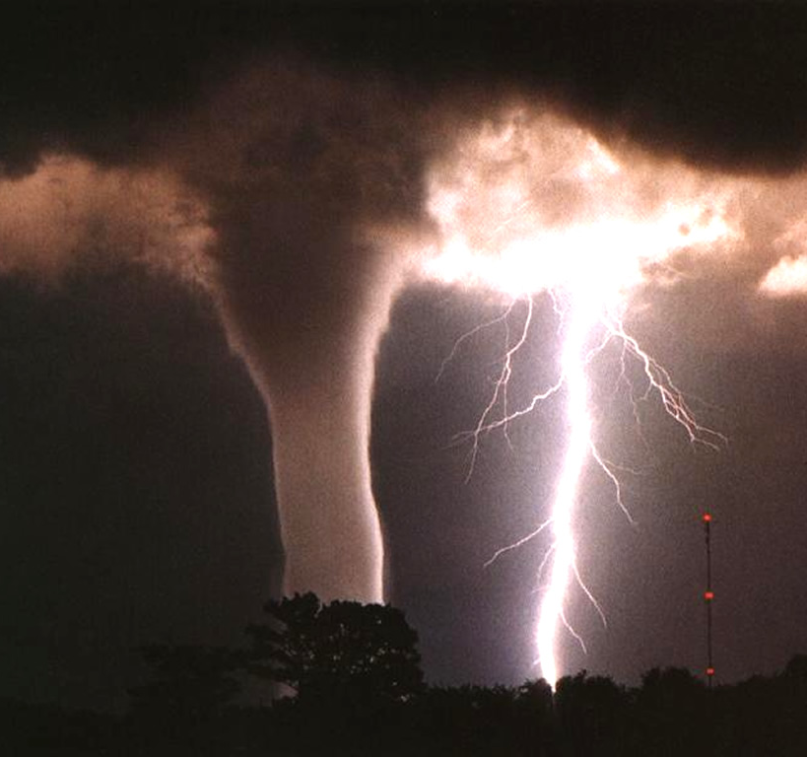


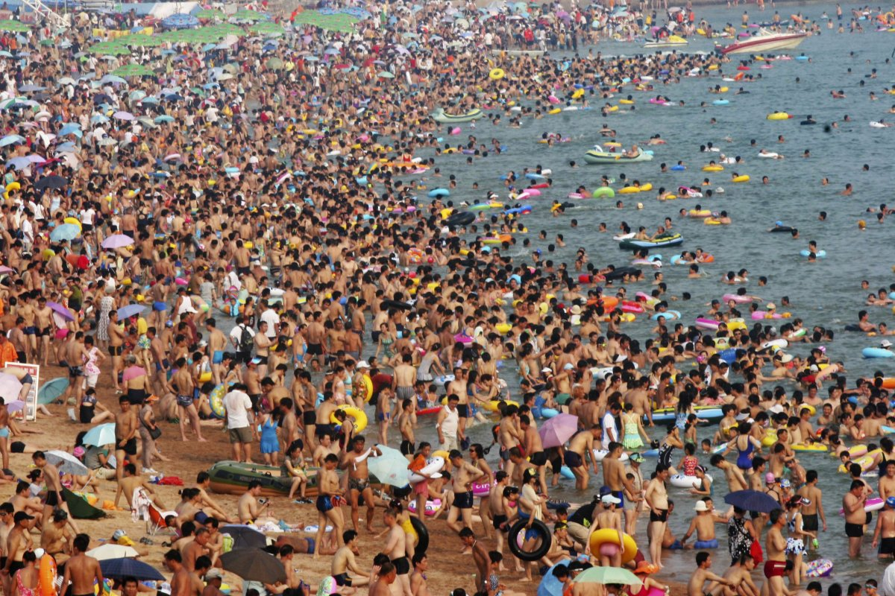
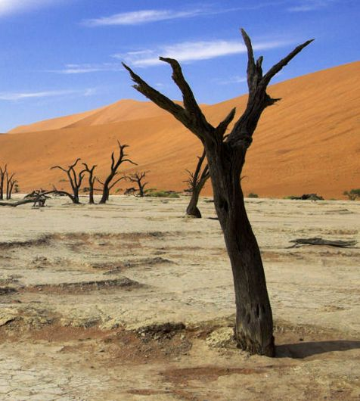
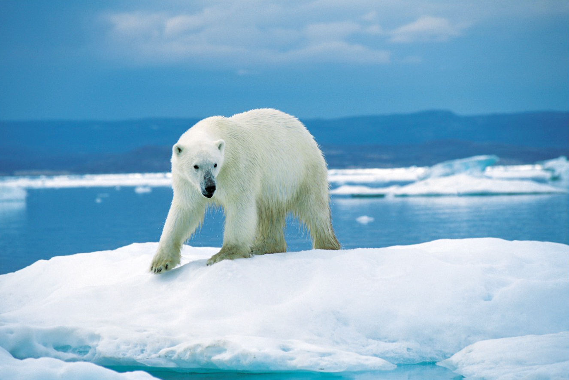
Topics in Geography
This Photo by Unknown Author is licensed under CC BY-SA
This Photo by Unknown Author is licensed under CC BY
Climate Change
Development and Health
Population
Urban Environments (Rio and Glasgow Case Study)
Rural Environments (Sahel Case Study)
Hydrosphere
Atmosphere
Lithosphere
Biosphere
Application of Skills
This Photo by Unknown Author is licensed under CC BY-NC
This Photo by Unknown Author is licensed under CC BY-SA-NC
This Photo by Unknown Author is licensed under CC BY-NC
This Photo by Unknown Author is licensed under CC BY-NC-ND

Slide 4

Careers in Geography
Geography is an obvious choice for careers in renewables, sustainability, and green issues, energy supply and managing the effects of hazards and climate change.
For careers in the world of business, an understanding of global economics forms an important part of geography.
If you are thinking of a career in law, human rights, international relations or welfare, then geography gives you the opportunity to consider relevant issues
If you are working towards a future course in medicine or veterinary medicine then geography is a good choice to give your options the breadth that universities seek, as you will gain a clear understanding of how the environment affects health and survival of people, animals and ecosystems.

Slide 5
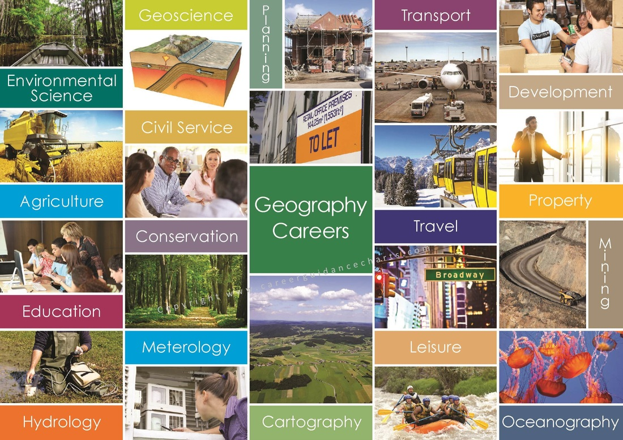
Where can Geography take me?

Slide 6

Transferable Skills
Varied perspectives- Looking at issues differently Geographers uniquely tackle and investigate big issues across a variety of scales and from different perspectives.
Fieldwork is an enjoyable opportunity to explore new environments. Fieldwork provides you with useful skills in collecting, understanding and presenting data
Teamwork - Working in teams during fieldwork and in a classroom environment is useful for developing communication skills.
Map work –using atlases, Ordnance Survey maps, satellite images gain useful skills in gathering, analysing and evaluating geographical information.
Geographical argument- Geography students gain strong research and analytical skills helping to produce convincing arguments and to communicate ideas effectively.
Use of data - Geography students will use data from a range sources: written and digital sources; visual and graphical sources; and numerical and statistical information.
Location knowledge - knowledge of the world’s continents, countries, regions and their physical, environmental and human location

Slide 7
You will be very well looked after in Higher Geography and fully supported to do well.
Please speak to one of us if you have any questions.
Mr Donnelly
gw20donnellychristop@glow.ea.glasgow.sch.uk
Mrs Alexander
gw14alexanderlynn@glow.ea.glasgow.sch.uk
Mrs Mitchell
gw21mitchelldonna1@glow.sch.uk

Slide 8
I enjoyed the subject at National 5, but I knew it would be useful for any type of job I would choose. I enjoyed all the aspects of natural geography, to do with the formation of the land to weather patterns. I continued with geography as I learned lots and it was fun. I’m like big brain now
Christopher
Here’s what our Bannerman Geographers had to say…
I chose geography in as it seemed most appealing out of the three to choose. It is also considered a science at university meaning I don’t have to take another.
My favourite topics have been rivers, climate change and population. I find climate change very interesting and it’s something that is currently going on at the moment.
Rivers and Population I found pretty easy to grasp the concepts and it was just a matter of remembering diagrams or statements. The topics were extremely similar from national 5 so it was just a case of building more onto the knowledge I had already gained from the year before. I also done pretty well for national 5 so I thought higher wouldn't be too difficult.
I think making sure you actually enjoy the topics is most important before picking the subject, there is a wide range of topics and with a bunch of fun activities for each to make what may be considered a boring topic, a lot more fun.
I would check the course specification for Higher to see if the topics look appealing. I chose it without knowing anything really about what was involved but I enjoyed it all, but so you have a rough idea.
Ellie
I chose geography because I really liked learning about camels/cacti, earthquakes, favelas. My favorite topics that I did in Nat 5 were the topics in Global Issues – Tourism and Climate change (easiest and the most interesting in my opinion). I chose to do higher geography because it was the subject that I did the best in compared to other subjects but not only that but all the geography teachers were amazing and that made me want to choose geography even more because I know it would be enjoyable and fun.
Global issues is not only a fun topic to learn about, but it also gives you a basic understanding of the problems globally and it widens your knowledge about these problems, even if you already know a little of the topic.
I learnt many skills – teamwork and communication skills from working with my friends to provide an exam model answer. Written skills have also improved as you learn the formula of model answers.
Joey

Slide 9
I chose geography in S2 because I enjoyed learning about the physical side of geography with features, formations and I found it the most interesting part.
The topics I enjoyed in Nat 5 were rivers and valleys, and my favourite to learn was limestone because I liked learning about how different features were formed and created in different ways.
I continued geography into higher because it was a subject I enjoyed and there were many different topics so there was a few that I quite liked and wanted to learn more about in higher.
I think geography was useful because doing any map work in class helped me when I was doing my duke of Edinburgh and vice versa.
Some skills I have learned is how to read a map properly by using grid references to pick out housing/environment problems and learning what different symbols mean.
An important bit of information is that there are different sections to geography between physical, human and environmental with many different topics within so there will be a section that you enjoy the best that will make you enjoy what you are learning in class because you are interested in it.
Molly
Here’s what our Bannerman Geographers had to say…
I chose to pick Geography in second year because it was recommended by one of my friends who was two years above me. The topic I enjoyed most in s2 was the tourism topic. I decided to continue with Geography because it's an interesting topic and seemed like it can be helpful when trying to follow the career path you want to. One of the skills I have learned is using a map, from identifying different structures, to seeing how steep hills are, and even being able to pinpoint where a certain thing is using six figure grid references
Paul
It was the subject I was most interested in out of geography, history and modern studies. I continued with geography because I am still interested in the subject. I think it's Important to learn about the world around us and how the earth works.
I learned research skills and presenting skills and along with the greater understaning of world issues I think these will benefit me in my future career.
Alanna

Slide 10
Please view the websites attached to get a better idea of the subject and where it can take you.
https://www.bbc.co.uk/bitesize/subjects/zmhs34j
https://www.sqa.org.uk/sqa/47922.html
https://www.rgs.org/choosegeography/
https://www.prospects.ac.uk/careers-advice/what-can-i-do-with-my-degree/geography
https://www.topuniversities.com/student-info/careers-advice/what-can-you-do-geography-degree

Slide 11
SCQF Progression in Global Studies
S4 | S5/S6 | S6 only
NAT4 History (SCQF level 4) | SFW Scottish Studies (SCQF level 5)
NAT4 Geography (SCQF level 4) | SFW Travel and Tourism (SCQF level 5)
NAT4 Modern Studies(SCQF level 4) | NPA Criminology (SCQF level 5)
NAT5 History (SCQF level 5) | Higher History (SCQF level 6) | Advanced Higher History (SCQF level 7) (available at the HUB)
NAT5 Geography(SCQF level 5) | Higher Geography (SCQF level 6) | Advanced Higher Geography (SCQF level 7)
NAT5 Modern Studies (SCQF level 5) | Higher Modern Studies (SCQF level 6) | Higher Politics (SCQF level 6)
Your S3 Global course choice will lead to one of the qualifications listed in the S4 column.
You can progress from any (SCQF level 4) course in S4, to any SFW (SCQF level 5) course in S5/S6.

Slide 12
