Slide 1
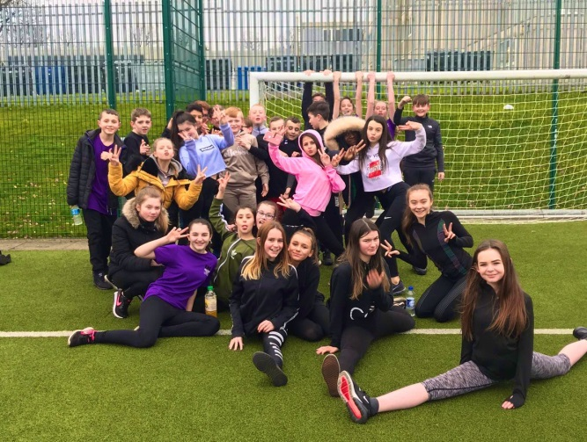
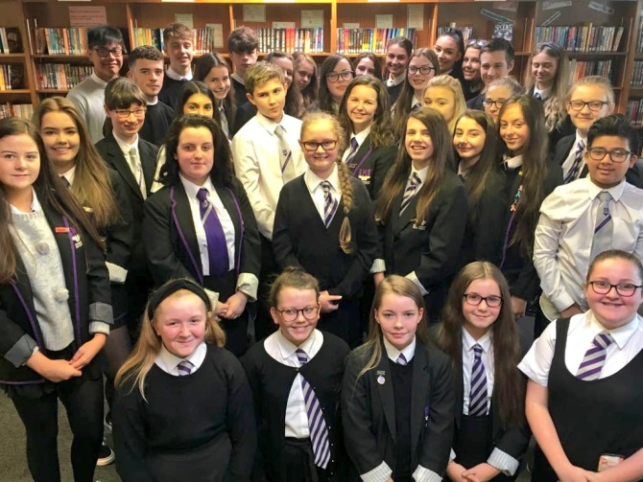
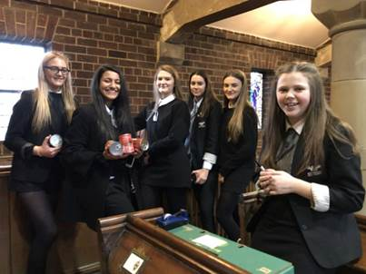
S4
INFORMATION EVENING
SESSION 2020-21
Respect Responsibility Ambition

Slide 2
Welcome – Ms Pearson (Year Head S4)
Purpose of the Evening – short presentation and key resources.
Mrs Mulholland – PT S4 Pastoral Care (and parent)
Feedback – What do you need from us to support your child?
Respect Responsibility Ambition

Slide 3
Our Goals:
To deliver the best possible outcomes and the highest attainment and achievement for every child
The ensure excellence and equity
To support all learners to achieve their full potential
Respect Responsibility Ambition

Slide 4
Senior Phase
Study for qualifications
Challenge and depth to learning
Wider Achievement
More formal assessment
Further development of 4 capacities of CfE
Promotion of active and healthy lifestyle
Planning beyond school
Respect Responsibility Ambition

Slide 5
Respect Responsibility Ambition

Slide 6
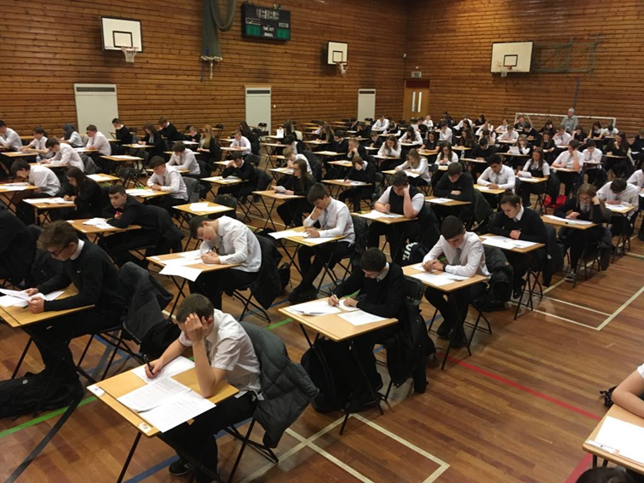
Prelims
29.11.21 – 3.12.21
Respect Responsibility Ambition

Slide 7
S4 Tracking - Important Dates
(5 Tracking reports this session)
September 2021 November 2021 December 2021 February 2022 March 2022 | Tracking report 1 Tracking report 2 Tracking report 3 Tracking report 4 Tracking report 5
29th Novemenber 2021 | Prelims begin
April 2022 | SQA Exam diet begins
Respect Responsibility Ambition

Slide 8
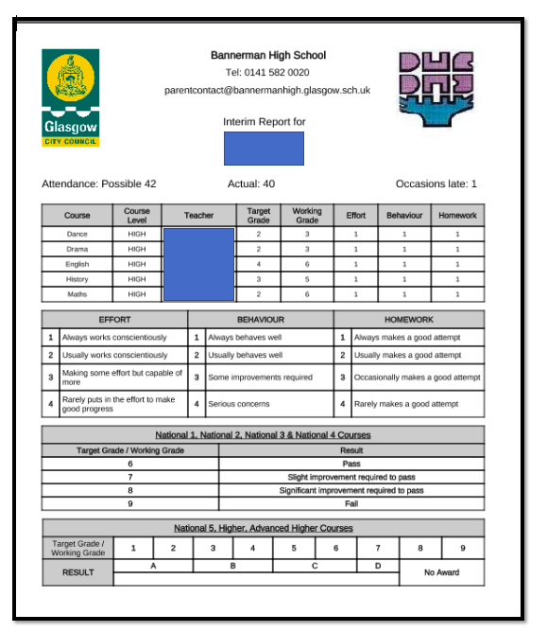
Senior Phase Reporting
At Bannerman we strive to raise attainment and achievement of all children and young people.
In the senior phase, we have a more frequent reporting schedule tracking reports (5 in total) - replacing the full report in the senior phase.
We believe that this reporting model will allow for more focused dialogue with students to improve learning and raise attainment.
Respect Responsibility Ambition

Slide 9
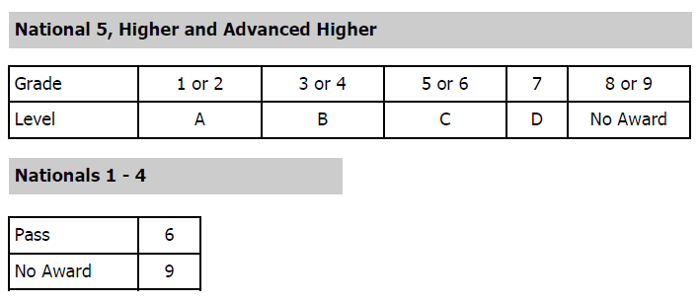
Working Grade – level of attainment for all National courses based on evidence from classwork, assessments, and level of application.
Target Grade - the level, agreed following discussion, which pupils will aim to achieve for the next tracking period. Teachers will discuss with pupils what they must do to progress to this stage/target level. These are set carefully using a range of information such as prior attainment across learning, school-based assessment data, the pupil’s own aspiration and teacher judgement.
Respect Responsibility Ambition

Slide 10
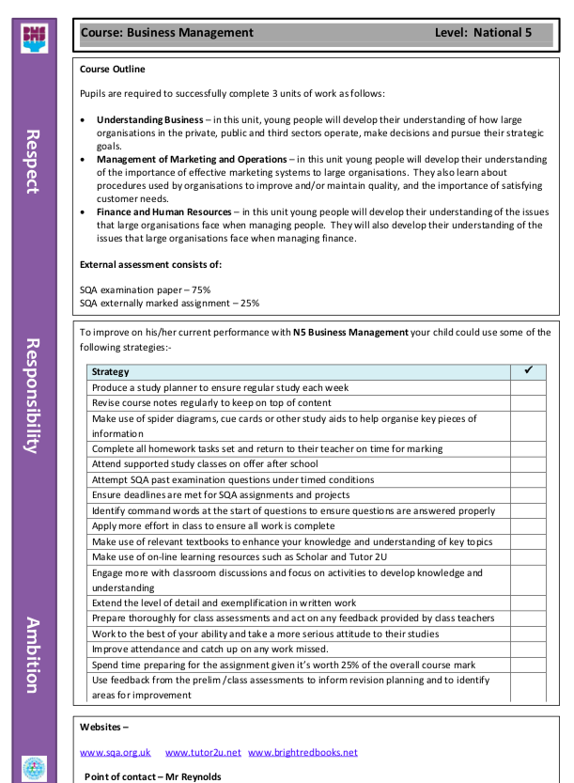
Senior Phase Study Guides
Respect Responsibility Ambition

Slide 11
HOW CAN I SUPPORT MY CHILD:
Time management is KEY to student success. Your child should start preparing for course assessments as early as possible. A weekly study timetable will help your child to stay on top of his or her workload and regular revision will alleviate stress.
Homework is an integral part of the teaching and learning process. Please encourage your child to ensure homework deadlines are being met.
Respect Responsibility Ambition

Slide 12
HOW CAN I SUPPORT MY CHILD:-
The health and wellbeing of your child is paramount. Although studying and course work will be priorities, it is also important for pupils to relax.
A healthy diet, a positive sleeping pattern and exercise can help maintain a good work/life balance and promote wellbeing.
Respect Responsibility Ambition

Slide 13
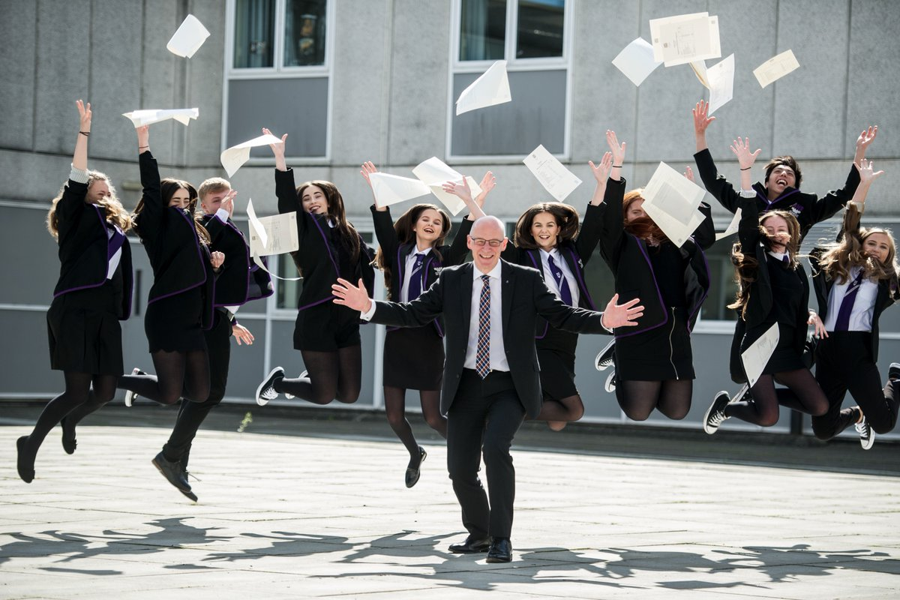
Respect Responsibility Ambition

Slide 24
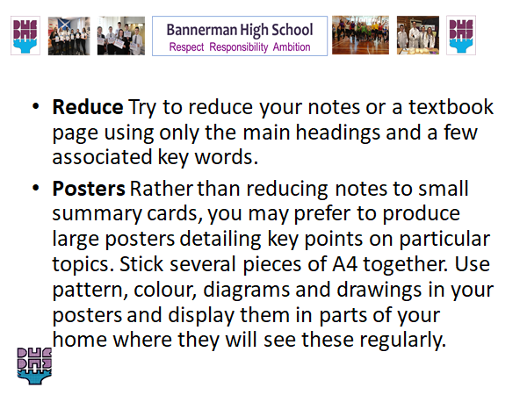

Slide 25
