Slide 1
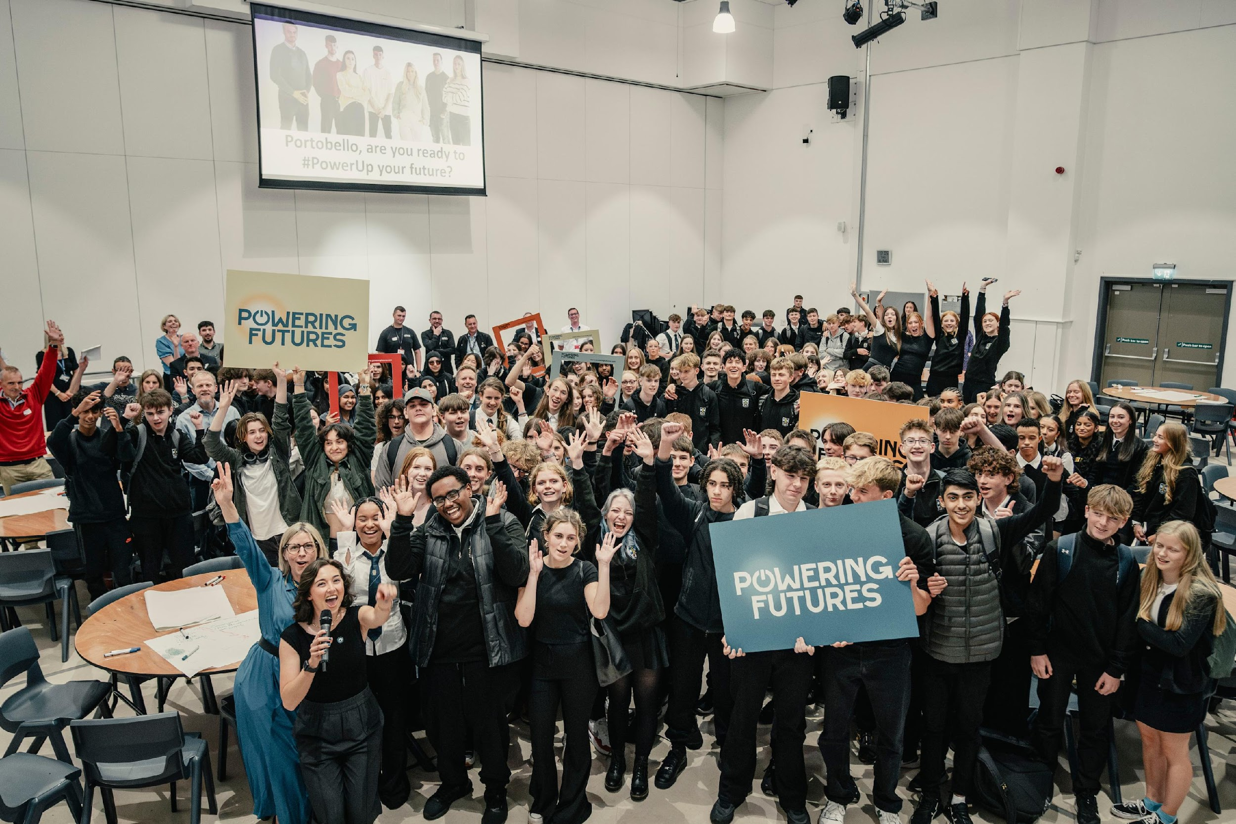




POWERING FUTURES CHALLENGE
SCQF LEVEL 6

Slide 2
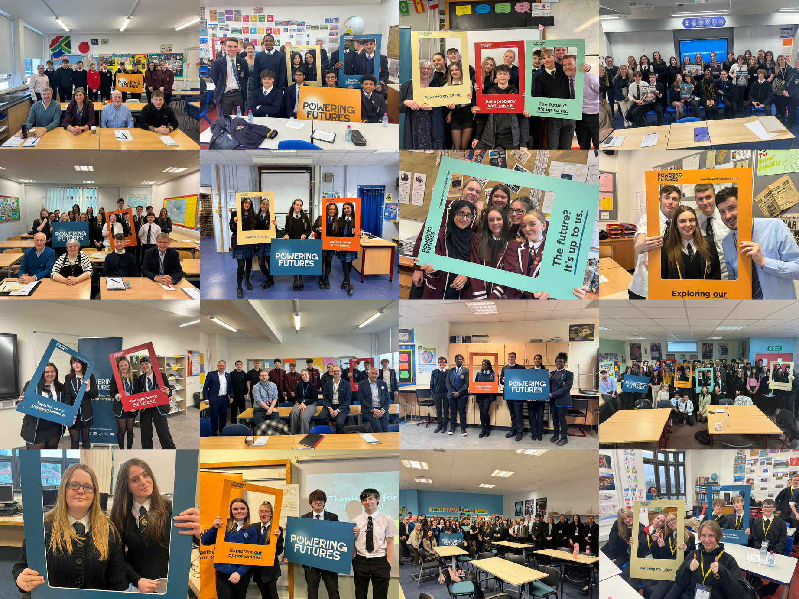
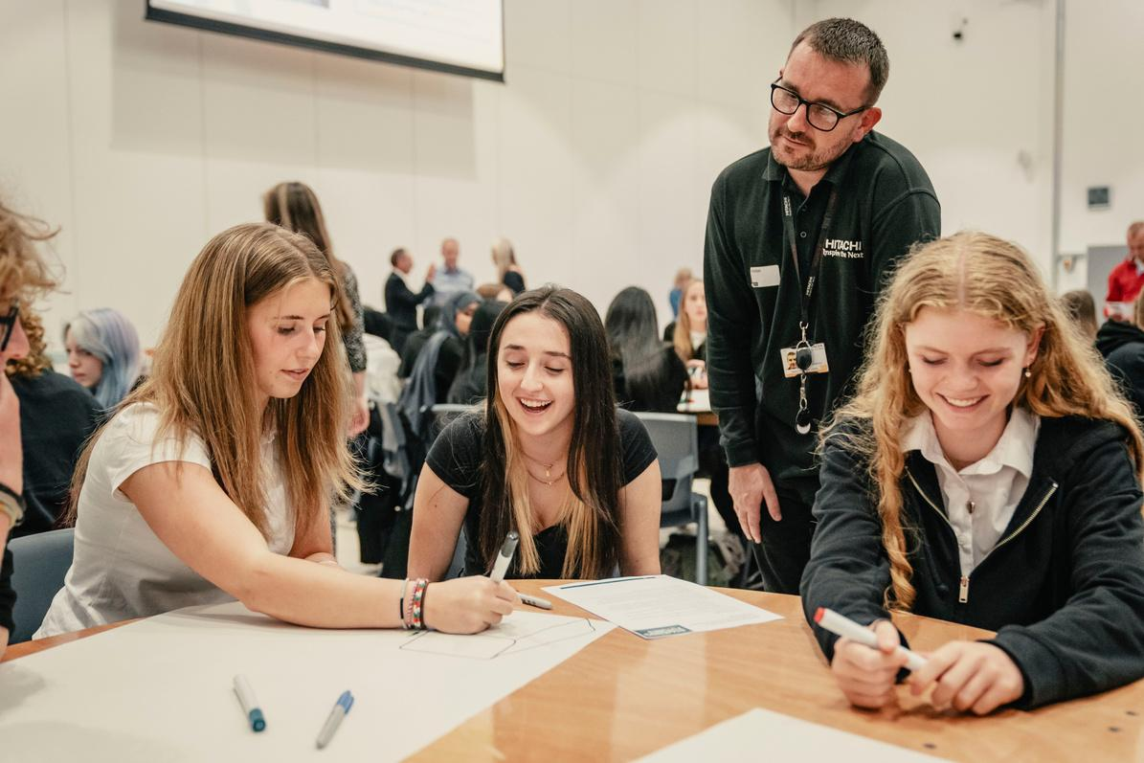
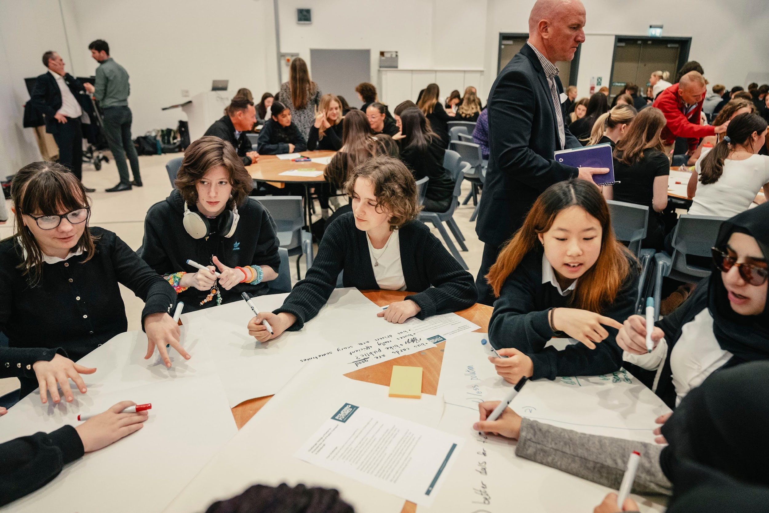


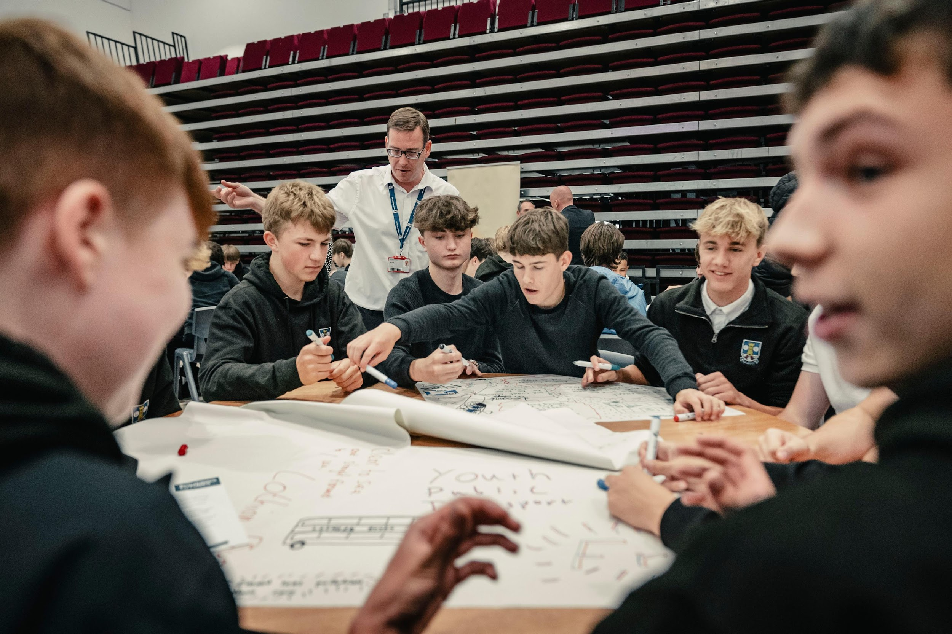

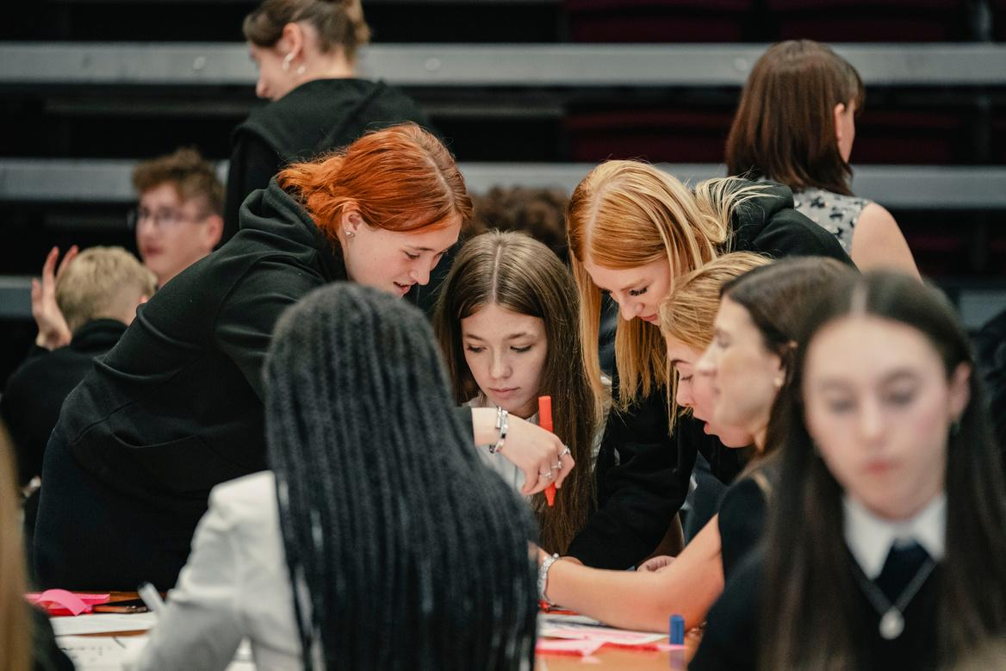
Powering Futures Challenge
SCQF Level 6
“I actually mentioned Powering Futures in [one of my university interviews] because the skills I am picking up - like teamwork, delegation of tasks and actively listening to other people – are all good skills for medicine.”
– Anza, St Benedict’s High School
What will I do on the course?
What will I achieve?
How is the course assessed?
“The Challenges are fun, and you start to realise by doing them what skills you need when you get a job.”
- Olivia, St Benedict’s High School

Slide 3
How will this course benefit me?
This course will help you stand out from the crowd on applications for university, give you experiences to talk about during job interviews and develop skills you will use in life after schools.
You will gain an understanding what it’s like to solve some of industry’s biggest challenges.
If you want to know more, come and speak to Mr Donnelly, or email gw20donnellychristop@glow.sch.uk and visit the Powering Futures website. You can also follow them on Instagram to find out more.
https://www.poweringfutures.com/education

Slide 4
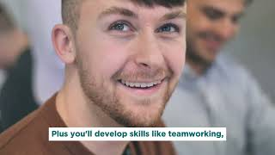
Here is a video of people, just a few years older than you, who have done this course before. As you will see, they believe that this course has significantly helped them in their careers.
https://www.youtube.com/watch?v=6pYfuwhbNJQ
Notes:
https://www.youtube.com/watch?v=6pYfuwhbNJQ

Slide 5
What will I do on the course?
In the Powering Futures Challenge, you will create a solution to a real-life sustainability challenge that has been set by a real business.
Working in a team throughout the year, you will develop the critical skills that employers are looking for you, helping you to thrive in your future destinations.

Slide 6
What will I achieve?
You will achieve a SCQF Level 6 award which is the same level as a Higher, it also contributes to your UCAS Tariff points.
You will attend Powering Futures 2 periods per week for a double. You will spend the other 4 periods of that collum in Level 5 Criminology. (There may be some exceptions for S6s on how the other 4 periods are spent).
You are getting two qualifications if you pick Powering Futures and Criminology. Level 6 Powering Futures, and Level 5 Criminology.

Slide 7
How is the course assessed?
This course is assessed continuously through the year.
There is no exam at the end.
To pass, you must complete a portfolio of evidence, work closely with your team and deliver a presentation to a panel of judges showcasing your team’s solution.

Slide 8


Pupils are currently working in groups to present a solution to a challenge set by the different businesses you can see below. The pupils will be attending Powering Futures Live at Hampden Park to present their solution to the panel made up of these businesses.

