Slide 1
WELCOME TO BUSINESS STUDIES & COMPUTING SCIENCE S2 OPTION CHOICES
This Photo by Unknown Author is licensed under CC BY

Slide 2
STAFF IN THE DEPARTMENT OF BUSINESS STUDIES & COMPUTING
Mr Reynolds (Faculty Head)
Mrs Owens
Ms Wingate
Mrs Morin
Mr Boyle
Mr Gray
Mr Colquhoun (Depute Head Teacher)

Slide 3
WHY CHOOSE ONE OF OUR SUBJECTS?
At some point in the not so distant future, you will ALL work in a business of some form whether it’s a bank, a hospital, a lawyers office or a nursery.
The more you know and are aware of the different and important aspects of a business e.g., management, finance, ICT and marketing, the more employable you will be!
Banking?
Games Design?
Law?
Police?
Safety Officer?

Slide 4
WHY CHOOSE ONE OR TWO OF OUR SUBJECTS?
To give only a few reasons:
To gain the skills and knowledge to manage an organisation
To start and run your own successful business
To undertake administrative roles in an organisation, eg, Senior Administrative Assistant or Office Manager
To develop essential skills in the use of spreadsheets, databases, word processing and other software packages
To learn how to program computers and design websites
To develop an understanding of the importance of Finance to individuals and business organisations
To develop the skills and knowledge for University
To develop enterprising skills

Slide 5
WHAT SUBJECTS DO WE OFFER IN S3?
S3 is an important year for you, as you complete your Broad General Education (BGE) and prepare for the transition to formal qualifications in the Senior Phase.
You will have the opportunity to study the following subjects:
Accounting
Administration & IT
Business Management
Computer Science

Slide 6
ACCOUNTING
Accountancy is the language of business. Without accounting to provide information to management, organisations would perform less successfully. This course may be of greatest appeal to those learners who enjoy numeracy-based learning opportunities. Learners will also have the chance to use spreadsheet software to provide accurate and fast calculations. Developing your problem-solving skills is very important in Accounting.
You will study:
Double entry book-keeping to record financial transactions;
Preparation of Income Statements to determine whether a business has made a profit or a loss;
Statements of Financial Position to value how much a business is worth;
Cash Budgets to ensure the best use of money;
Accounting ratios to analyse a businesses financial performance;
Inventory (stock) management;
Break-even and management decision making.

Slide 7
ACCOUNTING VACANCIES
INDEED.COM 15 December 2020

Slide 8
ADMINISTRATION & IT
You will develop your IT skills and use them to perform a range of business and administrative tasks using a range of software packages and features e.g.
Word Processing
Spreadsheets
Databases
Presentations
Desktop Publishing
Email and ediary
You will develop an understanding of administration in the workplace and key legislation affecting employees.
You will be able to show an understanding and appreciation of good customer care.
You will further develop your organisational skills in the context of organising and supporting small scale business events.

Slide 9
ADMIN VACANCIES
INDEED.COM 15 DECEMBER 2020

Slide 10
BUSINESS MANAGEMENT
You will develop an understanding about Entrepreneurs and why they set up in business.
You will explore the different types of organisations in the UK, e.g., sole trader, partnership, private limited companies, charities and social enterprises.
You will research the various functions of a business including Marketing, Human Resources, Finance and Operations.
You will investigate how stakeholders, e.g., customers, employees, government, suppliers, management and local community can all impact on a business organisation.

Slide 11
COMPUTER SCIENCE
The course is delivered through 4 key units:
Software Design and Development –
Learners will develop basic knowledge,
understanding and practical problem-solving
skills in software design and development.
Learners will develop basic computational
thinking and programming skills through
practical tasks.
Computer Systems – learners develop an understanding of how data and instructions are stored in binary form and basic computer architecture.
Database Design and Development - learners develop knowledge, understanding and practical problem-solving skills in database design and development.
Web Design and Development – learners develop knowledge, understanding and practical problem-solving skills in web design and development, through a range of practical and investigative tasks.

Slide 12
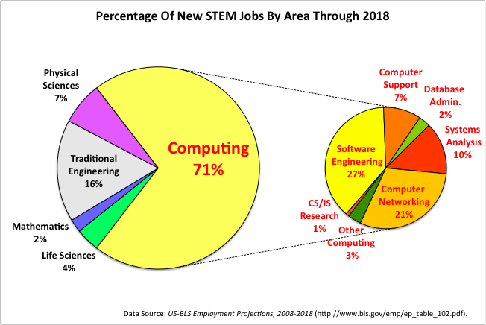
COMPUTER SCIENCE

Slide 13
WHAT SKILLS WILL I DEVELOP?
The subjects we offer develop your Skills for Work!
planning and organisational skills
skills in collaborating, leading and interacting with others
ability to work independently
critical thinking and decision making
searching and retrieving information to inform thinking and decision making
effective and appropriate communication
self-evaluation and peer-evaluation
computational skills
skills in analysis and problem solving in a technological context

Slide 14
CAREER CHOICES
The list of Careers with Accounting, Administration, Business or Computing is endless. They are very varied with the following only some of the areas where the qualifications and skills will be of use:
Health service
Travel agents
Legal profession
Banking
Police
Teachers
Accountant
Estate Agent
20% of you WILL go on to run your own business.

Slide 15
Pupils who study Accounting, Administration and IT, Business Management and/or Computer Science will be well qualified to proceed to a modern apprenticeship when they leave school. Apprenticeships are ideal for school and college leavers who want an alternative to university. Pupils can progress to modern apprenticeships in the following areas: Accounting Business and Administration Customer Service Cyber Security Financial Services IT: Management for Business Management
MODERN APPRENTICESHIPS

Slide 16
COURSES AT UNIVERSITY
After completing SQA Higher Grade courses, in Accounting, Administration and IT, Business Management and Computer Science, many of our pupils go on to Higher Education and study some of the courses outlined below:
Glasgow University | Strathclyde University | Caledonian University
Computer Science | Accounting & Finance | Economics & Law
Accounting and Finance | Economics | Finance, Accounting and Risk
Business Management | Management Science | Management and Human Resources
Digital Media and Information Studies | Marketing | Computing
Economics | International Business | Cyber Security and Networks
Finance | Accounting and Business Law | Applied Computer Games

Slide 17
Accountancy – Earnings 2020
Salaries for Accountancy vary considerably depending on location, size of company and specialisation, with starting salaries averaging £23,180 (although graduates have reported earning anything between £17,000 and £50,000 in their first job).
Graduates who enter Banking (unsurprisingly) get the big bucks, as a report this year revealed some investment bankers start off with an average salary of £45,000.

Slide 18
Computing Science – Earnings 2020
IT industries are on the up, and they offer heaps of choice: programming, systems analysis, web design, online security, games and apps – the list really is endless.
Graduates have reported receiving anything from £17,000 to £70,000 in IT roles.

Slide 19
ADVICE FROM THE CURRENT S6
“I have been in the Business and Computing Department since S1. I have studied National 5 and Higher Accounting and Administration and IT and this year I am studying Higher Business Management and Higher Economics. If you like working with numbers and love learning about the business world, the Business and Computing Department is for you. All of the teachers are amazing and you will always get excellent feedback on your work.” – Lucie Connor (S6)
“I picked National 5 Accounting and Business Management in S3 and if you’re someone who enjoys problem solving and thinks outside the box, then these subjects are for you. The Business and Computing Department are excellent. They give you feedback on your work straight away. Choosing these subjects at N5 has allowed me to progress to University to study for a career in Accountancy.” – Kieran Green (S6)
“National 5 Administration and IT is really enjoyable in my opinion. It is relatively easy to understand and helps you develop many skills which could be helpful in lots of jobs.” – Aili Miller (S6)

Slide 20
ADVICE FROM THE CURRENT S6
“I’d recommend the Department of Business Studies and Computing because they are very organised and when you form a bond with the teachers it’s a really great environment to learn in. They also helped me to realise what I want to do with my future.” – Ross Lennox (S6)
“National 5 Administration and IT has taught me the ICT skills which I have used throughout my years of secondary education and will continue to use whilst studying Business at University.” – Holly Jackson (S6)

Slide 21
SUMMARY
ACCOUNTING
If you have shown ability in Mathematics, enjoy problem solving and working with numbers, then you should do well and enjoy Accounting.
ADMINISTRATION & IT
If you enjoy working with computers and application packages such as word processing, databases, spreadsheets and want to develop the skills and knowledge required for office work then you should do well and enjoy Administration and IT.
BUSINESS MANAGEMENT
If you would like to develop and understanding of they key functions of business organisations or would like to find out about how you could set up your own business, then you should do well and enjoy Business Management.
COMPUTING SCIENCE
If you have shown ability in Mathematics, enjoy problem solving and like being creative, then you should do well and enjoy Computing Science.
If you require any further information, please do not hesitate to contact
Mr Reynolds (Faculty Head) at gw10reynoldswilliam@glow.sch.uk.

