Slide 1
National 3/4/5 Chemistry
Boom Bang a Bang

Slide 2
What’s in it For Me ?
What to expect in
National 3/4/5 Chemistry

Slide 3
What will I be studying?
Over the 3rd and 4th Years you will study 3 main topics
Chemical Changes and Structure
Natures Chemistry
Chemistry in Society
You will learn to handle Data and carry out experiments that count towards your course

Slide 4
What is Chemistry?

Slide 5
What can I expect if I choose Chemistry?
The course lasts 2 years (with an exam in May of your 4th year for National 5 only)
The course is made up of 3 main units
You will also be assessed on your practical work and your ability to plan, carry out and report on experiment as well as knowledge and understanding and problem solving skills.
Research project will be completed

Slide 7
Careers
Dental Receptionist
Nursery nurse
Vets Assistant
RSPCA
Brewery technician
Beauty Therapist
Hairdresser
Dental Hygenist
Farming
Marketing
Pharmacy Assistant

Slide 8
Careers Using Chemistry
Any medical career e.g. doctor, vet, dentist, nurse
Chemist ,biochemist
Nurse
Physiotherapist
Photographer
Horticulturalist
Conservationist
Environmentalist
Lab technician
Dental Receptionist
Nursery nurse
Vets Assistant
RSPCA
Brewery technician
Beauty Therapist
Hairdresser
Dental Hygenist
Farming
Marketing
Pharmacy Assistant
Teacher
Marine scientist
Production manager
Food scientist
Brewer
Medical sales
Pathologist
Zoologist
Researcher
Demolitionist
And many more

Slide 9
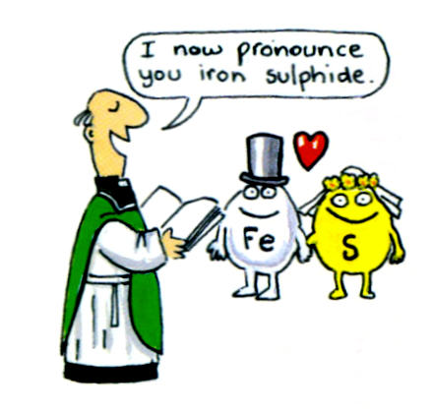
Chemical Reactions

Slide 10
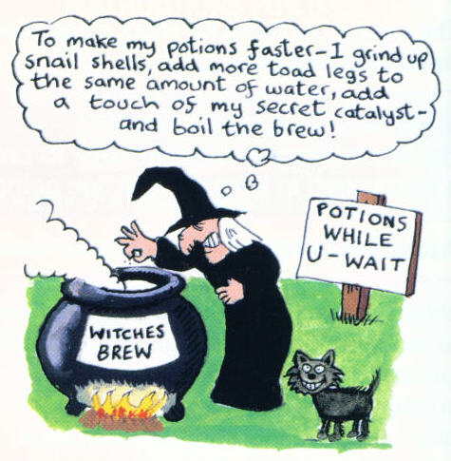
Reaction Speeds

Slide 11
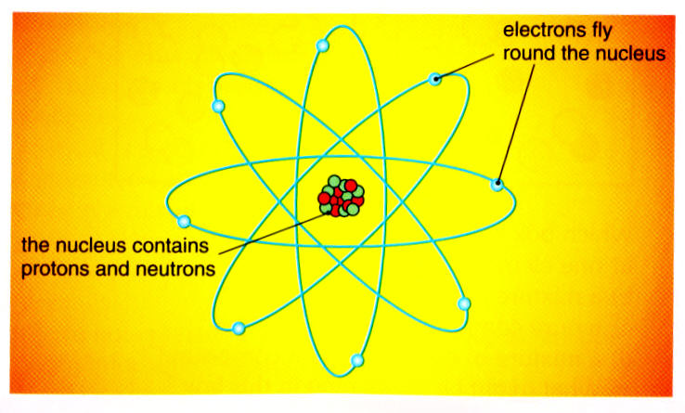
Atoms

Slide 12
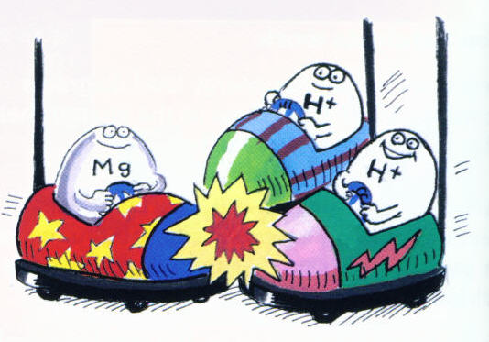
How Atoms Combine

Slide 13
Fuels

Slide 14
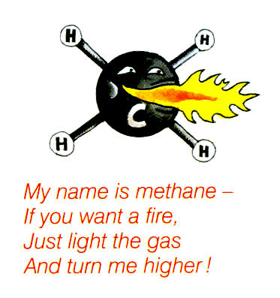
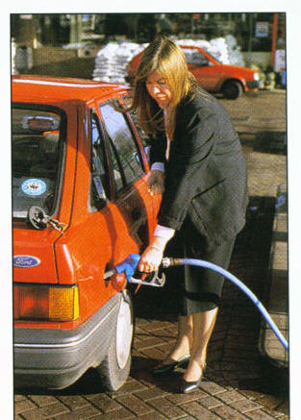
Hydrocarbons

Slide 15
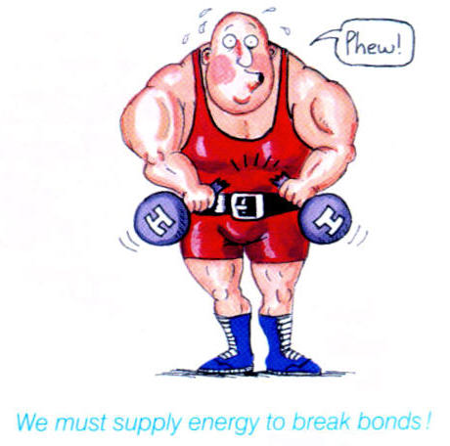
The Covalent Bond

Slide 16
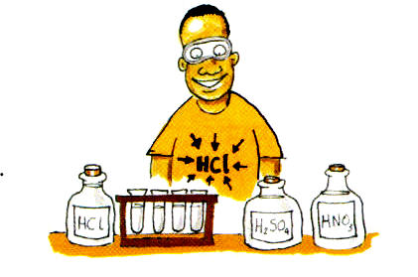
Acids and Bases

Slide 17
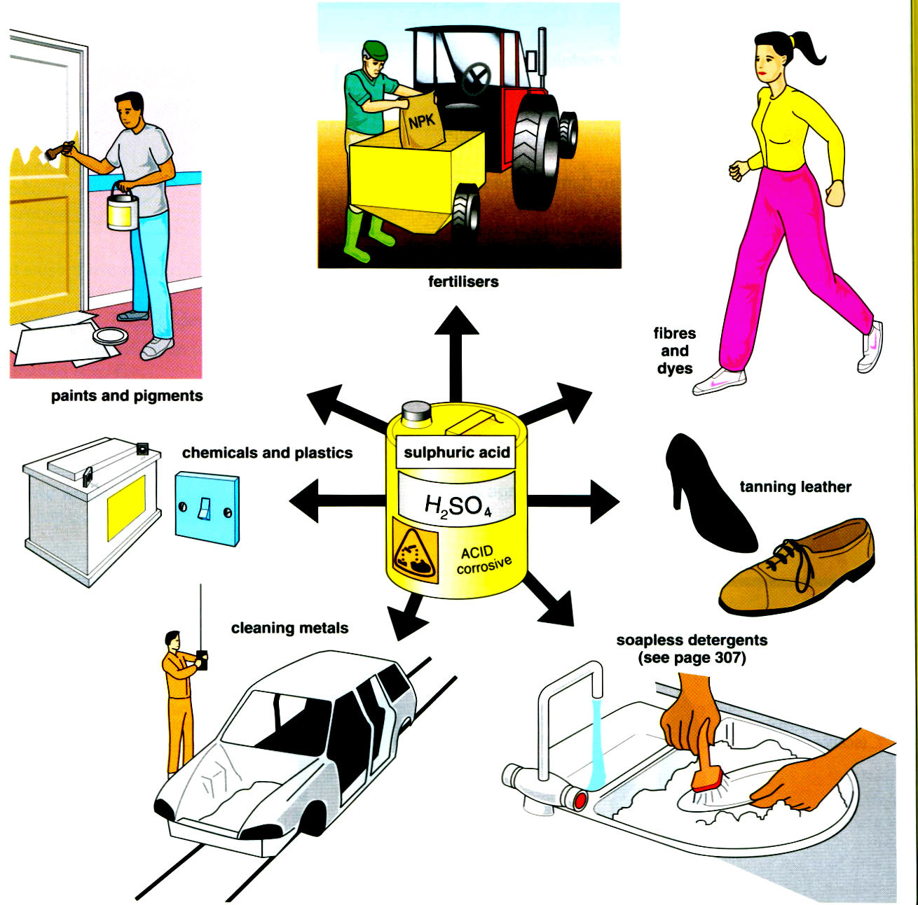
Reactions of Acids

Slide 18
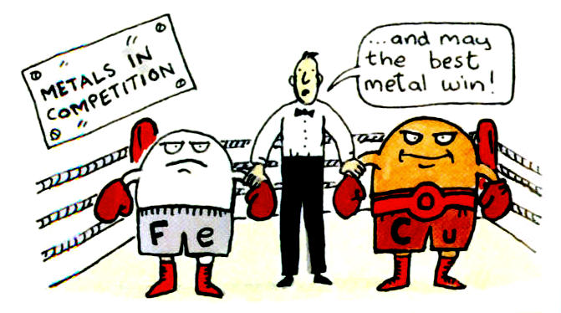
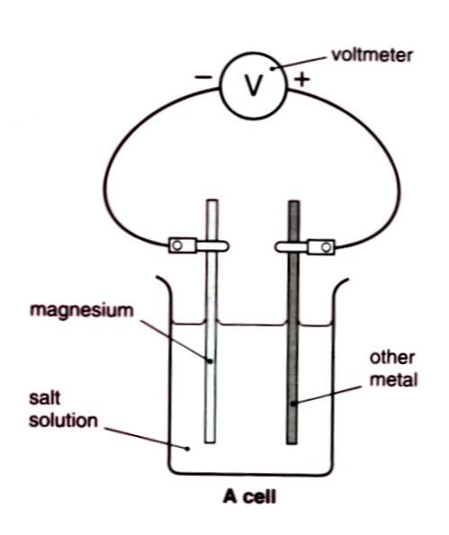
Making Electricity

Slide 19
Metals and Alloys

Slide 20
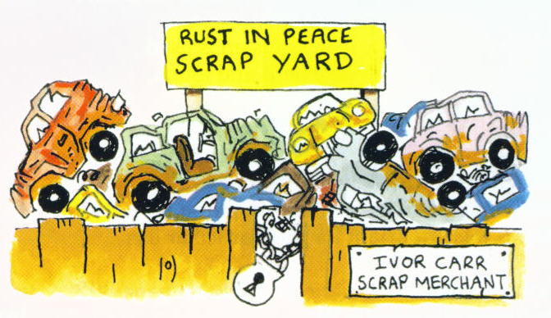
Corrosion

Slide 21
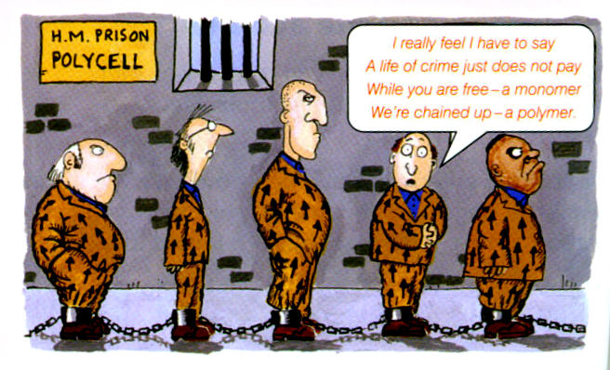
Plastics

Slide 22
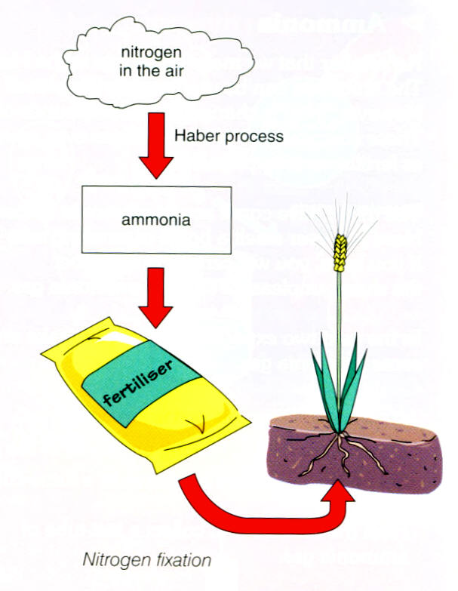
Fertilisers

Slide 23
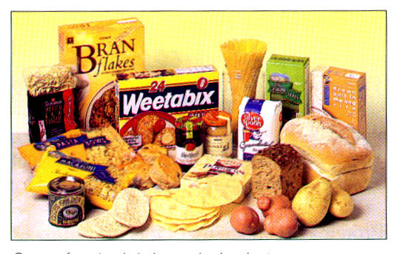
Carbohydrates

