Slide 1
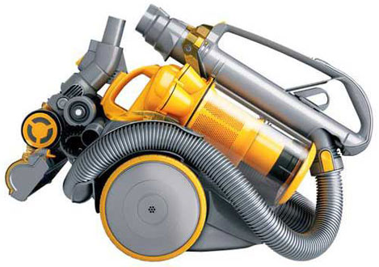
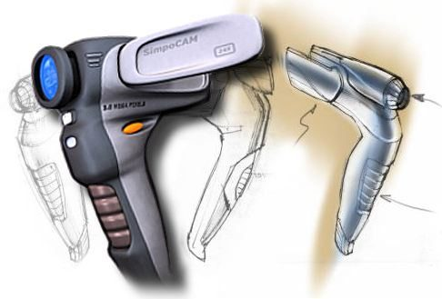
Design and Manufacture
National 4 & 5

Slide 2
Design & Manufacture
Introduction:
The National 4 & 5 Design and Manufacture courses provide students with a broad practical introduction to design, and materials and manufacturing processes. They provide opportunities for them to gain skills in designing and in producing and communicating design proposals. They allow students to explore the properties and uses of materials and to make models and prototypes of products they design.
The Courses provide students with skills that allow them to learn, live and work more effectively in our advancing technological society. It allows them to become not just effective contributors but informed and discerning consumers.
Course Aims:
The aims of the Course are to enable students to develop:
skills in the design and manufacturing prototypes and products.
knowledge and understanding of manufacturing processes and materials.
an understanding of the impact of design and manufacturing technologies on our environment and society.

Slide 3
Design & Manufacture
Skills, knowledge and understanding:
Analysing information
Applying knowledge and understanding of:
- idea generation techniques
- design factors
- graphic techniques
- modelling techniques
- planning techniques
- evaluation techniques
- tools, materials, and processes
knowledge and understanding of commercial manufacture
knowledge and understanding of the impact of design and manufacturing technologies on our environment and society
Problem solving
Working with others
Taking Initiative
Planning and Organisation
Creativity
Innovation and Inventiveness
Use of ICT, software and computer aided design and manufacture
Critical thinking through exploration and discovery
Searching and retrieving information
Analyse, evaluate and create products
Presentation skills

Slide 4
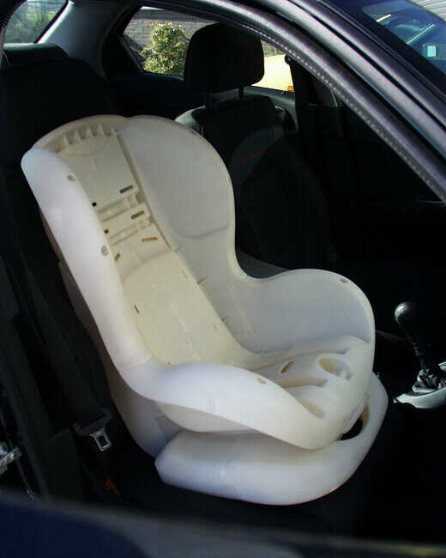
Design and Manufacture
National 4 & 5
Possible further study and career routes :
Higher (National 6) Design & Manufacture
Product Design (e.g. electronics, auto-motives, communications)
Interior design
Manufacturing apprenticeships
Design Engineering
Architecture
Quantity Surveying
Industrial Design
Skilled Trades
Model Makers
Graphic Designers
Teaching

Slide 5
Graphic Communication
National 4&5

Slide 6
Graphic Communication
Introduction:
The National 4 & 5 Graphic Communication courses allow learners to gain skills in reading, interpreting, and creating graphic communications. Learners will initiate, develop and communicate ideas graphically. They will develop spatial awareness and visual literacy through graphic experiences.
The Course is practical, exploratory and experiential in nature. It combines elements of recognised professional standards for graphic communication partnered with graphic design creativity and visual impact.
The Course allows learners to engage with technologies and it allows learners to consider the impact that graphic communication technologies have on our environment and society.
Course Aims:
The aims of the Course are to enable learners to:
develop skills in graphic communication techniques, including the use of equipment, graphics materials and software (2D and 3D)
extend and apply knowledge and understanding of graphic communication standards, protocols, and conventions where these apply
develop an understanding of the impact of graphic communication technologies on our environment and society

Slide 7
Graphic Communication
Skills, knowledge and understanding of the course
Replicating shapes and forms in 2D, 3D and pictorial
Initiating and producing preliminary, production and promotional graphics
Initiating and producing informational graphics
Developing visual literacy skills
Developing spatial awareness in 2D,3D and pictorial graphic situations
Using standard graphic communication equipment, software and materials effectively
Knowledge of graphic communication standards, protocols and conventions
Applying design skills, including creativity, when developing solutions to graphic tasks
The ability to evaluate work in progress and completed graphics and applying suggestions for improvement
Knowledge of a range of computer aided graphic techniques and practices
Knowledge of colour, illustration and presentation techniques
Knowledge and understanding of the impact of graphic communication technologies on our environment and society
Problem solving
Working with others
Taking Initiative
Planning and Organisation
Creativity
Innovation and Inventiveness
Use of ICT, software and computer aided design
Critical thinking through exploration and discovery
Searching and retrieving information
Presentation skills

Slide 8
Graphic Communication
National 4 & 5
Possible further study and career routes :
Higher (National 6) Graphic Communication
Product Design
Advertising
Marketing
Civil Engineering
Architecture
Computer Simulation
Animation
Print Design
Design Engineering
Data Analyst
Teaching

Slide 9
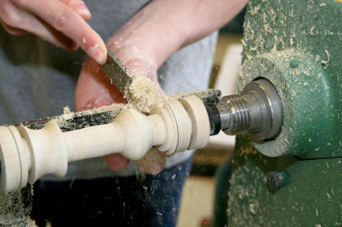
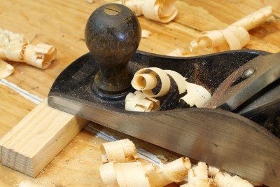
Practical Woodworking
National 4 & 5

Slide 10
Woodworking Skills
Introduction:
The Course is practical, exploratory and experiential in nature. It combines elements of technique and standard practice with elements of creativity.
The Course provides opportunities for learners to gain a range of practical woodworking skills and to use a variety of tools, equipment and materials. It allows them to plan activities through to the completion of a finished product in wood.
The Course will also give learners the opportunity to develop thinking, numeracy, employability, enterprise and citizenship skills.
Course Aims:
The aims of the Course are to enable learners to develop: skills in woodworking techniques skills in measuring and marking out timber sections and sheet materials safe working practices in workshop environments practical creativity and problem-solving skills knowledge of sustainability issues in a practical woodworking context.

Slide 11
Woodworking Skills
Skills, knowledge and understanding for the course
Using a range of woodworking tools, equipment and materials safely and correctly for woodworking tasks with complex features
Adjusting tools where necessary, following safe working practices
Reading and interpreting drawings and diagrams (working drawings)
Measuring and marking out timber sections and sheet materials in preparation for cutting and shaping tasks
Practical creativity in the context o woodworking tasks with complex features
Using a practical problem-solving approach to woodworking tasks
Applying knowledge and understanding of safe working practices in a workshop environment
Knowledge and understanding of the properties and uses of a range of woodworking materials
Knowledge and understanding of sustainability issues in a practical woodworking context
Problem solving
Working with others
Taking Initiative
Planning and Organisation
Searching and retrieving information

Slide 12
Practical Woodworking
National 4 & 5
Possible further study and career routes :
Joinery
Crafts
Construction trades
Manufacturing
Engineering
Theatre. (Stage production)
Visual arts
Teaching

