Slide 1
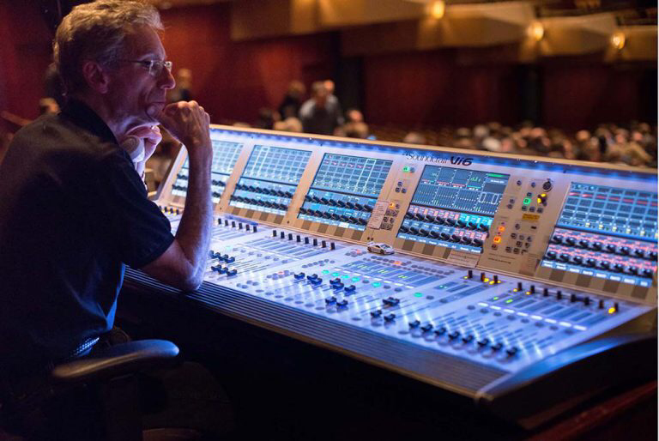
Music
National Course

Slide 2
Music – What will I learn?
You will develop your performance skills on 2 chosen instruments.
You will learn basic music theory and how to apply this to write your own music.
You will learn about a variety of different styles of music and how to identify musical features within each style.

Slide 3
Music – What skills will I develop?
Performance Skills - performing to others, musicianship, self confidence, independent learning.
Personal and Social Skills – building your confidence, self-awareness, responsibility, accountability, resilience, meeting deadlines, time-keeping.

Slide 4
Music – What will my exam be like?
National 4 – No external exam however you must perform 8 minutes of music and complete your own composition.
National 5 is split into 3 sections.
Performance Exam (50%) – Perform 8 minutes (using 2 instruments) of music to an examiner.
Understanding Music Paper (35%) – complete a listening paper identifying musical concepts.
Composition and Evaluation (15%) – write your own piece of music and evaluate it. Sent to the SQA

Slide 5
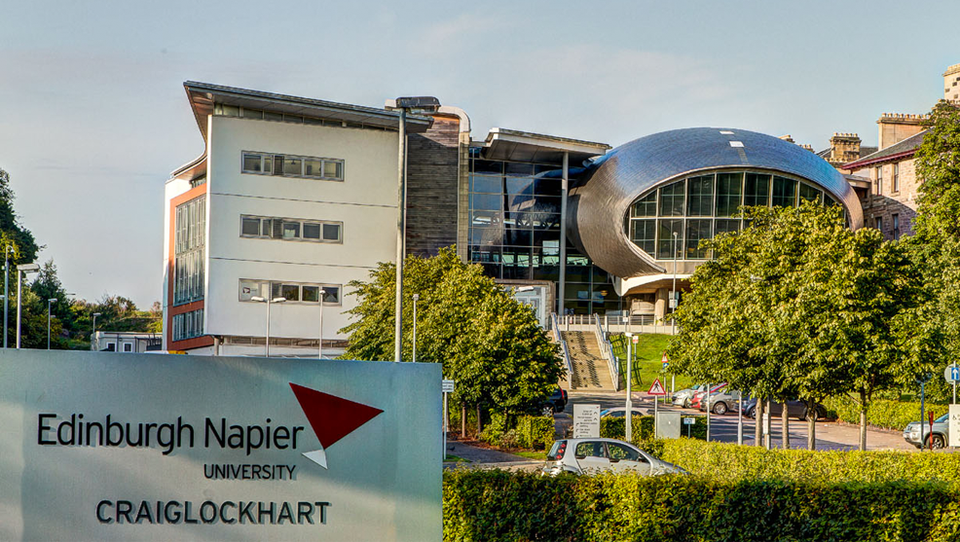
Music – Future Pathways
Music can be studied beyond school at both college and university. Some courses focus on performance, some focus on theory, some focus on music technology and others have a little bit of everything.
Here are just some Scottish education establishments offering courses in music.
University of Glasgow
University of the West of Scotland
Edinburgh Napier University
Royal Conservatoire of Scotland (RCS)
Glasgow Clyde College
Riverside Music College
Glasgow Kelvin College

Slide 6
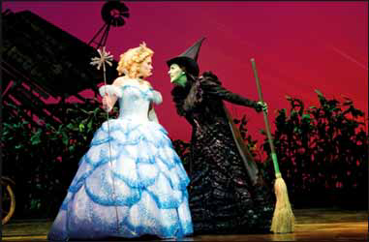
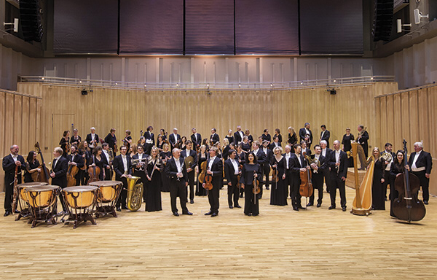
Music – Future careers
Here are just some careers linked to music.
Musician
Musical Theatre Performer
Music Teacher
Music Therapist
Music Management
Music Journalism
Song Writer/Composer
DJ
Sound Technician
Music Technology

Slide 7
Music – Future careers
There are other jobs that benefit from studying Music.
Primary Teacher
Actor
Various positions within theatre
Retail related careers
Hospitality
Customer Care
Creative Industries

Slide 8
Things to think about…
Before picking Music ask yourself the following questions:
Do I enjoy playing at least 2 musical instruments?
Do I enjoy being creative and making my own music?
Do I enjoy listening to different types of music?
If there is anything else you would like to know/ask, please contact a member of the music department who will happily answer your questions.
gw10borlandkaren@glow.sch.uk (Mrs Borland PT Performing Arts)
gw10purdieaileen@glow.sch.uk (Ms Purdie)
gw15hillwilliam@glow.sch.uk (Mr Hill)
gw19@brownalistairjam@glow.sch.uk (Mr Brown)
gw12renniesarah4@glow.sch.uk (Mrs Clowes)

