Slide 1
National PE Studies
Course overview 2020-21

Slide 2
Course Content
In the National PE course you will study the four factors that impact performance. These are :
The Physical Factor
The Social Factor
The Mental Factor
The Emotional Factor

Slide 3
Weekly Schedule
For National PE Studies you will get three periods each week. You are expected to bring PE kit each practical period, without fail. You are also expected to bring PE kit to core PE droids also and act as an ambassador for the department promoting health and activity to all. Each week of National PE you will get:
Two practical periods of PE
One written theory period, in a classroom.

Slide 4
National PE Activities
Football
Basketball
Volleyball
Badminton
Fitness
Gymnastics
Athletics

Slide 5
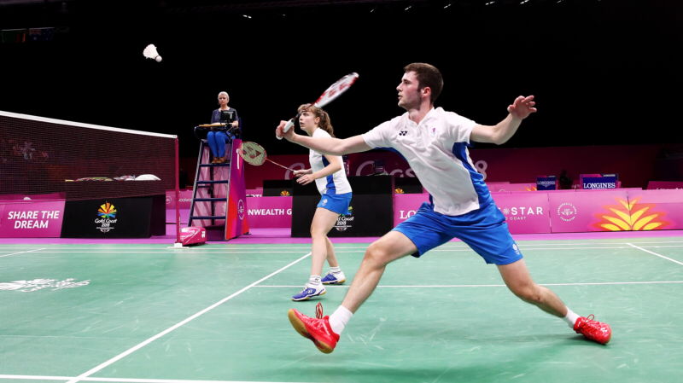
Careers using PE
Sports science
PE teacher
Professional sportsperson
Sports coach/consultant
Sports policy at local and national level
Diet and fitness instructor
Personal trainer
Physiotherapist

