Slide 1

WHY STUDY NATIONAL
GEOGRAPHY?
S2 Option Choices

Slide 2

What will I learn about in National 4/5 Geography?
The Geography course covers both the physical and human environments and Global Issues that shape our world.
There is plenty of room for discussion and extended research, which will help you become an independent thinker and learner.
You will be able to show your understanding of a range of opinions and be able to illustrate your answers with case studies from local, national and international examples.
You will learn in a wide variety of ways, using maps, data analysis, photos, videos, group work and field work

Slide 3
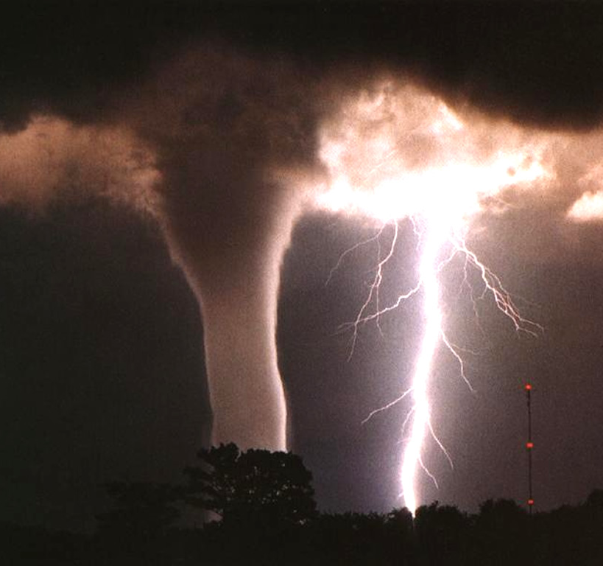

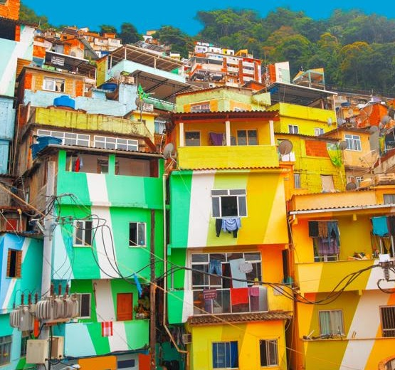
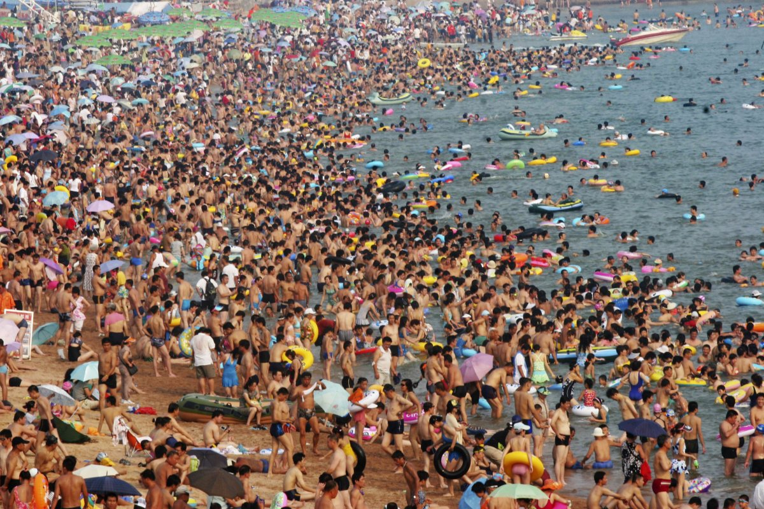
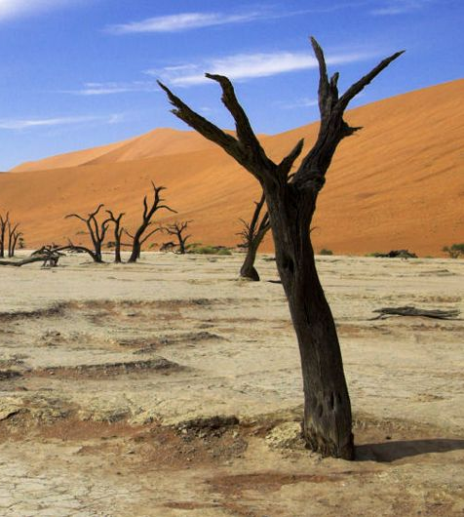
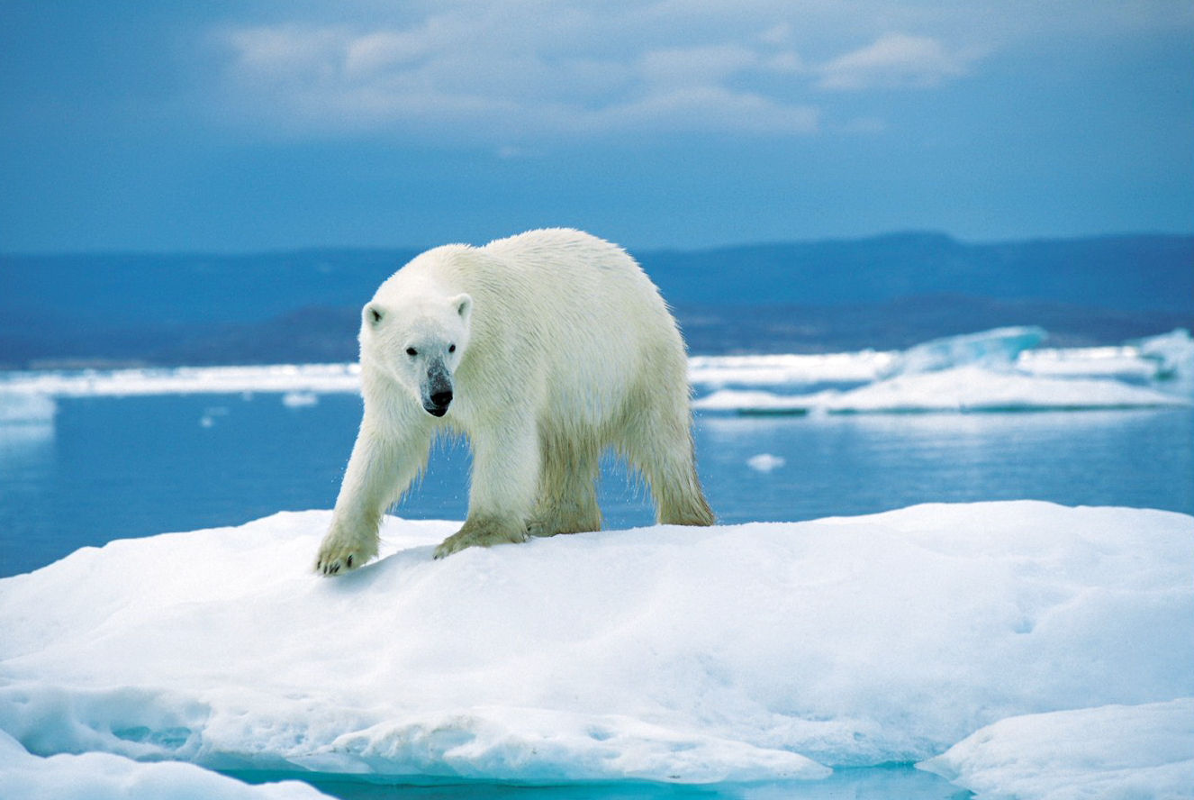
Topics in Geography
This Photo by Unknown Author is licensed under CC BY-SA
This Photo by Unknown Author is licensed under CC BY
Climate Change
Tourism
Population
Physical Landscapes
Weather
Urban Environments
Rural Environments
Map Skills
This Photo by Unknown Author is licensed under CC BY-NC
This Photo by Unknown Author is licensed under CC BY-SA-NC
This Photo by Unknown Author is licensed under CC BY-NC
This Photo by Unknown Author is licensed under CC BY-NC-ND

Slide 4

Careers in Geography
Geography is an obvious choice for careers in sustainability and green issues, energy supply and managing the effects of hazards and climate change.
For careers in the world of business, an understanding of global economics forms an important part of geography.
If you are thinking of a career in law, human rights, international relations or welfare, then geography gives you the opportunity to consider relevant issues
If you are working towards a future course in medicine or veterinary medicine then geography is a good choice to give your options the breadth that universities seek, as you will gain a clear understanding of how the environment affects health and survival of people, animals and ecosystems.

Slide 5
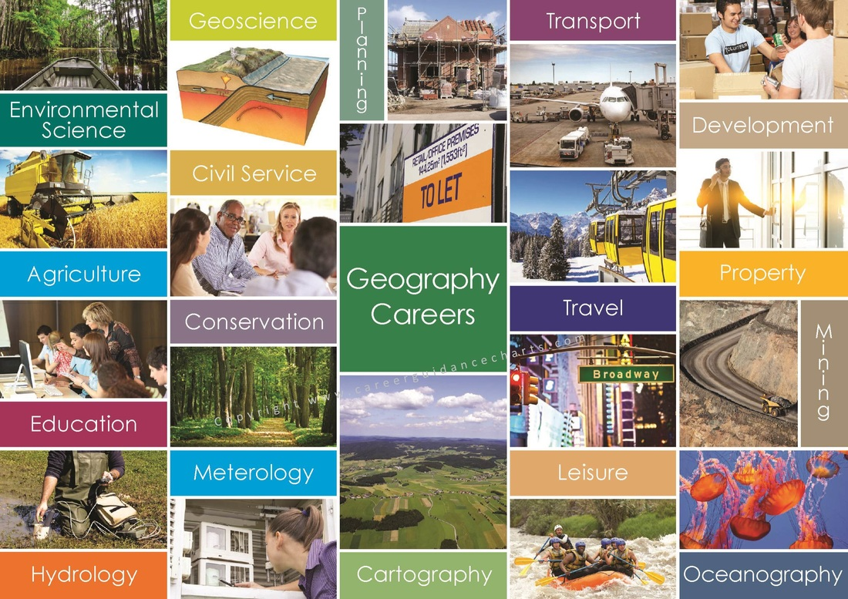
Where can Geography take me?

Slide 6

Transferable Skills
Varied perspectives- Looking at issues differently Geographers uniquely tackle and investigate big issues across a variety of scales and from different perspectives.
Fieldwork is an enjoyable opportunity to explore new environments. Fieldwork provides you with useful skills in collecting, understanding and presenting data
Teamwork - Working in teams during fieldwork and in a classroom environment is useful for developing communication skills.
Map work –using atlases, Ordnance Survey maps, satellite images gain useful skills in gathering, analysing and evaluating geographical information.
Geographical argument- Geography students gain strong research and analytical skills helping to produce convincing arguments and to communicate ideas effectively.
Use of data - Geography students will use data from a range sources: written and digital sources; visual and graphical sources; and numerical and statistical information.
Location knowledge - knowledge of the world’s continents, countries, regions and their physical, environmental and human location

Slide 7
You will be very well looked after in S3/S4 Geography and fully supported to do well.
Please speak to one of us if you have any questions.
Mr Donnelly
gw20donnellychristop@glow.sch.uk
Mrs Alexander
gw14alexanderlynn@glow.sch.uk
Mrs Mitchell
gw21mitchelldonna1@glow.sch.uk

Slide 8
It looked fun and interesting to learn about the weather topic and climate change. I like learning new ways to help the planet and new fun facts about nature and climates. I like learning about different climates, cultures. Geography is very useful for global knowledge and will help a lot with the future jobs. how to read the weather ( what will the weather be like today) , countries, global warming and climate change , how to answer exam questions , top up on world knowledge ( flags ,traditions, etc )
Kayla
I chose geography in s2 as it seemed most appealing out of the three to choose. It is also considered a science at university meaning I don’t have to take another.
My favourite topics have been rivers, climate change and population. I find climate change very interesting and it’s something that is currently going on at the moment. Rivers and Population I found pretty easy to grasp the concepts and it was just a matter of remembering diagrams or statements.
I think making sure you actually enjoy the topics is most important before picking the subject, there is a wide range of topics and with a bunch of fun activities for each to make what may be considered a boring topic, a lot more fun.
Ellie
I enjoyed the subject, but I knew it would be useful for any type of job I would choose. I enjoyed all the aspects of natural geography, to do with the formation of the land to weather patterns. I continued with geography as I learned lots and it was fun. I’m like big brain now
Christopher
I chose geography because I really liked learning about camels/cacti, earthquakes, favelas. My favorite topics that I did in Nat 5 were the topics in Global Issues – Tourism and Climate change (easiest and the most interesting in my opinion). I chose to do higher geography because it was the subject that I did the best in compared to other subjects but not only that but all the geography teachers were amazing and that made me want to choose geography even more because I know it would be enjoyable and fun.
Global issues is not only a fun topic to learn about, but it also gives you a basic understanding of the problems globally and it widens your knowledge about these problems, even if you already know a little of the topic.
I learnt many skills – teamwork and communication skills from working with my friends to provide an exam model answer. Written skills have also improved as you learn the formula of model answers.
Joey
Here’s what our Bannerman Geographers had to say…

Slide 9
I chose geography in S2 because I enjoyed learning about the physical side of geography with features, formations and I found it the most interesting part. The topics I enjoyed in Nat 5 were rivers and valleys, and my favourite to learn was limestone because I liked learning about how different features where formed and created in different ways.
I think geography was useful because doing any map work in class helped me when I was doing my Duke of Edinburgh and vice versa.
Some skills I have learned is how to read a map properly by using grid references to pick out housing/environment problems and learning what different symbols mean.
An important bit of information for the S2 is that there are different sections to geography between physical, human and environmental with many different topics within so there will be a section that you enjoy the best that will make you enjoy the class because you are interested in it.
Molly
I chose Geography in S2 because I really enjoyed the subject during S1. I enjoy doing the Urban City work, but all topics have been interesting thus far. I also enjoyed the previous tasks in S2 such as the Favela Task. I like the fact that we are learning about information to do with where we live now. I also liked finding out about what we can do to prevent climate change. This was interesting as we found out lots of things about the world that we never knew before.
I have learned more about weather, climate change and developments to the city. Geography is a very varied and interesting subject for people who wish to learn more about the world, the topics are varied and interesting and you learn about many things you likely did not know before. There is much more to Geography than meets the eye.
Ross
Well the reason I choose geography in s2 was so I can learn about the world and what effects does it have on all of us. I enjoyed tourism and a climate change the reason I have continued with geography is that it can help you work out what is happening to the world and that it is fun.
It is important to learn about climate change. I also learned about Mumbai and how people are affected. I have learned so much about the world and the challenges we might face.😁
Brooke
I thought it would be a really good experience to learn more all the different things going on in the world. I also had a lot of background knowledge and I felt like it would be the best fit for me as I would love to travel when I'm older.
I really enjoyed the Health and Climate Change unit as those two topics really stand out and give you a better understanding of people and how things like Climate Change and health problems can affect our daily lives.
I continued with Geography because it sparked an interest in me and I really enjoyed learning about different things.
I think that if anyone is looking to pick Geography they should as they can gain better understanding of issues surrounding the world and the different countries as well.
Fern
I chose to pick Geography in second year because it was recommended by one of my friends who was two years above me. The topic I enjoyed most in s2 was the tourism topic. Paul
I chose geography in s2 because I did well at it and enjoyed it . I liked the Japan learning and climate change in s3. I learning about other places and cultures
I have learned what the weather reports mean and how to read a map
Noah

Slide 10
Further information can be found at these weblinks.
https://www.bbc.co.uk/bitesize/subjects/znbw2h
https://www.sqa.org.uk/sqa/47446.html
https://www.rgs.org/choosegeography/
https://www.prospects.ac.uk/careers-advice/what-can-i-do-with-my-degree/geography
https://www.topuniversities.com/student-info/careers-advice/what-can-you-do-geography-degree

Slide 11
SCQF Progression in Global Studies
S4 | S5/S6 | S6 only
NAT4 History (SCQF level 4) | SFW Scottish Studies (SCQF level 5)
NAT4 Geography (SCQF level 4) | SFW Travel and Tourism (SCQF level 5)
NAT4 Modern Studies(SCQF level 4) | NPA Criminology (SCQF level 5)
NAT5 History (SCQF level 5) | Higher History (SCQF level 6) | Advanced Higher History (SCQF level 7)
NAT5 Geography(SCQF level 5) | Higher Geography (SCQF level 6) | Advanced Higher Geography (SCQF level 7)
NAT5 Modern Studies (SCQF level 5) | Higher Modern Studies (SCQF level 6) | Higher Politics (SCQF level 6)
Your S3 Global course choice will lead to one of the qualifications listed in the S4 column.
You can progress from any (SCQF level 4) course in S4, to any SFW (SCQF level 5) course in S5/S6.

Slide 12


