Slide 1
National 4/5 History
Information about the benefits of studying History in S3 and S4
The following slides will tell you about the topics we study, plus the skills you will develop and potential job opportunities for the future.

Slide 2
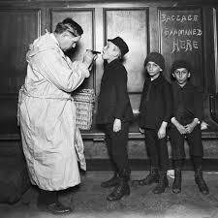
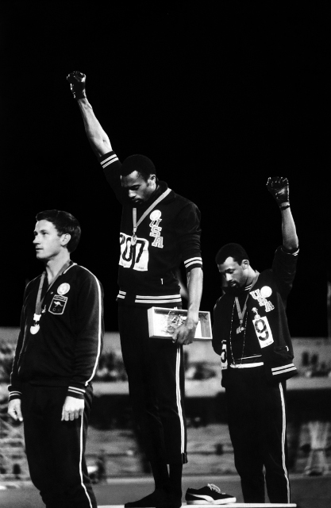
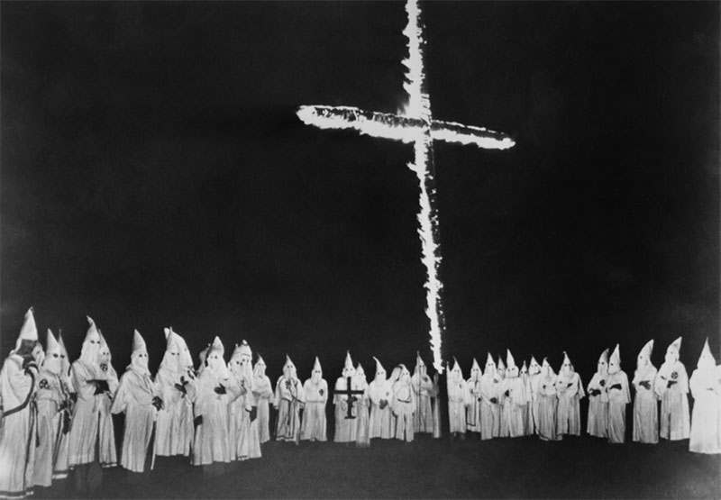
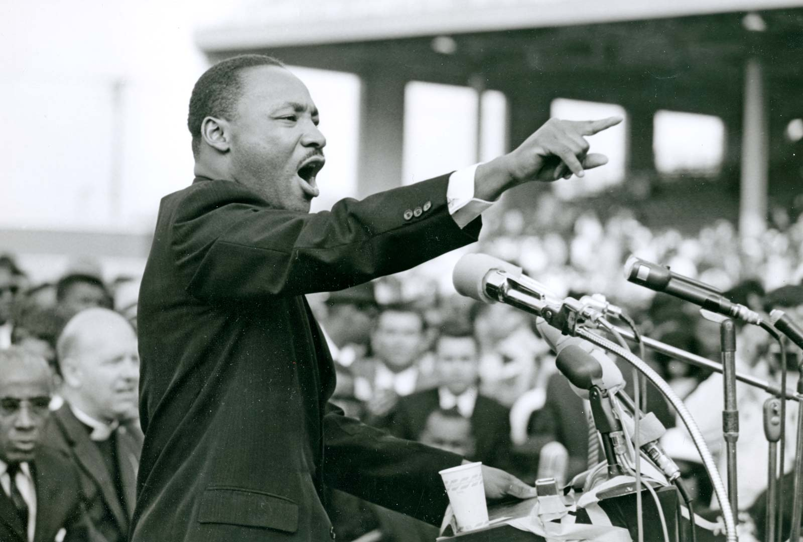
Free at Last?: Civil Rights in the USA
Firstly, we look at our World topic, Free at Last, in S3. Areas we learn about include:
What happened when immigrants from Europe arrived in the USA.
How Black Americans were treated by whites up until WW2.
The Civil Rights Campaigns in the 1950s including the Montgomery Bus Boycott
The Civil Rights Campaign in the 1960s and Radical Protests.

Slide 3
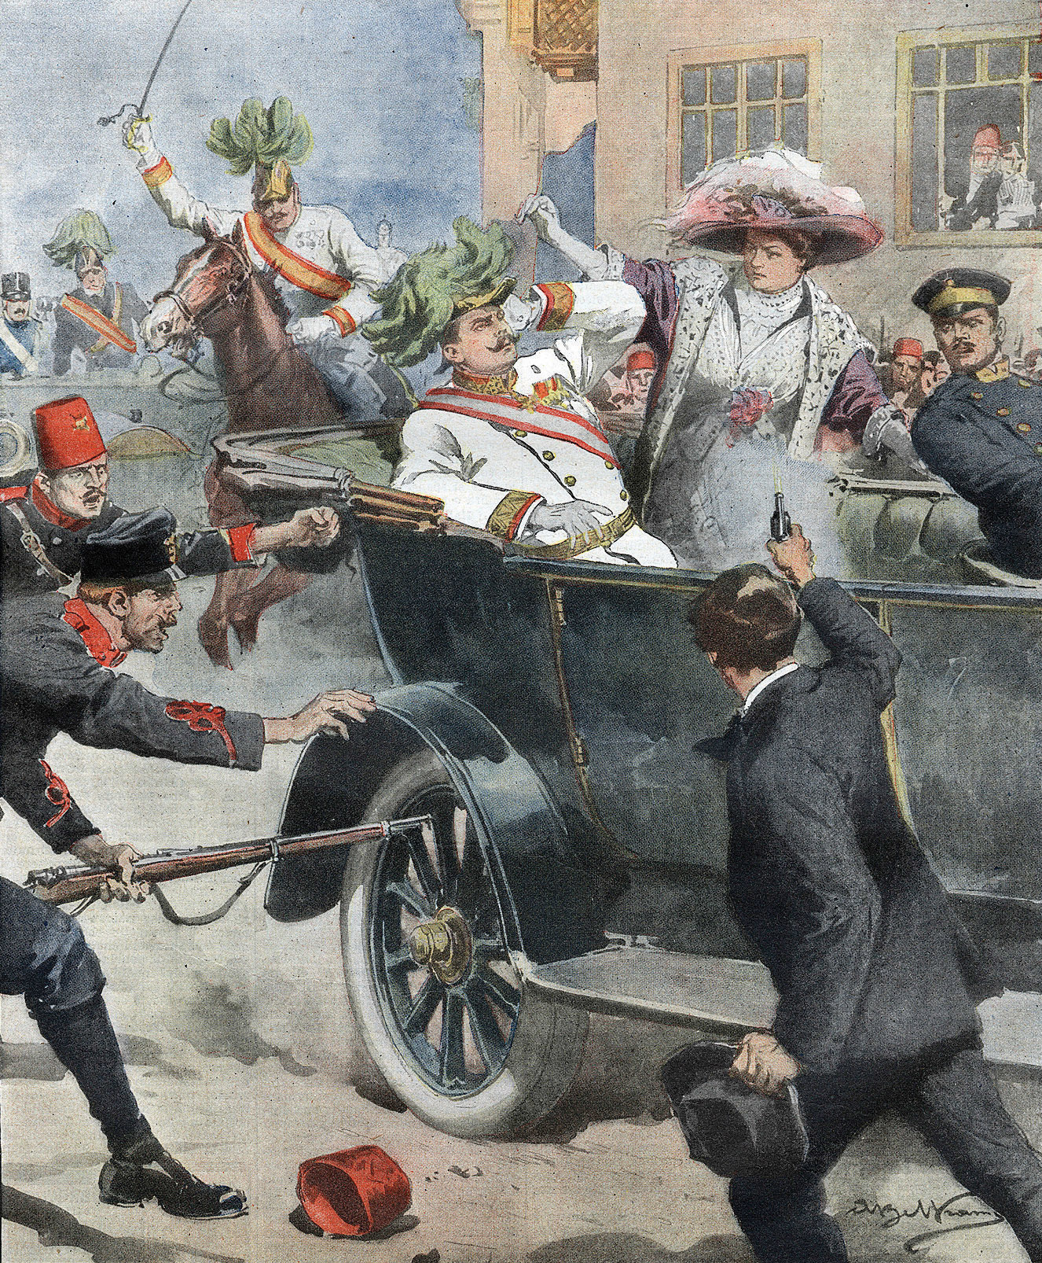

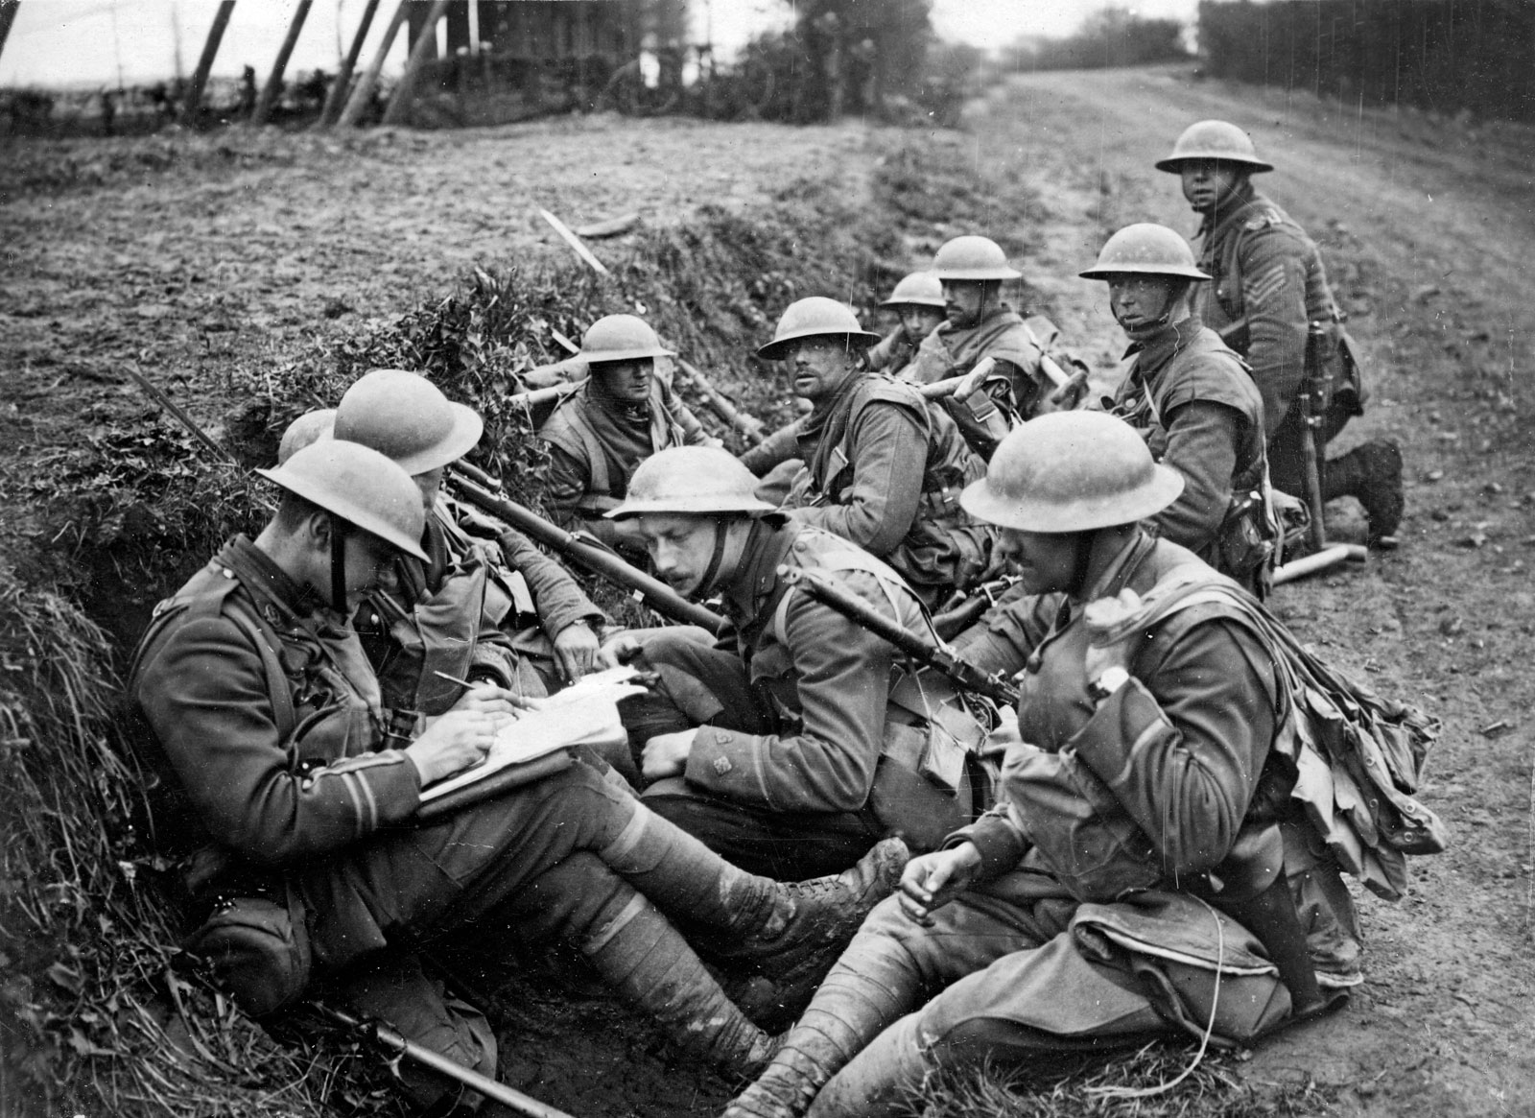
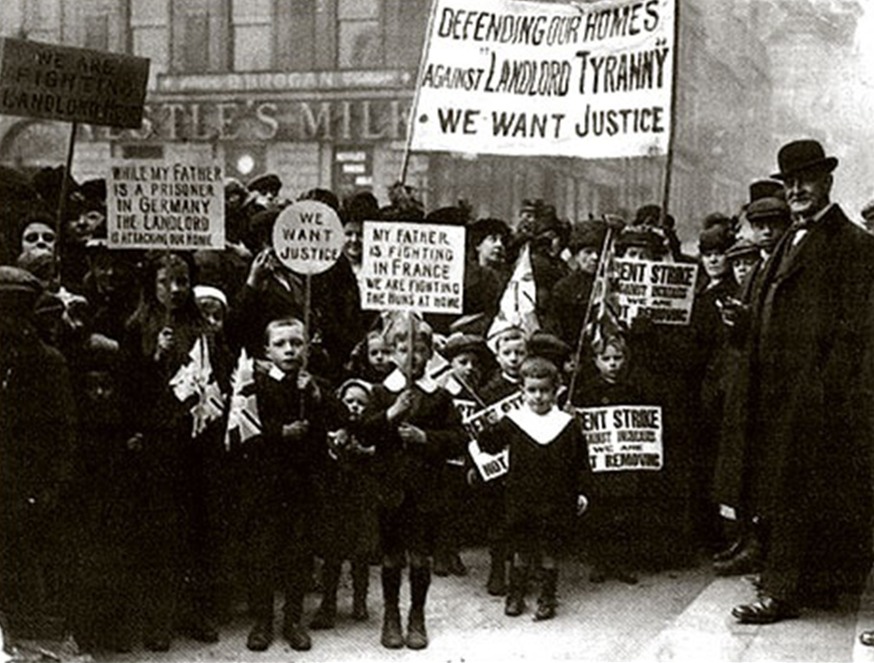
The Era of the Great War
Then at the end of S3 we move onto our Scottish topic, the Era of the Great War. Here we learn about:
The Causes of WW1.
Why Scots volunteered to fight in the war.
What life was like for Scottish soldiers fighting in the trenches.
What the impact of the war was for those at home in Scotland.

Slide 4
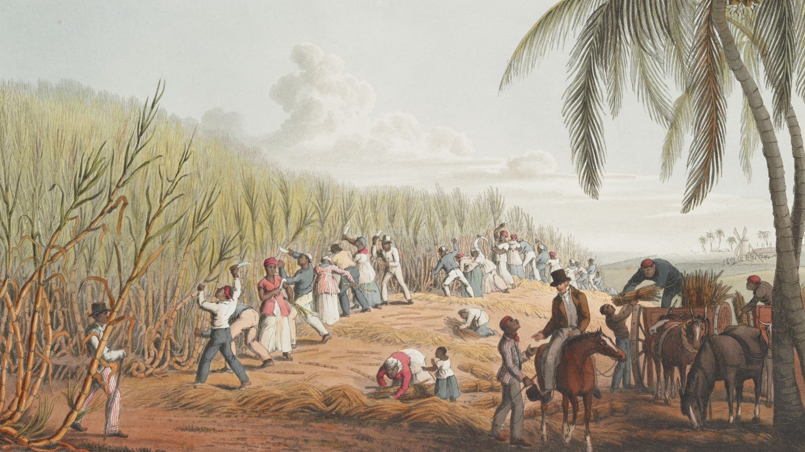
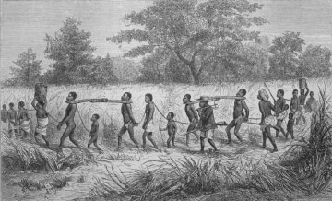
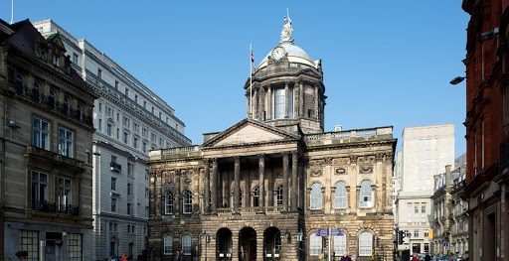
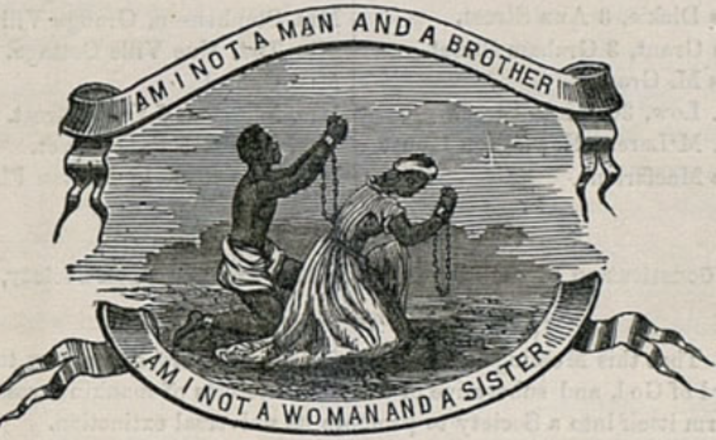
The Trade in Enslaved African People
Finally, in S4 we study our final British topic, the Atlantic Slave Trade. Issues we learn about include:
How the Slave Trade between Britain, Africa and Caribbean was organised and what happened at each stage.
What the positive impact was for Britain, who were the people involved and the cost of how this was achieved.
What life was like for slaves during the journey across the Atlantic Ocean and once they arrived at the plantations on the Caribbean.
What arguments were there against the slave trade and why it eventually stopped.

Slide 5
What Will I Learn in National 4/5 History
There are many fantastic life lessons that History teaches us, other than knowledge of important past events, people and societies.
1. History is VERY RELEVANT today –
Big issues today such as racial equality have roots in what we study.
By learning about this in the past it means we have a better understanding of the present and how to go forward in the future.
2. History ALWAYS CHANGES –
Even though History is about the past, new information is always being discovered.
Also, people can look at a topic in a different way which can change how people view different events.
This makes it an exciting and dynamic subject.
3. History offers up DIFFERENT OPINIONS –
History is full of exciting and controversial debates.
Sometimes very good things can come out of people acting terribly which benefits some people but disadvantages others.
It’s up to you to look at the information and decide what the correct answers are.

Slide 6
What Skills Will You Learn that Will Help You In the Future?
There are many skills that you learn from studying History but here are some of the key ones:
Communicating
There are lots of different opinions and viewpoints when studying History. You will encounter people with different view from you and discuss your differences.
This builds up your ability to communicate and debate respectfully with other people. Communication is something that EVERY job requires!
Analysing
In History you look at lots of Sources of information from the past and have to pick out the important bits.
This is useful as analysing information is common in lots of different jobs.
Evaluating
You will look at different historical arguments and decide which one you think is the most important.
A great answer in History is not about whether you are right or wrong, but how well you can support your decision based on evidence.

Slide 7
What Assessments will I Sit in National 4/5 History?
S3
In S3, all pupils will begin the National 5 course and sit a class knowledge assessment at the end of each booklet. This will culminate with the end of S3 assessment which will consist of National 5 Exam skills.
S4 (Until Christmas)
All pupils will sit regular assessments based upon the exam skills needed for the final exam as well as a Prelim Exam in December. After this each pupils' appropriate qualification level will be decided based on the assessment evidence obtained so far.
Post-Prelim National 4
If it is decided that N4 is the appropriate course level for a pupil, they will continue to finish the course content as well as completing unit assessments in order to complete their qualification.
Post-Prelim National 5
If it is decided that continuing with N5 is the appropriate level for a pupil, they will continue to finish the course content and continue to prepare for the final SQA exam. This exam will be worth 80 marks and the paper will last for 2 hours and 20 mins. There is also had an extra self-led assignment completed in class which accounted for 20% of your grade.

Slide 8

Different Degrees You Can Do With History.
Here are a list of degrees where History is something that colleges and universities look for:
History
Politics
Law
Other Social Sciences (Criminology, Sociology, Psychology etc.)
Teacher Training (Primary and Secondary)
There are other degrees like English where History is not essential, but it does help!

Slide 9




Different Jobs You Can Do With History.
Here are a list of jobs where History is something that employers look for:
Teacher (especially History or Global/Social Studies)
Lawyer (Historians are sought after because they are used to examining evidence and creating arguments)
Politicians (History is the 2nd most common degree amongst MPs)
Specialist History Jobs (Archaeologist, Archivist, Specialist Tour Guide)
There are also hundreds of other jobs where the skills learned in History from the previous slides are very useful.
So, it is a subject that is useful for a large number of jobs!

Slide 10
What Some of Our Previous S4 Pupils Have to Say About National History.
My favourite topic throughout History was Free at Last as it is a very strong topic and I really enjoyed it.
I feel the teachers put so much care, effort and passion into the subject and really enjoy teaching it to their students.
Carla
I picked History in S2 because I'd enjoyed learning about History before that.
I enjoy history because the topics are interesting.
Duncan
I chose History because the topics intrigued me, and I liked learning about Nazi Germany in S2.
My favourite part of the course is the Atlantic Slave Trade which we are currently studying because I find it interesting looking into the injustice that happened way before my time.
All of the History teachers make the work enjoyable and help to explain things in ways that are easy to understand.
Neve
The reason I picked History in S2 is because I found it very engaging, and you got to learn about all the different events that have happened in the past. The teachers have a had big impact on my choice as I really enjoyed being in their class as it is a space to have fun while learning no matter what teacher I have. For example, I loved learning about the Civil rights and the Holocaust in S2.
Jennifer

Slide 11
What Some of Our Previous S4 Pupils Have to Say About National History.
I have found the WW1 topic very interesting because it gives you an insight into how hard it was to live at war and what the conditions for the soldiers were like. Over the last two years I’ve enjoyed having a good time in class. Everyone gets along and there is just seems to be a good feeling in the class when we’re there.
Carson
The reason I picked History in S2 is that I found it interesting and fun. The teachers really try to get you to engage in your learning and have fun with it. One of my favourite topics was Civil Rights in the USA since we always had debates and got to find out other people’s views, as well as the laughs and jokes you’d have in the classroom. If you ever worry about what teacher you get, I wouldn’t since there all really kind and funny and really do care for your learning and will always be there to give you extra help and support!
Robyn
I chose History because I had a great experience in S2 which made me really excited to pick it in S3.
I have had really great teachers who always offered help when it was needed.
I also loved learning about really interesting things like the Civil Rights Movement because it really mattered to me to learn about that.
Teni

Slide 12
Is History the Right Choice for You?
If you are thinking about taking History next year, it is important to think about these key questions when making your choices:
Did you enjoy History in S1 and S2? If you enjoy the subject, then you are more likely to do well!
Is History a subject that will help you get your dream job in the future?
Do the topics mentioned in this presentation sound interesting and things you would like to learn.
Remember, if your timetable allows, you CAN pick more than one Global subject. So, you can choose do Geography or Modern Studies as well as History if you wish!
If you have any further questions about National History, then get in touch with one of the following teachers:
Mr Kelly (gw15kellyross@glow.sch.uk)
Mr Bristow (gw18bristowbobby@glow.sch.uk)
Miss Montgomery (gw22montgomerykirsty@glow.sch.uk)
Mrs Fitzpatrick (gw10fitzpatrickpauli@glow.sch.uk)
Mr Hastings (gw21hastingsbernard@glow.sch.uk)
Or find more information on the SQA Website
https://www.sqa.org.uk/sqa/47447.html

Slide 13
SCQF Progression in Global Studies
S4 | S5/S6 | S6 only
NAT4 History (SCQF level 4) | SFW Scottish Studies (SCQF level 5)
NAT4 Geography (SCQF level 4) | SFW Travel and Tourism (SCQF level 5)
NAT4 Modern Studies(SCQF level 4) | NPA Criminology (SCQF level 5)
NAT5 History (SCQF level 5) | Higher History (SCQF level 6) | Advanced Higher History (SCQF level 7) (available at the HUB)
NAT5 Geography(SCQF level 5) | Higher Geography (SCQF level 6) | Advanced Higher Geography (SCQF level 7)
NAT5 Modern Studies (SCQF level 5) | Higher Modern Studies (SCQF level 6) | Higher Politics (SCQF level 6)
Your S3 Global course choice will lead to one of the qualifications listed in the S4 column.
You can progress from any (SCQF level 4) course in S4, to any SFW (SCQF level 5) course in S5/S6.

Slide 14
