Slide 1

WHY STUDY
Scottish Studies
Senior Option Choices

Slide 2

What will I learn about in Scottish Studies?
What is Scottish Studies?
It’s the study of Scotland —- in terms of its people, languages , society, culture, natural and built environment, and heritage.
Why study it?
The Scottish Studies Award allows learners to develop their knowledge and understanding of Scotland and provides many opportunities for learners to develop their skills, and to make connections across the curriculum.
Purpose and aims of the course
To allow learners to broaden their knowledge of Scotland, to develop an understanding of the contribution that Scotland and it’s people have made and continue to make and reflect on the place of Scotland within the wider context of the UK and the rest of the world. Leaners will also have the chance to explore an aspect of Scottish Studies that is of particular interest to them.
The course
The Scottish Studies course contains elements of 3 different Global Studies subjects namely: History, Modern Studies and Travel and Tourism.
How you will study
There is plenty of room for discussion and extended research, which will help you become an independent thinker and learner..
You will learn in a wide variety of ways, using booklets, videos, group work and research.

Slide 3
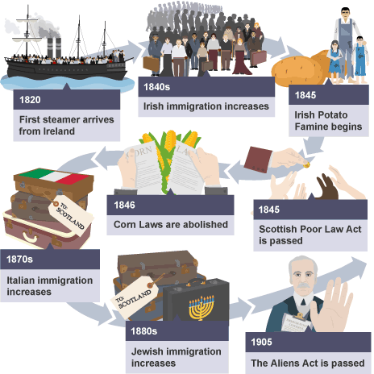
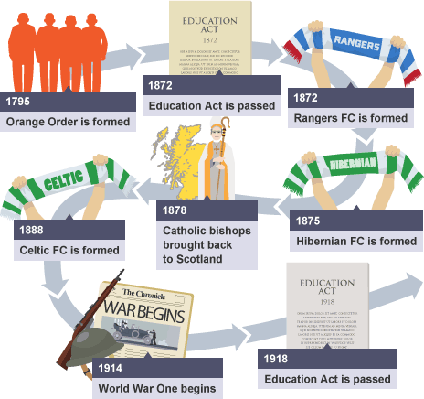
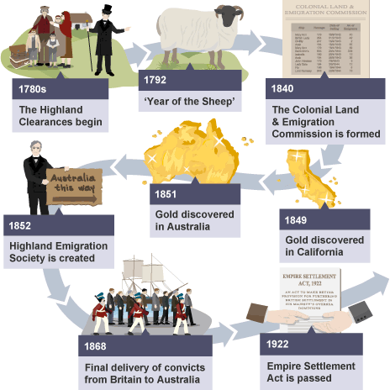
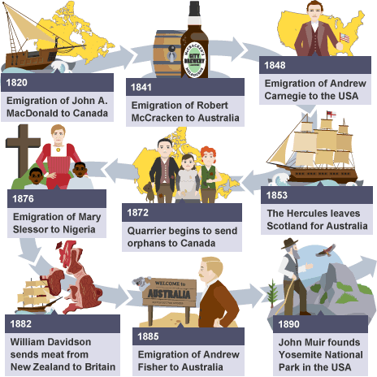
History topic:
Migration and Empire 1830-1939
Immigration to Scotland, 1830s–1939
The experience of immigrants to Scotland, 1830s–1939
Scottish emigration, 1830s–1939
Experience of Scots abroad, 1830s–1939

Slide 4
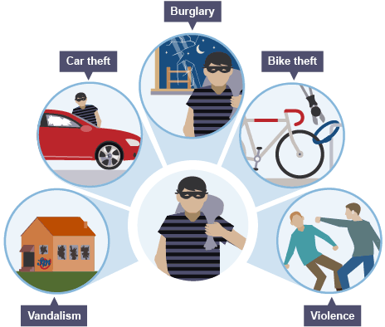
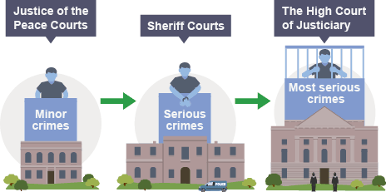
Modern Studies:
Topic: Crime and the Law
Nature of crime
Causes of crime
Consequences of crime
Criminal justice system
Responses to crime
Police
Prisons

Slide 5
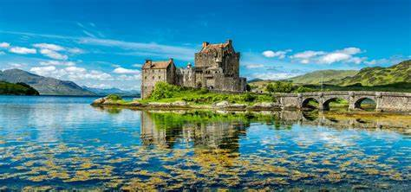

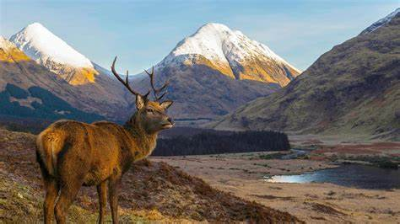
Topic: Travel and Tourism
Travel and Tourism: Employability (National 5)
Travel and Tourism: Customer Service (National 5)
Travel and Tourism: Scotland (National 5)
Travel and Tourism: UK and Worldwide (National 5)

Slide 6
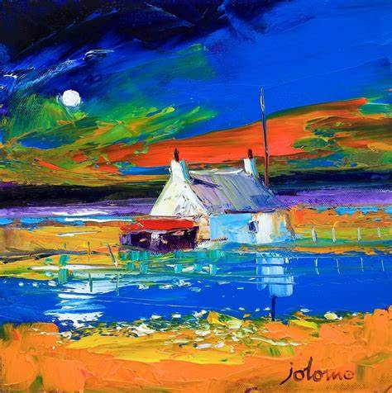
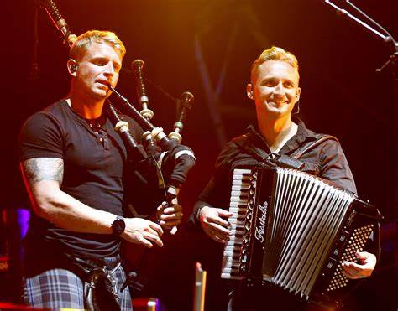
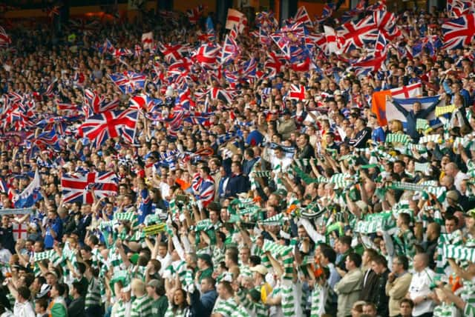
Scotland in Focus:
Mandatory unit
Learners who complete this Unit will be able to:
Plan and complete an activity that has a Scottish focus
Reflect on what they have learned about their Scottish focus during the activity
This could be in the format of a booklet, poster or PowerPoint.

Slide 7

Progression in Scottish Studies
Progression This Award or its Units may provide progression to:
Scottish Studies at SCQF level 6
Developing the skills knowledge and understanding gained during this unit to achieve a national 5 in History/Geography/Modern Studies.
Other Awards, Courses or Units at SCQF level 5 e.g. Criminology
It may also provide a good foundation for progression to training or employment in a variety of sectors including financial services, care, tourism, hospitality and the creative, cultural and heritage industries.

Slide 8
Transferable Skills
Skills for learning, skills for life and skills for work:
It is expected that learners will develop broad, generic skills through this Award. The skills that learners will be expected to enhance and develop through the Award are based on SQA’s Skills Framework: Skills for Learning, Skills for Life and Skills for work:
e.g.
Personal learning
Employability
enterprise and citizenship
Thinking skills
Remembering
Understanding
Applying
Analysing and Evaluating
Creating

Slide 9

Further information can be found at these weblinks or by contacting your teachers
Useful Links
chrome-extension://efaidnbmnnnibpcajpcglclefindmkaj/https://www.sqa.org.uk/sqa/files_ccc/SSAlevel5Specification.pdf
https://www.sqa.org.uk/sqa/64329.html
Mr Kelly
gw15kellyross@glow.sch.uk
Mr Bristow
gw18bristowbobby@glow.sch.uk
Miss Montgomery
gw22montgomerykirsty@glow.ea.glasgow.sch.uk

Slide 10
SCQF Progression in Global Studies
S4 | S5/S6 | S6 only
NAT4 History (SCQF level 4) | SFW Scottish Studies (SCQF level 5)
NAT4 Geography (SCQF level 4) | SFW Travel and Tourism (SCQF level 5)
NAT4 Modern Studies(SCQF level 4) | NPA Criminology (SCQF level 5)
NAT5 History (SCQF level 5) | Higher History (SCQF level 6) | Advanced Higher History (SCQF level 7) (available at the HUB)
NAT5 Geography(SCQF level 5) | Higher Geography (SCQF level 6) | Advanced Higher Geography (SCQF level 7)
NAT5 Modern Studies (SCQF level 5) | Higher Modern Studies (SCQF level 6) | Higher Politics (SCQF level 6)
Your S3 Global course choice will lead to one of the qualifications listed in the S4 column.
You can progress from any (SCQF level 4) course in S4, to any SFW (SCQF level 5) course in S5/S6.

Slide 11
