Slide 1

Travel & Tourism
Skills for Work N4/N5
Senior Option Choices

Slide 2

What will I learn about in Travel & Tourism?
Tourism is a major employer and revenue earner to the economy.
This course allows you to gain knowledge of a variety of tourist destinations, both in Scotland, the UK and the rest of the world.
You will also learn about a range of occupations in travel & tourism which will prepare you for employment in the industry.
You will also learn how to deal with customer enquiries, complaints and gain an understanding of marketing and promotion in Travel and Tourism.

Slide 3



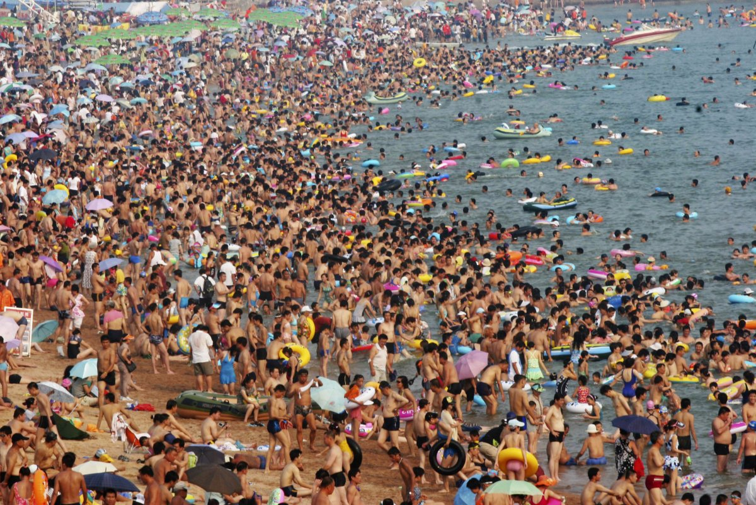
There are 4 Units to study
They are continually assessed.
There is no final exam.
Scotland unit
UK and Worldwide
Customer Service
Employability
This Photo by Unknown Author is licensed under CC BY-NC

Slide 4
What do I learn in each Unit?
Scotland Unit
You will gather information, describe a range of destinations and attractions, identify current trends, and describe the impact of tourism in Scotland.
You will do this for a CITY, a SCENIC AREA and a COASTAL destination.
You should also be able to provide information to potential customers on selected destinations, for example, recommend accommodation, activities, attractions and amenities and produce a travel itinerary on selected areas.

Slide 5
What do I learn in each Unit?
UK/Worldwide Unit
You will gather information, describe a range of destinations and attractions, identify current trends, and describe the impact of tourism in the UK (not Scotland), a short-haul destination and a long haul destination.
You should also be able to provide information to potential customers on selected destinations, for example, recommend accommodation, activities, attractions and amenities and produce a travel itinerary on selected areas.
This Photo by Unknown Author is licensed under CC BY-NC
This Photo by Unknown Author is licensed under CC BY-NC

Slide 6
What do I learn in each Unit?
Customer Service Unit
This unit outlines the benefits of good customer service to the travel & tourism industry. It deals with customer issues and actions required to respond to customer’s needs and wants.
You will learn how to reply to customers when they have questions and how to resolve situations where there are complaints.
This Photo by Unknown Author is licensed under CC BY-NC
This Photo by Unknown Author is licensed under CC BY-NC

Slide 7
What do I learn in each Unit?
Employability Unit
This unit investigates job roles and careers across the travel & tourism industry.
You will demonstrate your employability skills and attitudes in a work-related practical activity. You will also have an opportunity to update your CV and print copies off for any jobs you might wish to apply for!
You will evaluate your own potential for a chosen job in the travel & tourism industry.
This Photo by Unknown Author is licensed under CC BY-NC
This Photo by Unknown Author is licensed under CC BY-NC

Slide 8

Careers in Travel & Tourism
This award is an obvious choice for careers in travel, such as in the aviation industry such as cabin crew, ground staff at a airport or in travel agents such as Tui or Barrhead Travel.
For careers in the world of business, you will have undertaken study and practical experience in dealing with customer enquiries, ensuring customers feel listened to and helped to purchase a holiday that they will love and to sort things out if there is a problem.
If you are trying to get a part time job of any sort, this qualification shows that you have been prepared for the world of work, and the two N4/N5 units in Employability and Customer Service help you stand out from every other candidate seeking that job alongside you.

Slide 9

Further information can be found at these weblinks or by contacting your teachers
https://www.sqa.org.uk/sqa/65337
https://www.myworldofwork.co.uk/my-career-options/job-categories#job-category-hospitality-catering-and-tourism
https://nationalcareers.service.gov.uk/job-categories/travel-and-tourism
Mr Donnelly
gw20donnellychristop@glow.ea.glasgow.sch.uk
Mrs Alexander
gw14alexanderlynn@glow.ea.glasgow.sch.uk
Mrs Mitchell
gw21mitchelldonna1@glow.ea.glasgow.sch.uk
Miss Reid
gw10reidgillian2@glow.ea.glasgow.sch.uk

Slide 10
SCQF Progression in Global Studies
S4 | S5/S6 | S6 only
NAT4 History (SCQF level 4) | SFW Scottish Studies (SCQF level 5)
NAT4 Geography (SCQF level 4) | SFW Travel and Tourism (SCQF level 5)
NAT4 Modern Studies(SCQF level 4) | NPA Criminology (SCQF level 5)
NAT5 History (SCQF level 5) | Higher History (SCQF level 6) | Advanced Higher History (SCQF level 7) (available at the HUB)
NAT5 Geography(SCQF level 5) | Higher Geography (SCQF level 6) | Advanced Higher Geography (SCQF level 7)
NAT5 Modern Studies (SCQF level 5) | Higher Modern Studies (SCQF level 6) | Higher Politics (SCQF level 6)
Your S3 Global course choice will lead to one of the qualifications listed in the S4 column.
You can progress from any (SCQF level 4) course in S4, to any SFW (SCQF level 5) course in S5/S6.

Slide 11
